Slide 1
Thesis: Due to the evolution of different political systems and values in England; France; and The Holy Roman Empire (Germany), coupled with the growing greed and disparity found within a rigid hierarchical system, a series of long catastrophic events helped accelerate and eventually brought down the political, cultural, and religious systems of Medieval Europe.

Slide 3
Hundred years war background
Like many medieval problems it begins with Henry II and Eleanor of Aquitaine…
Normans and Anjous (devil spawn) marry, creating Plantagenets and a whole lot of inbreeding
By the end, Philip IV (France) was actually the grandfather of Edward III (England)
Philip dies, no heir
Edward claims French throne, launches war to get it in 1337
War lasted over 100 years – 1337 until 1453 (Ed III and several other English and French kings were dead by then)

Slide 5
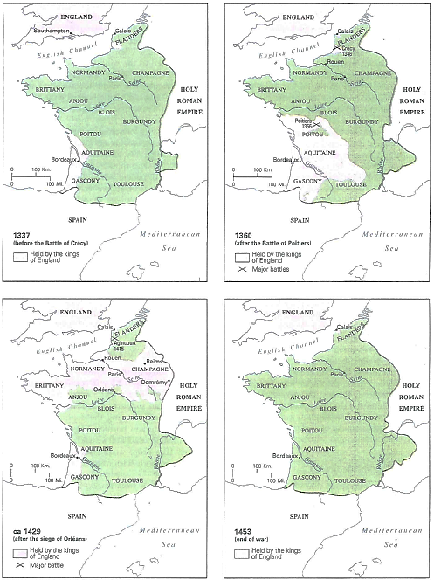
Green shows land held by French in each phase
Years shown:
TL: 1337
TR: 1360
BL: 1429
BR: 1453

Slide 6
Hundred Years War
Key changes in warfare
Chivalry practiced, supposedly
Crossbow and Longbow introduced by English
Arrows from longbows were strong enough to pierce armor
Led to serious beat downs by the English

Slide 7
Hundred Years War
Most of English side of war fought and won under Henry V (1386-1422)
Usually considered model late middle ages king—got on with nobles, church also chivalrous and educated
Reckless youth then came of age, cleaned up England made it powerful
Amazing general
Died early (infection from battle)
English slaughtered the French at Crecy, Poitiers, and Agincourt…

Slide 9
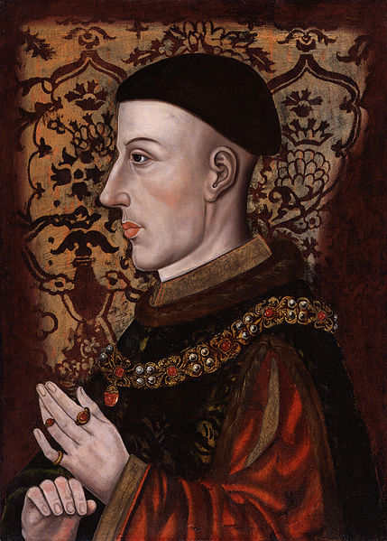
Battle of Agincourt - 1415
Outnumbered English (6,000) army led by Henry V crushes French (25,000) because of better technology – mainly archers
Victory so inevitable (to the French) they were throwing dice for the spoils the night before
Henry motivates men to victory, and French choose a very crummy spot to fight
200 English die; 7,000 French die
Henry executes French nobles who surrender (not very chivalrous)
One of the most famous battles in English history
Begins Anglo-American “underdog mentality”

Slide 10
Green shows land held by French in each phase
Years shown:
TL: 1337
TR: 1360
BL: 1429
BR: 1453

Slide 11
Joan of Arc

Slide 12
Joan of Arc
Agincourt continues series of French losses, and at first the war starts to end w/a truce saying Henry V is King of France when the French King dies
But Henry dies first and French renege. This goes badly until…
Peasant girl named Jeanne D’Arc claims to have had visions from God telling her to save France from the English
She becomes their military leader!
Leads the French army at Orleans – age 19
Almost loses, but at the last minute she leads a charge and defeats the English
Charles VII, the true heir to the French throne, goes with her to Reims (Cathedral) and is crowned King of France
BUT….

Slide 13
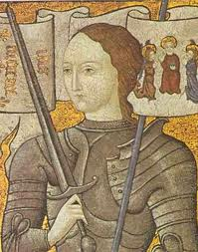
Joan of Arc
She gets captured and turned over to the English in 1430
English give her to “church authorities” to stand trial
They condemn her as a witch
Burned at the stake in 1431…
… & French do nothing to stop it

Slide 14
Impact of Hundred Years War
Nationalism in England and France
French monarchy becomes stronger and stronger
No longer a feudal lord, but a national leader
Plunges England into civil war: War of the Roses over which royal family would rule
End of the middle ages

Slide 15
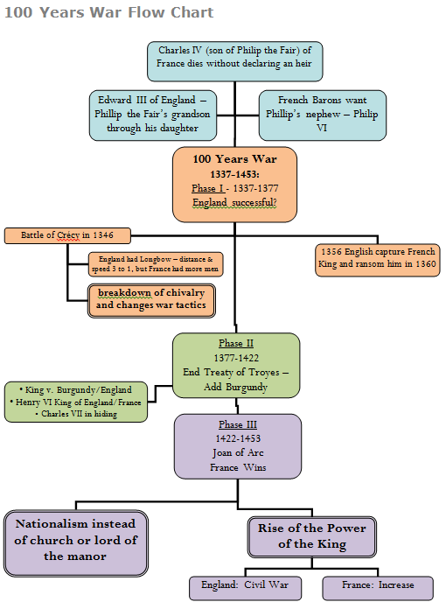

Slide 16
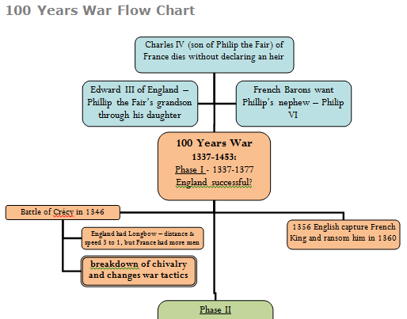

Slide 17
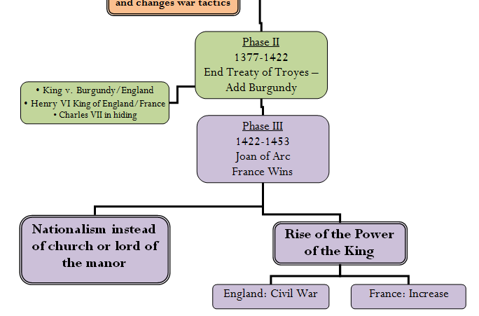

Slide 18
Middle Ages Renaissance
Discuss (& take notes on your discussion) in your table groups how/why you think the Middle Ages end & the Renaissance begins, consider the following things…
100 Years War
Role of the church-power, fighting with kings (including Avignon–“Great” Schism eventually, but will get to that part next week)
The Black Death
Write an INDIVIDUAL thesis’ish statement based on your table discussion in your notes
Notes:
-Vikings raid Europe, which eventually leads to Feudalism because the Vikings are paid off and given land for their support (military) and conversion to Christianity
-William of Normandy (William the conqueror) leads to King Henry II and common law which in turn leads to King John (the lame) losing the Duchy of Normandy and is forced to sign the Magna Carta to appease his lords and Vassals creating strength in fiefs
-Parliament is then instilled because King Edward (Longshanks, Brave Heart) needs taxes to continue to fight wars and in the spirit of the Magna Carta looks to a body of people to pass laws requiring more taxes solidifying the connection between the Kings and his lords
-The strength of the government and the ability to grow more food leads to a population increase, but does eventually does not have enough food to support the influx in people leading to a famine weakening the overall health of the population making people susceptible to diseases brought back from trading in the East killing massive amount of the population, forcing people to develop technology inspiring new growth and thoughts in science, and the arts

