Slide 1
1066: Norman Invasion of Britain
Some helpful things to know before we watch the movie!

Slide 2
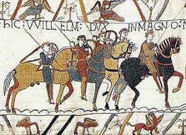
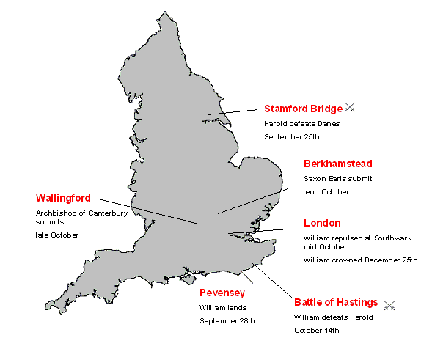
Norman Conquest of 1066

Slide 3
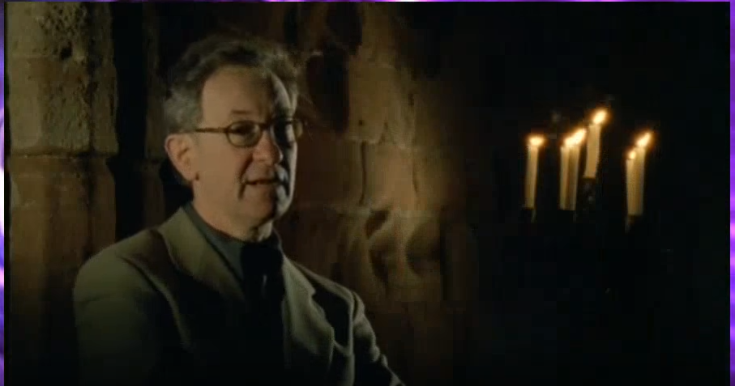
Simon Schama – Conquest!

Slide 4
Impact of 1066
Questions from Viewing Guide?
Doomsday Book
William in Normandy – how control England when not there?
Gives out lands only in fiefs, not outright control to supporters
Most extensive book of economics of the land since… Roman times…?
Other impacts of the Norman conquest on Britain?
Reading(s) addressed more – including long term impact, what are they?

Slide 5
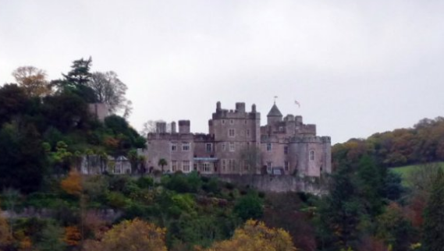
Dunster Castle

Slide 6
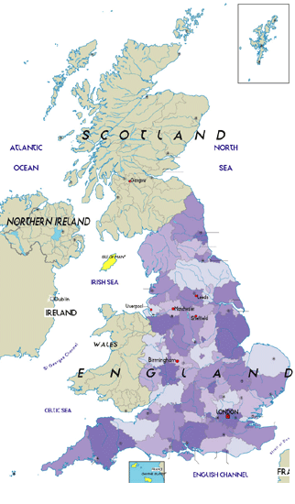
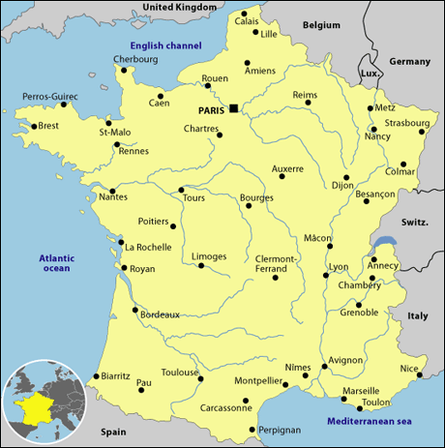
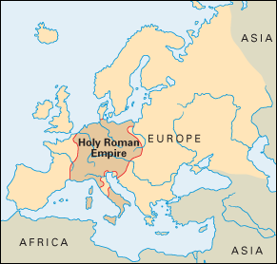
Big Three Politics: England, France, and The HRE

Slide 7
Thesis: Due to the evolution of different political systems and values in England; France; and The Holy Roman Empire (Germany), coupled with the growing greed and disparity found within a rigid hierarchical system, a series of long catastrophic events helped accelerate and eventually brought down the political, cultural, and religious systems of Medieval Europe.

Slide 9
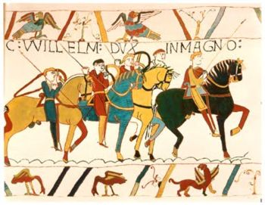

Slide 10
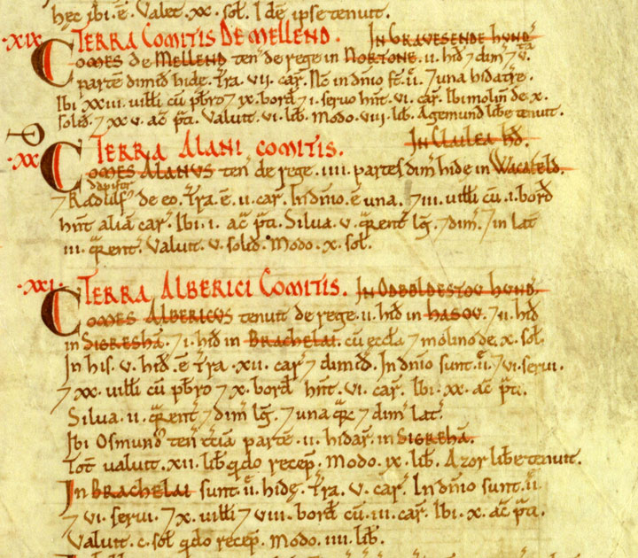
England after William
Brought French customs and feudal system w/him
Language: English is out, French is in
Establishes dynasty (Norman)
Domesday Book – systematic organization; supposed to last until the end of the world
Gives Normandy to oldest son, England to middle son, and $$ to youngest son, Henry
Henry I beats both of them—Robert at the Battle of Tinchebrai; William is assassinated – H I unites England & France
Starts to establish central and judicial power used today

Slide 11
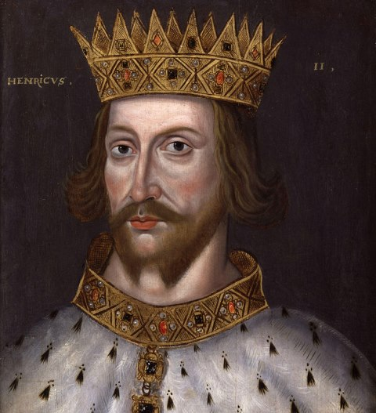
Henry II (1154-1189)
After The Anarchy, Henry II, great-grandson of William the Conqueror, takes the throne
Quintessential high medieval king, marries quintessential high medieval queen, Eleanor of Aquitaine (France)
Begins Plantagenet dynasty

Slide 12
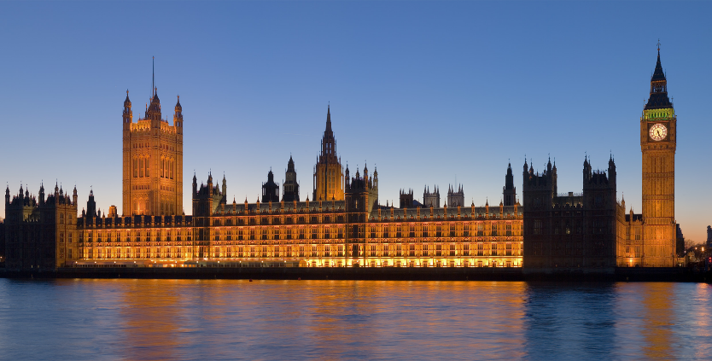
Visual #5

Slide 13
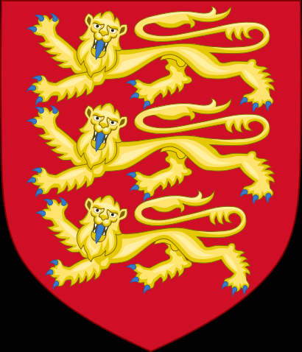
Henry II (1154-1189)
Started juries, common law, & seeds of what would become Parliament
Strengthened courts by sending royal judges out to collect taxes, punish crimes
Got rid of personal, manorial courts & papal courts so that only royal courts could have trials→ standardizes justice & separates church and state
Most remembered for fight with Archbishop Thomas Beckett

Slide 15
Common Law
THIS IS NOT THE IDEA THAT THERE ARE THE SAME LAWS THROUGHOUT THE LAND!
Rather a version of who makes the laws:
Centuries of court decisions in England
When added up, this becomes a body of laws known as common law
Basis of law in United States, Canada, Zimbabwe, India, Australia, etc. other former English colonies (about ¼ of the world)

Slide 16
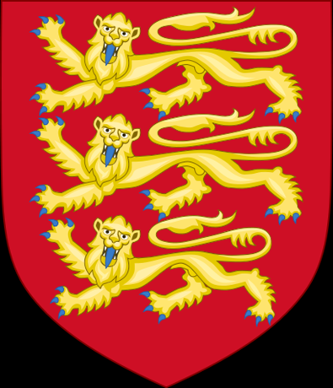
Early Plantagenets – Richard I & John
Plantagenets (begun by Henry II) lasts to 1453
longest English dynasty
Henry II succeeded by Richard the Lionhearted who goes on crusade, a lot
He dies heirless, his brother John becomes King:
Starts war with France for no real reason—annoys nobles
Loses most of it by the end—annoys nobles

Slide 17
Early Plantagenets – Richard I & John
Tries to oppose a papal appointment
Pope places Interdict on England—annoys nobles
Eventually becomes a vassal of the Pope—annoys nobles
Taxed nobles without their consent—annoys nobles
Tries to conscript and control peasants and serfs—annoys nobles (and peasants)

Slide 18
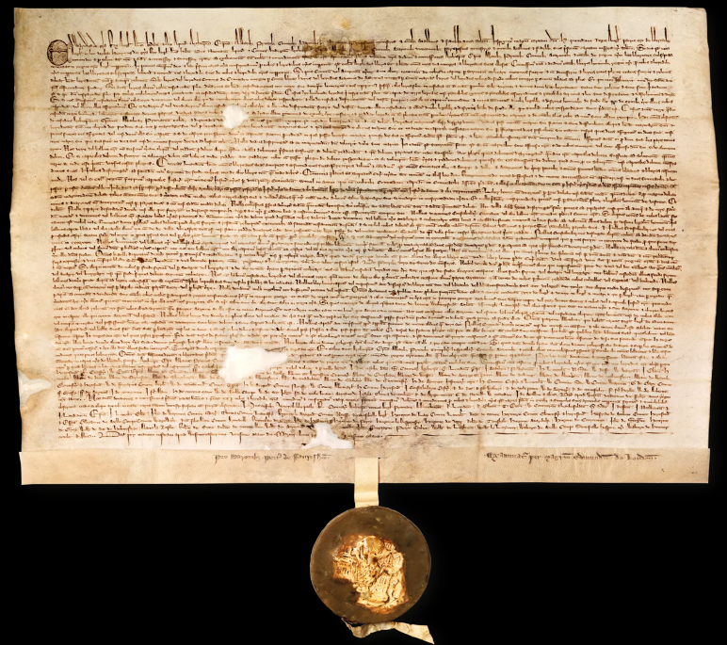
Visual #3

Slide 19
Magna Carta
England was (& still is) most free country Europe-first to curtail King’s power in Magna Carta
Nobles force John to sign a document (Great Charter) – Runnymede 1215
Limited power of the king
Guaranteed many rights—for nobles
No taxation without representation
Right to a jury trial
Protection under the law for all citizens
Four left today: Lincoln, Salisbury, British Library, US National Archives
First basis civil rights in Britain and then US
Start idea of Bill of Rights
Same rights that US founding fathers fought for

Slide 20
Edward I (1239-1307) & Parliament
Edward I (Longshanks) conquers Wales, most of Scotland (for a bit), Ireland, & wins back the majority of Western France
To fight these wars he needs money; trying to follow the Magna Carta he calls a group of people asking them to make a law of taxation:
Two knights & two wealthy citizens from every county in England, as well as nobles & bishops → House of Commons and House of Lords
Met at Westminster in London, 1295
Functions very well—shares power
Only to have his incompetent son and grandson blow it all…

