Slide 1
The Thirty Years’ War
1618 – 1648
This will be quick!

Slide 2
Thirty Years’ War
Let me tell you about the war
Let’s make a t-chart of the major players on each side of the war
How is this war similar to the French Wars of Religion?
Different – beyond the obvious (people, location)?
Consequences of the Thirty Years’ War – this is what is most important… hint, hint, wink, wink, nudge, nudge…

Slide 3
Tension - Catholics & Lutherans
Peace of Augsburg – 1555
Left Protestant and Catholic princes very suspicious of each other
Both groups start to organize formally to try and spread their own influence
Ferdinand is the spark that ignites the flame of war

Slide 4
Ferdinand
Son of Charles V, the HRE who quit and joined a monastery
Ferdinand II becomes king of the Austrian part of Charles’ empire (Philip was King of Spain)
Austria mainly Catholic, but parts were Protestant (Bohemia)
Protestants in Prague revolt, Ferdinand’s army crushes them

Slide 6
War breaks out
War breaks out
DEFENSTRATION OF PRAGUE (2ND ACTUALLY)
German Protestant princes join rebellion
This starts the Thirty Years’ War
War over religion and territory and power among European royal families
Two phases
Hapsburg victories
Hapsburg defeats
(Hapsburg = name of Spain and Austria’s royal families in Holy Roman Empire)

Slide 7
Hapsburg victories
Spanish and Austrian armies crush Protestant armies
Ferdinand II paid his army by letting them plunder and destroy villages thousands of German villages
Most of central Europe largely destroyed in fighting

Slide 8
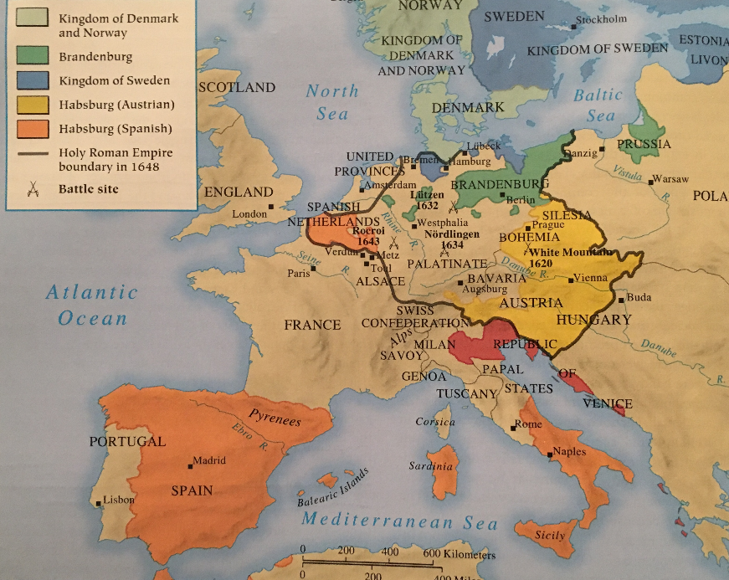

Slide 9
Sweden to the rescue
Gustavus Adolphus, king of Sweden (a Lutheran) helps Protestants
Sweden at this point is a huge power in Scandinavia
Controlled Finland, parts of Russia, Poland, German lands
Swedes drive Hapsburg armies out of northern Germany
Gustavus Adolphus killed in battle in 1632

Slide 10
France gets involved
Louis XIII and Richelieu (and three musketeers)
Although Catholic, they detest the Hapsburg family (competitors)
Decide to support the Swedes and the German Protestants
Defeated the Hapsburgs in 1648

Slide 11
Critical Reading
So how does your critical reading fit in to all of this?
Think: Why would Ms. Maners have us read this article?
What conclusions can you draw from the reading?

Slide 12
Peace of Westphalia (1648)
Weakened Spain
Strengthened France
Gave independence to German princes (from Holy Roman Empire)
Swiss Confederation recognized
Dutch gain independence, Catholic part stays with Spain, later becomes Belgium
Introduced idea of having all participants of a war meet to negotiate peace treaties

Slide 13
Results of the war
German lands destroyed
Lost 25% of their population
Economy ruined
War main reason Germany not unified until 1870
Biggest result: Europe was a group of independent, equal states – no religious empires
HRE still exists but has no importance in Germany, becomes a Hapsburg—Austrian— rubber stamp

Slide 14
Results of war
Military Revolution
Rebellions
Some empires in eastern Europe were very weak
Poland’s system requiring 100% agreement on all decisions
Ottoman Empire (Turks) was too big and not able to control land it ruled over (Hungary, Romania, Bulgaria)
Holy Roman Empire loses its authority after Thirty Years’ War

