Slide 1
Unit 1, Part 5– Absolutism
Think about what you have learned thus far about the political systems in European countries:
If you were to take over a European country, which one would you take over? Why?
How would you go about doing this?
Once you took over what would you do to keep & strengthen your power?

Slide 2
Causes of Absolutism
Feudalism out, unified church out
Religious/territorial conflict = uncertainty & fear, start a cycle
Church was weaker at the same time (Reformation)
Big armies required higher taxes to support them
Peasants revolted against taxes
Kings rule even more harshly

Slide 3
Characteristics of abs rulers
Based on what you know so far, brainstorm some possible characteristics of absolutist rulers with your table group!

Slide 4
Characteristics of abs rulers
Run by one, singular person
    Divine right and without consent
Glorification of the State (Ruler) rather than local culture
Controls/limits power of the nobility
Economy is for the RULER not the citizens of the state
    No one is exempt from paying taxes
War-Expansion is normal – discourage/distract domestic unrest
Standing army
Bureaucracies
Secret police – controlled social gatherings, religious gatherings
Control over all aspects of justice

Slide 5
Absolutism
…in France

Slide 6
Huguenots
Catherine de Medici
  Mother of King Charles IX – too young to rule
  Arranges a wedding for her daughter to a Protestant Prince (Henry, a Huguenot) in hopes of peace
  Has Protestants in Paris murdered instead
    St. Bartholomew’s Day 1572
Charles IX dies as does his mother
  Protestant Prince Henry “converts” to Catholicism
Henry becomes King Henry IV

Slide 7
Henry IV heals France
1598 – Henry signs the Edict of Nantes
  Allows Protestantism, lets them live in peace
Henry worked hard to rebuild France
  Assassinated in 1610
His son Louis XIII becomes King
  Weak king, but had a smart man advising him
  Cardinal Richelieu

Slide 8
Cardinal Richelieu
Extremely ambitious man, despite his church position
Two steps he took as Louis XIII’s advisor
Limited Protestant rights
  Forbade Protestant cities to have walls around them
  Believed they were conspiracies against the Catholic King
Limited power of nobility
  Forced them to tear down their castles

Slide 9
Louis XIV
Most powerful ruler in French history
“L’etat, c’est moi” – I am the state
At first, the real power was Richelieu’s successor Cardinal Mazarin
  Louis XIV was four years old when he became king
Ends 30 Years War
But becomes very unpopular with the French due to high taxes

Slide 10
Louis XIV
Violent riots (mostly nobility) against Mazarin – the Fronde
Louis bitter about the nobles who rebelled and swore he would weaken them
Nobles rebellion fails for three reasons
  Nobles distrusted each other
  Government was violent in its response
  Peasants and townspeople tired, were willing to live under an absolute monarch

Slide 11
Louis XIV
M dies, Louis XIV takes over completely (age 22-23)
Expelled nobles from all royal government posts
Replaced them with intendants, or government agents
  Collected taxes, administered justice
Louis had tight control over the nobility

Slide 12
The Sun King
Louis XIV was also known as the Sun King, reigns for 72 years
Nobles wait on him in elaborate rituals
  100 nobles awaited him when he awoke every morning – to wait on him
Having his nobles at court had advantages
  Made them dependent on Louis
  Kept them away from their homes, making the intendants more powerful
His court - Versailles
  Visible manifestation of France’s superiority and wealth
  One of the most magnificent royal palaces in the world

Slide 13
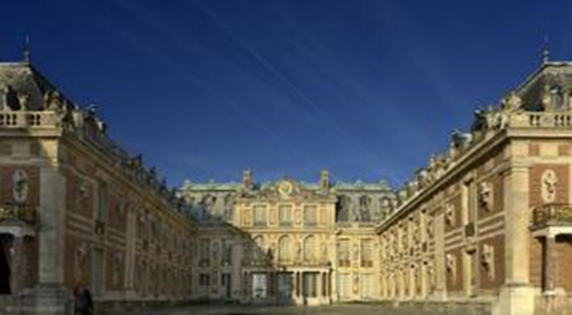
Versailles

Slide 14
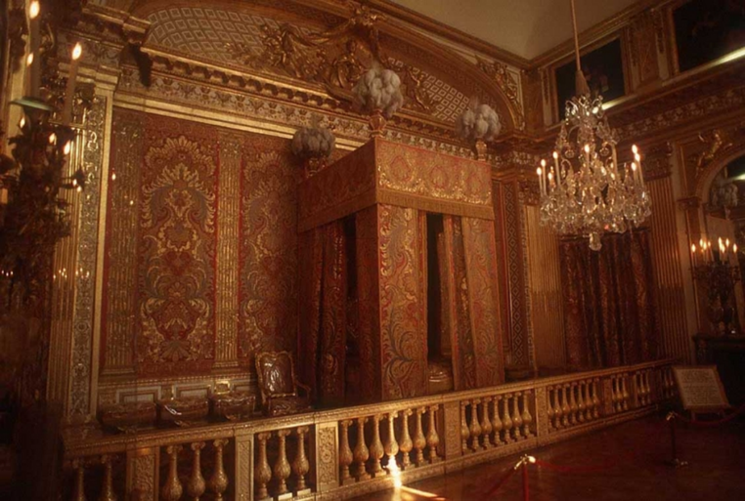
Versailles – King’s Bedchamber

Slide 15
Economic growth
Colbert – becomes Louis’ finance minister
Goal: make France super-rich and self-sufficient
  Q: What does self-sufficient mean?
Gave government money & tax benefits to French companies
BUT Colbert dies…
Big mistake – cancels the Edict of Nantes in 1685
  Q: What did the Edict of Nantes do?
1000s of Huguenot craftspeople & merchants left France
  Huge negative impact on French economy

Slide 16
Louis Disastrous Wars
Under Louis, France becomes the most powerful nation in Europe
  20 million residents (4 X as many as England, 10X as many as Holland)
France invades countries to expand territory
Invades the independent Netherlands
  Dutch break open their dams, flood the land to prevent France from taking over
  France gained very little

Slide 17
France has Enemies
European countries start to ally against France
  England, Austria, Sweden, Spain form alliance
Spain ends up having a new king who is related to Louis XIV – Spain and France now allied
Other European countries alarmed

Slide 18
War of Spanish Succession
Allied countries attack France to prevent a merger with Spain
  14 year long war
England is the big winner – they get Gibraltar at the tip of Spain which controls access to Mediterranean
War was expensive for France – about $21 billion in debt by end of the war (1715)

Slide 19
Free-write at end of notes
Was Louis XIV a successful ruler?
  Why or why not?

