Slide 1
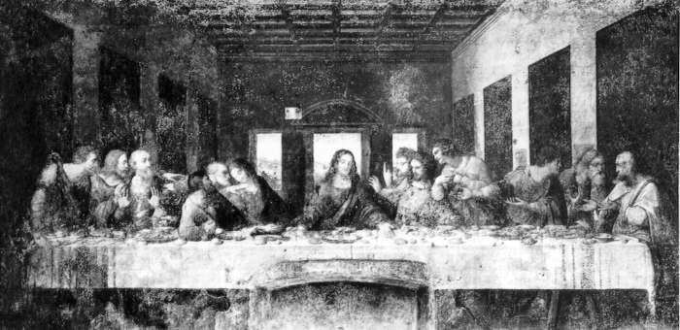
Renaissance Art
European History
Mrs. Maners

Slide 2
Renaissance Thought
During the rise of the Renaissance changes occurred in economics and politics. It also saw changes in intellectual thought.
There were three new intellectual trends - individualism, humanism, and secularism.
Individualism placed importance on the individual. It stressed personality, uniqueness, and genius.
It was the idea that human talent & abilities should be stretched and fully realized.

Slide 3
Renaissance Thought
Humanism was the “new learning” that developed, and like individualism it place emphasis on human beings…
More on this on FRIDAY with your readings – do you remember which number you should read?
NOTE if you are doing document NUMBER 1 –
You do NOT need to answer all the questions at the end.
Your reading is longer, so take fewer notes and just do a couple of the questions as an after reading strategy!

Slide 4
Renaissance Thought
Secularism was a concern with the material world. Renaissance people were concerned with money and pleasure.
This was a separation from the Middle Ages which placed concern in the eternal “other world.”
Renaissance thought was still deeply religious and they incorporated these new ideas into their already existing religious ideals.

Slide 5
Renaissance Art
These great changes in intellectual thought could be seen in Renaissance literature and art.
The art of the time enveloped all of these changes - individualism, humanism, and secularism.
Renaissance art strove for naturalism - art based on observing, faithfully reproducing, and celebrating the world of man and nature.
It brought back the classical nudes, the realistic shape and form of the body.

Slide 6
Medieval Painting
Medieval Art was always based on a religious theme.
Paintings were meant to tell religious stories to an illiterate public.
Paintings were two-dimensional, and unrealistic.
There was little to no emphasis on man or nature.

Slide 7
Renaissance Painting
Painting in the Renaissance stressed the individual, the feeling of humans.
The figures no longer looked flat and cartoon-like. They were three- dimensional and very real.
Artists found beauty in the ordinary, like this scene between an old man and a child.

Slide 8
Renaissance Painting
Painters still used religious themes as well, such as the martyrdom of St. Sebastian in this painting.
However, your focus in this picture is not on St. Sebastian, but on the archers.
The artist shows off his anatomical expertise in the archers, demonstrating the beauty and movement of the human body.

Slide 9
Major Works of the Renaissance
David c. 1425-1430 by Donatello
First life size nude statue since antiquity that was free standing
Roughly my size
Dukes of Milan helmet
Florence – Milan at war
Body more detailed than the face

Slide 10
Major Works of the Renaissance
The Birth of Venus c. 1480 by Sandro Botticelli
Botticelli was a famous painter, a favorite of the Medici Family
Well developed bodies, reflection of genuine nudes of antiquity
Graceful movements, everything seems to flow and float

Slide 11
Major Works of the Renaissance
Mona Lisa c.1503 by Leonardo da Vinci
da Vinci was the embodiment of the term “Renaissance man.”
Portrait of a unknown woman - many believed da Vinci to be in love with
da Vinci used new painting techniques to make the portrait appears if it glows from within.
Mysterious smile on her lips

Slide 12
Major Works of the Renaissance
The Creation of Adam, Sistine Chapel Ceiling c. 1508-12
During Michelangelo Buonarroti’s life time he was called a genius, one who had a divine gift. He acknowledged his genius and drove himself to perfection.
He stressed organic qualities of the human body - round muscular, strong. He also loved to use bright, vivid colors.

Slide 13
Major Works of the Renaissance
This is a section of the Sistine Chapel, his largest and most difficult work.
It shows God passing the divine spark - the soul- to Adam.
Michelangelo foreshadows the coming of Eve, he places her cradled under Gods left arm.

Slide 14
Major Works of the Renaissance
School of Athens c. 1510 by Raphael
Famous painter, equal to da Vinci & Michelangelo
Interested in exploring people of the world
People engaged in various actions-showing energy & power
Groups of famous Greek philosophers gathered around Plato and Aristotle
Plato - da Vinci & the man alone in front - Michelangelo

Slide 15
Humanism
Get in to your groups (will show in a minute) & share what your readings said about humanism – take notes on others?
Come up with one working definition of humanism BASED on information from ALL the documents
Have one person write the definition on the strip of paper provided & turn it in to the A in-box (with all names on it)
However, everyone should have their own copy of the definition in their lecture notes
Be able to explain it to the class on Monday
Why did you include what you did?
What did you not include and why?

Slide 16
The Italian Renaissance
Firenze and Venezia 14th and 15th centuries
(Florence and Venice, 1300-1500)

Slide 17
Thesis
Florence used its advantageous socioeconomic, historical, and cultural position to launch a Renaissance of scholasticism and the arts. Given its wealthy banking status throughout Europe, Florence was able to spread its new found ideas and taking a leading position on the European stage. This, combined with the numerous wealthy citizens of Florence who used their riches to patronize the leading artist and thinkers of the day, created an atmosphere brimming with creativity which subsequently compounded upon itself and led to a barrage of new, unparalleled, masterpiece works.

Slide 18
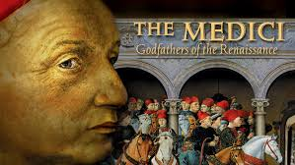
Medici: Godfathers of the Renaissance

Slide 19
Renaissance 1304-1588
Word literally means “rebirth”
What was reborn was a Classical (Greek & Roman) ideas—art, architecture, philosophy, literature, finance, views of the world, etc.
Began in Italy—mainly Florence—in 14th century, and moved to the rest of Italy—like Venice—in 15th century, as it spread through Southern Europe
Then spread to Northern Europe, through Holland and Flanders and onto England and Denmark and Sweden
Never hit certain countries like Holy Roman Empire, Baltics, Poland, Russia. Because of this, these countries will have messed up histories down the road

Slide 20
Classic crash course
Classics = Greek and Roman (more Greek based to us now, more Roman based to Petrarch when the idea started)
Both based around and split from one of the all-time great stories: The Trojan War. Greeks = Greeks in the story; Trojans = Romans. Romans lose the battle but win out in the end → pinnacle of society to Renaissance men
Greeks famous for democracy, city-states, philosophy, mathematics, literature (epics and plays), mythology
Romans famous for republic, weaponry, power, Latin, birthplace of Christianity, architecture, aqueducts, baths, gladiators, Caesar, empire, “world” dominance, togas, copying the Greeks

Slide 21
Renaissance Thought
Share class working definitions of Humanism
Humanism was the “new learning” that developed, and like individualism it place emphasis on human beings. It was the revival of antiquity, interest in Latin & Greek classics.
Humanism came from the Latin word humanitas meaning anyone considered educated and civilized.
Humanists sought to understand human nature through the study of pagan and classical texts, and Christian thought.

Slide 22
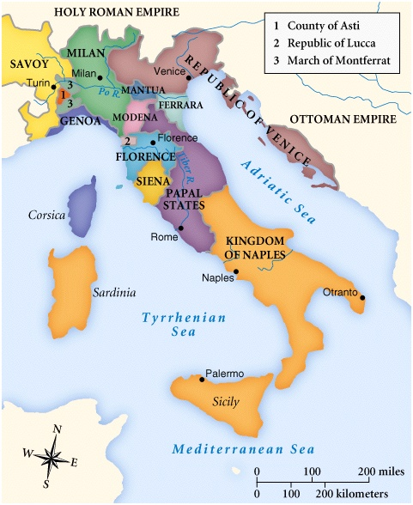
Renaissance 1304-1588
Marked by study of classics, move from god-centric to people-centric view.
New focus on scholasticism & the individual

Slide 23
Venice (Venezia)
City built completely on water
Influential in trade with East, exploration, & banking
Ruled by Doge, known as a Republic
Famous Venetians: Marco Polo & Titian

Slide 24
Florence (Firenze)
Renaissance began with birth of Francesco Petrarch in 1304 in Florence
Florence controlled by large families, ruled kind of like early mafia
Also somewhat resembles democracy—citizens vote on certain things (but are bribed)
Rash of famous Florentines: Dante, Petrarch, Boccaccio, the Medici family, Brunelleschi, Michelangelo, Leonardo, Donatello, Machiavelli

Slide 25
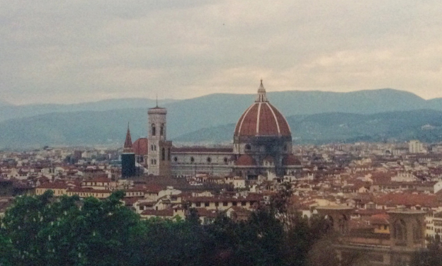
Duomo F. Brunelleschi

Slide 26
Why Italy?
One of the first effected by the plague = first country to return to health and city life
Church weakened by plague and closest to Italy = more secular approach, more concern for the arts
Plague ➔ more focus on life & enjoying it = more liberalism➔ more demand for arts & literature
Commercial Revolution = more exchange of people and ideas + more money = more liberal approach to life and more patronage

Slide 27
Why Italy?
Loose confederation of states = much easier to change one or two parts, like Venice or Florence than a whole country
Had most of the classics buried in their land = easier to find through excavation and searching in the depths of churches
Unique systems of governments = allowed just enough freedom for arts to flourish
Warm = more food, more people, more specialization
Something in the water = rash of important Italians, kind of like our founding fathers

Slide 28
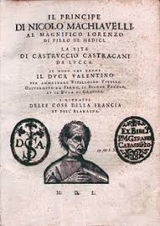
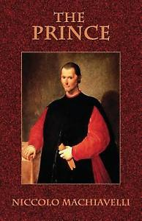
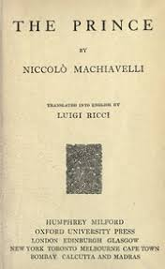
The Prince

Slide 29
The Prince
Talk in your table groups… be prepared to answer in class discussion (will use cards)
Who was Machiavelli?
Why did Machiavelli write The Prince?
What is Machiavelli's view of Human Nature?
What were the main components of a good leader according to Machiavelli?
Machiavelli writes, “…where there is no court of appeal, the end is all the counts.” What does this statement mean? Provide an example of the meaning from the reading.
What is Machiavelli saying about POWER?
Examine one current leader who you believe follows Machiavelli’s advice. Who are they-justify your answer?

Slide 30
The Prince
Take notes on classmates answers & Maners’ commentary
Who was Machiavelli?
Why did Machiavelli write The Prince?
What is Machiavelli's view of Human Nature?
What were the main components of a good leader according to Machiavelli?
Machiavelli writes, “…where there is no court of appeal, the end is all the counts.” What does this statement mean? Provide an example of the meaning from the reading.
What is Machiavelli saying about POWER?
Examine one current leader who you believe follows Machiavelli’s advice. Who are they-justify your answer?

Slide 31
344-350
Talk in your table groups… be prepared to answer in class discussion
Why so much on humanism in this class?
How did the textbook change, adjust, enhance your thinking on humanism that was not in the documents?
What is Neoplatonism? Why does it matter?
How did education change in the Renaissance Era?
Did women have a renaissance?
Printing press-schminting press… why do we care?

