Slide 1
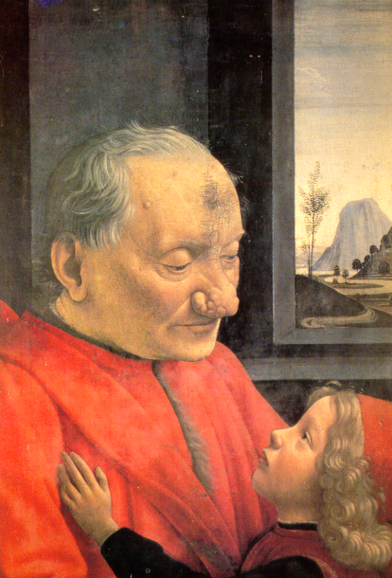
Renaissance Painting

Slide 2
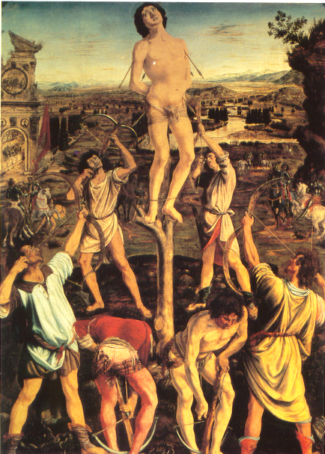
Renaissance Painting

Slide 3
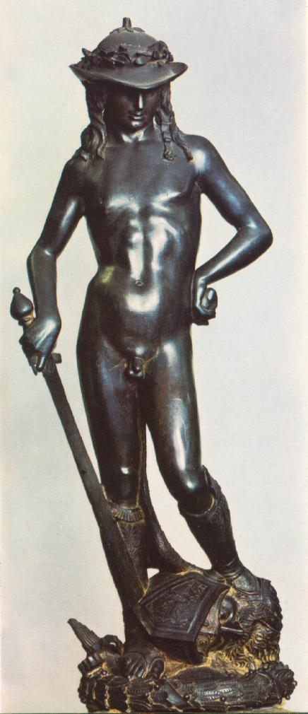
Major Works of the Renaissance

Slide 4
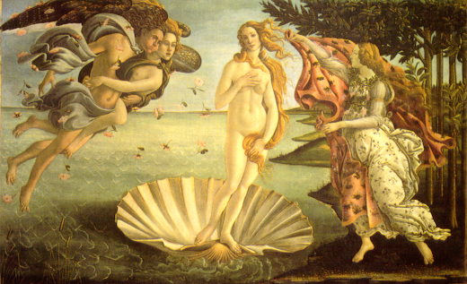
Major Works of the Renaissance

Slide 5
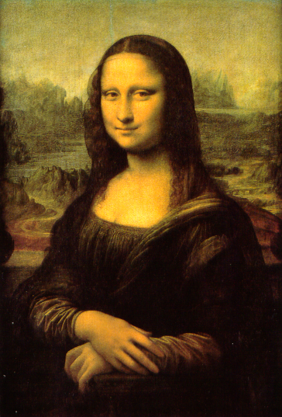
Major Works of the Renaissance

Slide 6
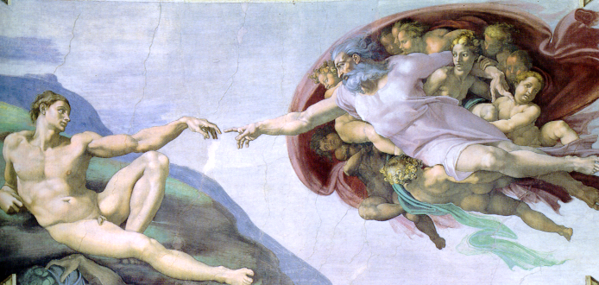
Major Works of the Renaissance

Slide 7
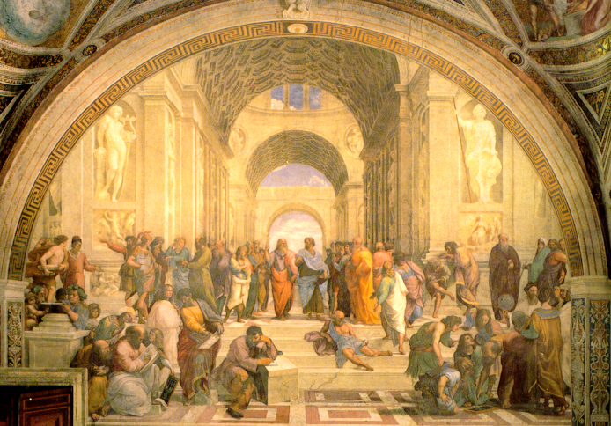
Major Works of the Renaissance

Slide 8
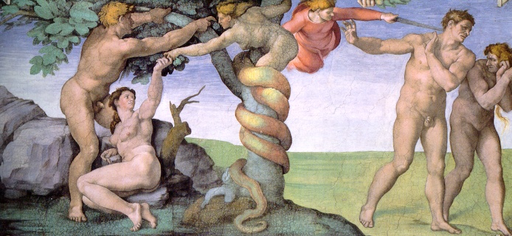
Renaissance Art

Slide 9
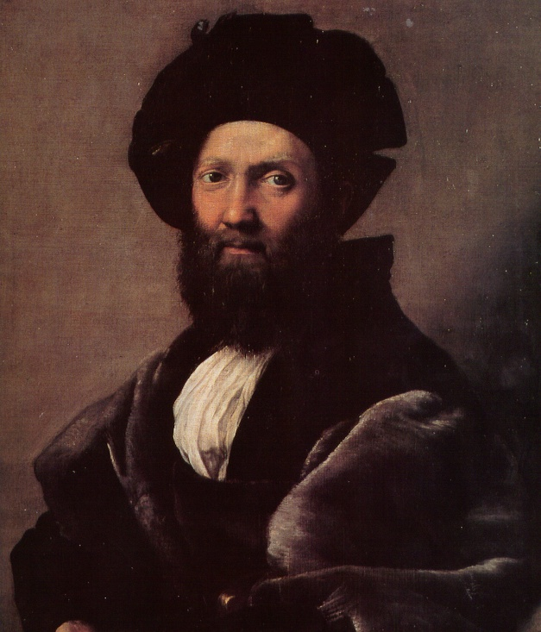
Renaissance Art

