Slide 1
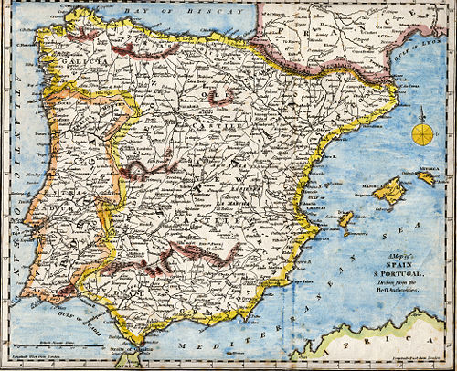
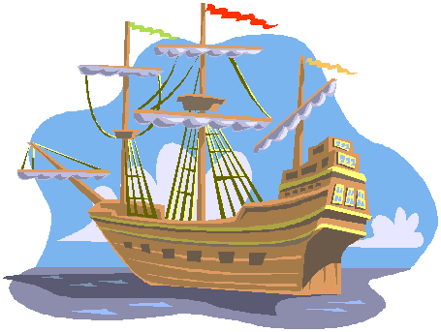
The Age of Exploration
1400s-1600s

Slide 2
The Age of Exploration
What do you remember from last year?
What were some of the reasons it started…
Who was involved in starting it…
Who was involved in the conquest of Latin America…
What were the results of the conquest…

Slide 3
The Age of Exploration
Reasons it started…
Portugal, Spain Reconquista
Advances in navigation
God, gold & glory
Who started…
Henry the Navigator
Columbus, de Gama, Magellan
Who conquest of Latin America…
Cortez – Aztec
Pizarro - Inca
Results of the conquest…
Encomienda system
Slave trade
Gold inflation
Genocide

Slide 4
Age of Exploration
All big European countries involved but Spain and Portugal involved most and earliest.
Original goal stemmed from quicker access to the East with its silk and spices
Voyages outside of Mediterranean began as Portuguese looked for better agricultural opportunities in Atlantic islands
Pair also had restless armies leftover from Reconquista of Iberia

Slide 5
Portuguese Explorers
Begun with patronization of Henry the Navigator
Establish trade with Africa, Arabia, India, and parts of Asia, eventually Japan
Relied on small chains of trading posts
Start long chain of European empires

Slide 6
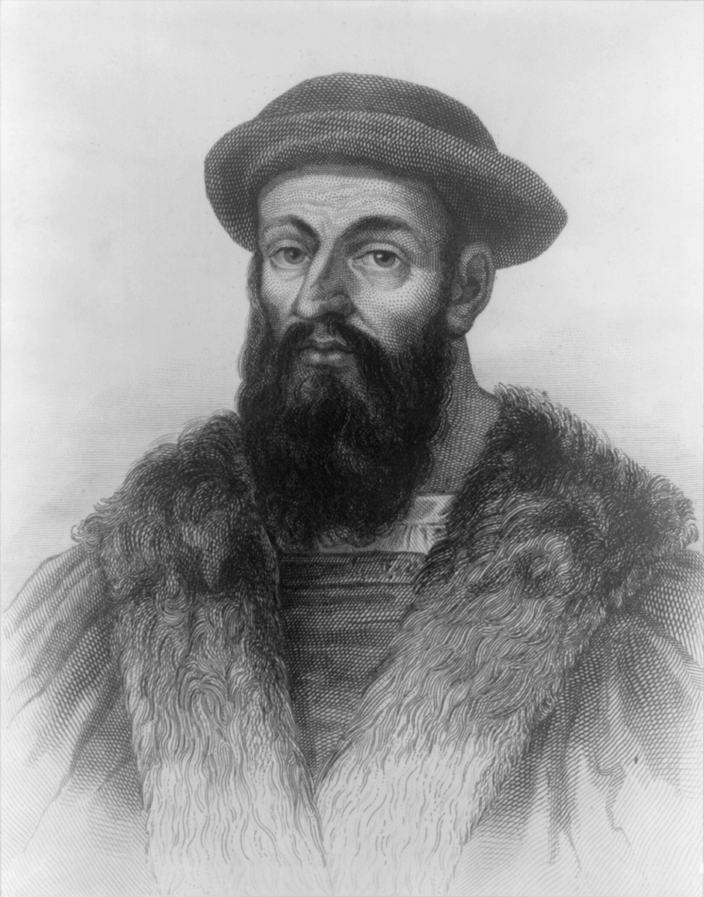
Ferdinand Magellan
First European in the South America, Southern African and the Pacific Ocean
First expedition around the world—circumnavigate– 1519-1521—but dies on it

Slide 7
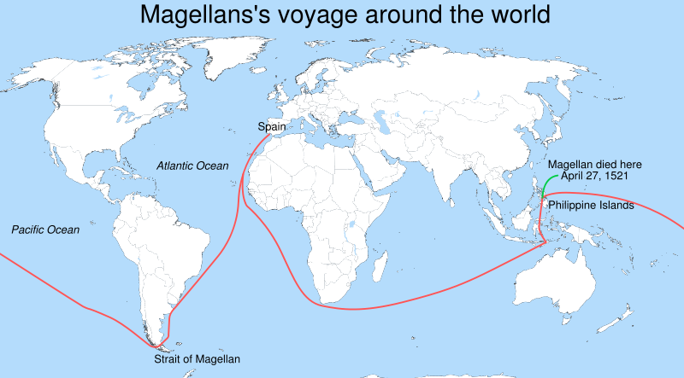

Slide 8
Treaty of Tordesilla
Divided up the world between Portugal and Spain in 1494. At the time they were doing all the trade/colonization
Done at the insistence of the Pope, to prevent conflict
Gave Portugal Brazil, all of Africa, Asia, and the Middle East (and yet to be discovered Australia)
Gave Spain all of North and South America

Slide 9
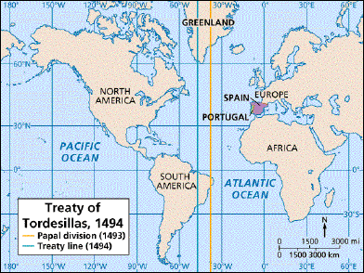

Slide 10
Spanish Explorers
Used conquest and colonization rather than trade as a main means of expansion
King Ferdinand and Queen Isabella funded explorers from all over in an effort for glory and gold
Concentrated exploration to Americas

Slide 11
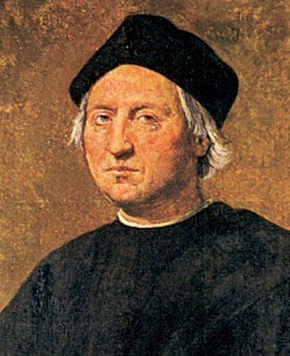
Christopher Columbus
Italian by birth
Landed in Caribbean—by accident
Had wanted to sail west to reach India
Four total voyages to Americas
Treated natives cruelly
Began Columbian Exchange

Slide 12
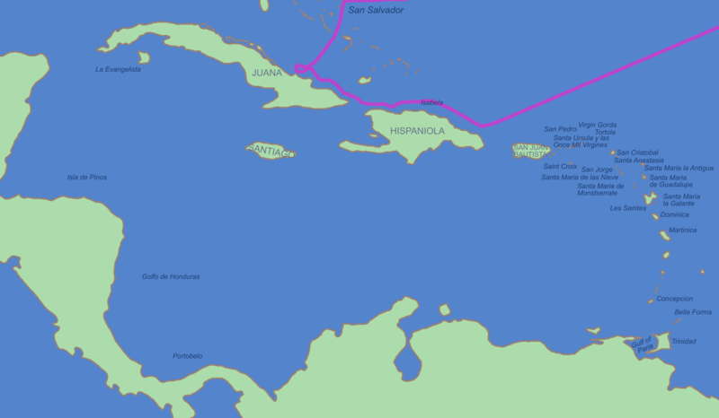
First Voyage

Slide 13
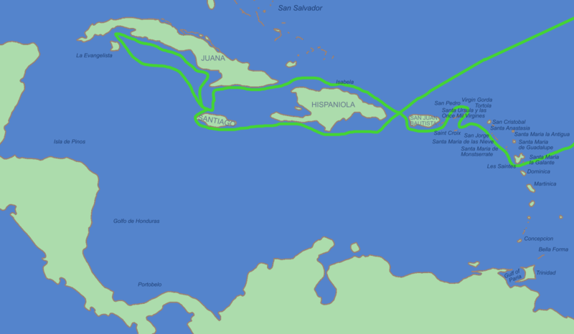
Second Voyage

Slide 14
Conquistadors & Missionaries
conquistadors—or conquering generals—who took out the Aztec and Incan tribes came to Americans in search of conquests and riches—gold was the main theme
some were even looking for legends or relics, like the Fountain of Youth
they were followed up by missionaries trying to convert natives
both conquests and conversions were brutal
enslavement was common

Slide 15
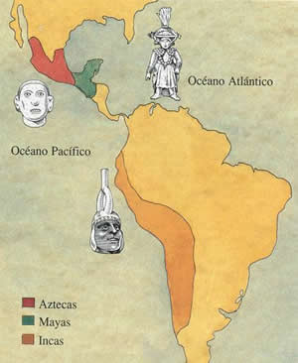
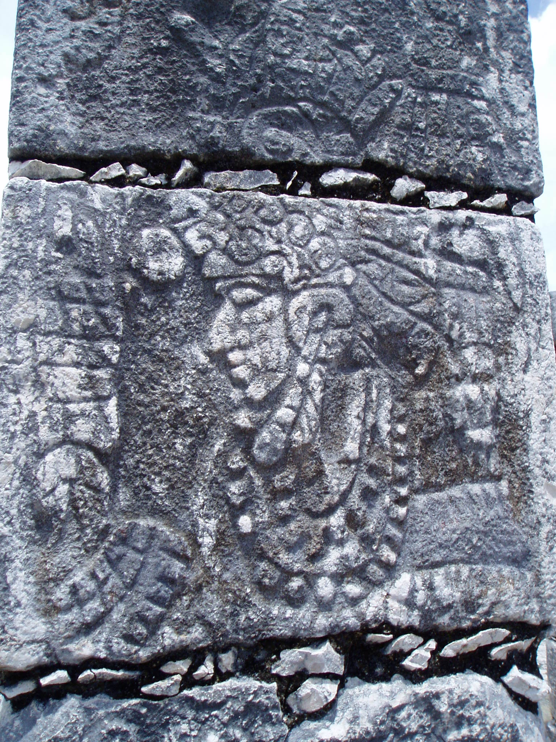
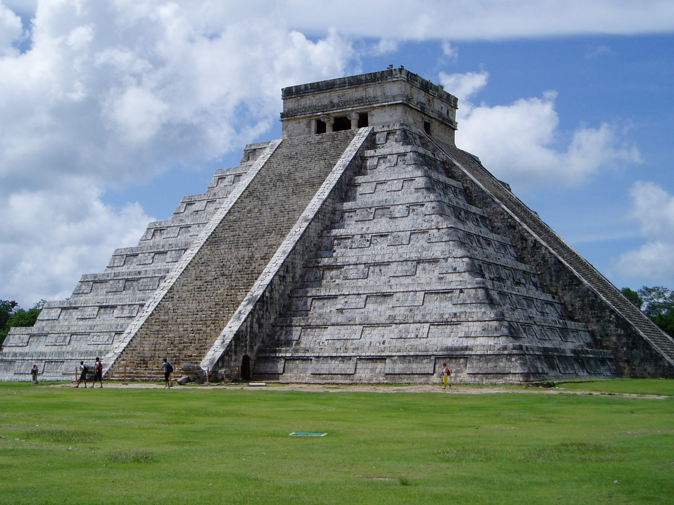

Slide 16
Triangle Slave Trade
One of the by products of all this was the advent of the slave trade
At first Native Americans and then Africans were victims of the trade—Spain and Portugal were main instigators at first. England and France later involved.
Africans rounded up and kidnapped other Africans and then traded them
This resulted in a triangular trade: Slaves from Africa to the Americas, new products like tobacco, cotton, or sugar from the Americas to Europe and guns and gold to Africa from Europe.

Slide 17
Understanding Latin American colonial absolutism
Directions: Using your critical reading & notes, your other table group members, outside resources (like any book or the internet, etc.), & your brain you will gain an understanding of the inner workings and impact of the Colonial Absolutism on Latin America. These are your notes—it is imperative that you & your table group are thorough, comprehensive, clear, & that you each have a copy of the information garnered—there will be no additional lecture. How you chose to display your notes is up to you, but in the course of them you should make sure that you hit on the following:
Definitions: peninsular, creole, mestizo, royal fifth, viceroy, caste system, honor system, hegemony, transculturation, encomienda system, peonage
System analysis: You need to understand the inner workings of the following systems that made up colonial life. When thinking about these systems consider how they impacted all walks of life in colonial Latin America and how they related to ideas and themes of Absolutism (divine right, hard and soft power, Hobbes vs. Locke, etc.) Do this for the following:
Economic systems (both forced and paid labor)
Government & political systems
Socio-cultural systems

