Slide 1
Thesis
With the fall of Rome many Europeans found themselves with a common, sociocultural and patriarchal void in their lives. Eventually, with the long and often violent Christianization of Europe, that void was filled. However, this constant squabbling led to chaos on a large scale, causing medieval life to become incredibly dangerous for the common man. In order to cope with these dangers the lower classes gave up freedom to receive protection from the higher classes causing a rigid, hierarchical system to arise to keep balance and order.

Slide 2
Part I: With the fall of Rome many Europeans found themselves with a common, sociocultural and patriarchal void in their lives.

Slide 3
Rome in less than five minutes
Rome founded in 753 BCE
Starts as a monarchy, migrates to a republic
Julius Caesar then takes control
Assassinated 15 March 44 BCE → eventually succeeded by Augustus Caesar who “founds Rome a city of brick and leaves it a city of marble” creating Roman Empire
Roman Empire
Most dominate in early Western Civilization
Reaches height in mid 100s CE
→ spans all of Mediterranean; corners: Britain, Morocco, Turkey and Egypt
Begins slow but steady decline over next 200 years
Reorganized by Diocletian (into Diocese) and split two halves—Eastern and Western
Eastern-more valuable-capital at Constantinople-lasts till 1453
Western-capital Rome-hemorrhages and falls in 476

Slide 4
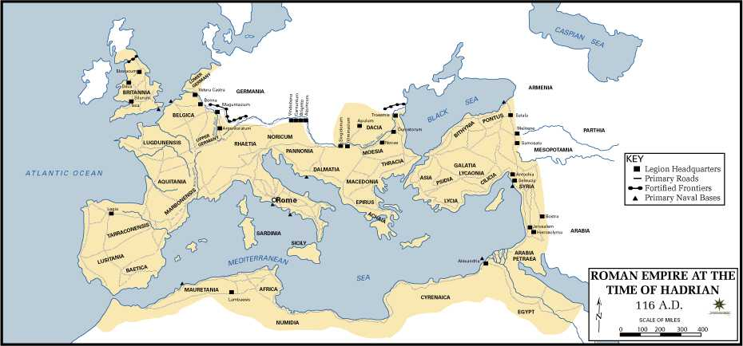

Slide 5
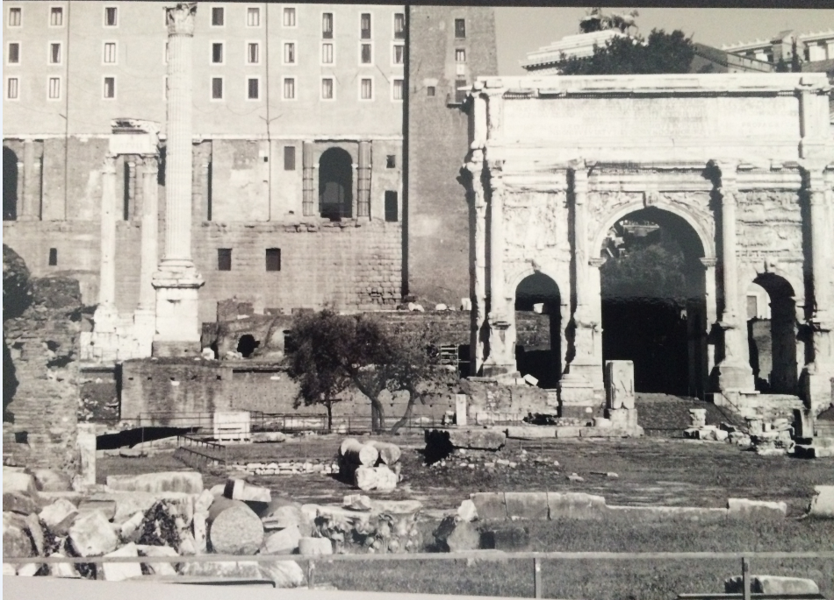

Slide 6
Thesis
With the fall of Rome many Europeans found themselves with a common, sociocultural and patriarchal void in their lives. Eventually, with the long and often violent Christianization of Europe, that void was filled. However, this constant squabbling led to chaos on a large scale, causing medieval life to become incredibly dangerous for the common man. In order to cope with these dangers the lower classes gave up freedom to receive protection from the higher classes causing a rigid, hierarchical system to arise to keep balance and order.

Slide 7
Part I: With the fall of Rome many Europeans found themselves with a common, sociocultural and patriarchal void in their lives.

Slide 8
The end of the Western Empire
Emperors in West become progressively weaker and more corrupt—and get assassinated, a lot.
Leads to starvation and gang violence
Climaxes with Alaric I of the Visigoths sacking (pillage, steal, rape, murder) Rome for a series of days in 410 CE—beginning of the end
Next 60 years are a series of good harvests followed by sacks by various Germanic tribes (Goths, Visigoths, Ostrogoths Franks, Magyars, Saxons, Jutes, Lombards, etc.)
Romulus Augustus is overthrown in 476 C.E.

Slide 9
Side effects of the fall
Result is one of the oddest phenomena in history:
Progress went backwards → people could see the old work in architecture, art, medicine, etc., but could not recreate it or build future ideas off it (and won’t be able to for nearly 325 more years)
General size and skill of life decreases
Trade disruption
Decline of cities: population shifts out to regressive, agrarian society
Decline of arts and learning
Loss of a common language
All this leads to a major, disunifying void

Slide 11
Part II: Eventually, with the long and often violent Christianization of Europe, that void was filled.

Slide 12
Rise of Christianity
Jesus of Nazareth (6/4BCE-31/33CE)
Healer & exorcist in and around Galilee
Executed for unknown reasons around Passover in early 30s
Most success came from later convert Paul of Tarsus
Seen as an odd cult; persecuted off and on for many years in Rome—mainly for fun (Diocletian was famous for this)
All that changed with Constantine
Edict of Milan making it illegal to persecute Christians issued in 313
Incredibly rapid expansion of Christianity after Edict of Milan

Slide 13
Rise of Christianity
Made official state religion in 391. Leading to two key issues:
1. Beginning of tension between religion and politics (church and state)
2. Disagreements over key issues lead to first Christian split. Occurs along line of empire divided by Diocletian:
Catholics led by the Pope in the West
Orthodox led by Patriarch of Constantinople in the East
Each sect thought the other was heretical. So they fought. Physically & verbally. Constantly.

Slide 14
Augustine of Hippo (354-430 C.E.)
Grew up as alcoholic, promiscuous individual (against the will of his mother) before having a revelation in a brothel and converting to Christianity
Became one of the early leaders of the church.
Bishop of N. Africa in 396 C.E.
Earliest Christian philosopher. Major work was City of God.
Goodwill of God & good works is what you needed to be “saved” and you could not receive that unless Christian.
Must beg to be saved—God does not do this naturally
War in the name of religion (and peace) can be ok

Slide 15
Clovis & Christian Europe
Due to slow disintegration of infrastructure of Roman Empire, Christianity took a bit to spread
Conquering tribes saw it as something that made Rome weak
Eventually taken up by Franks (Germanic tribe) with conversion of Clovis I:
Hagiography: tells of a Constantine like conversion on the battle field to win a war
Clovis used Christianity to lord over others, integrating it into everyday life:
Politics, socioeconomics, culture
Blurred lines of Church and State
Slowly, but surely (over the last 400 years) you had to be Christian to do anything

Slide 16
Part III: However, this constant squabbling led to chaos on a large scale, causing medieval life to become incredibly dangerous for the common man.

Slide 17
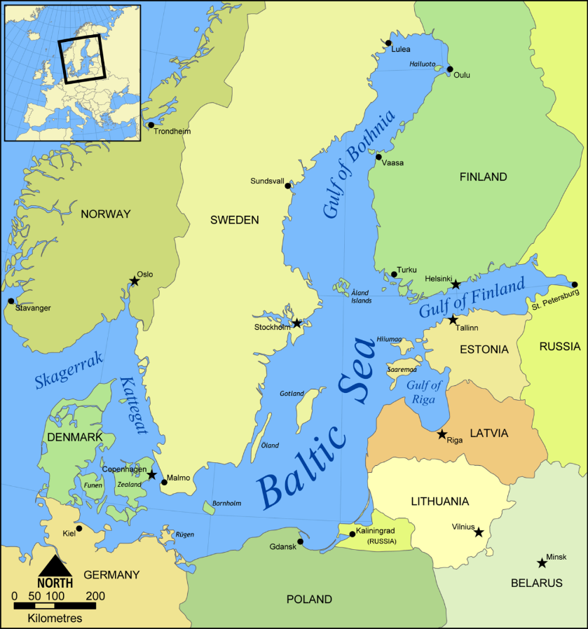
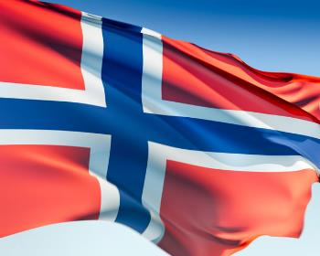
The Vikings

Slide 18
Vikings
Seafaring warriors from Scandinavia
Around 800-1000 Europe generally warms up
Leads to more food in Northern areas = more people
Scandinavia gets too crowded, warrior culture leads to looking for new places to conquer
Conquering turns to raiding = Vikings
Attacks occur all over Europe→ records exist from Britain to Constantinople
Attacks are common & random, smash & grab
Indiscriminate in age, gender, area, religion or social status
Incredibly quick & brutal
Not just on coast (boats could sail in 3 feet of water)
Almost invincible (even battled Charlemagne to stalemate)

Slide 19
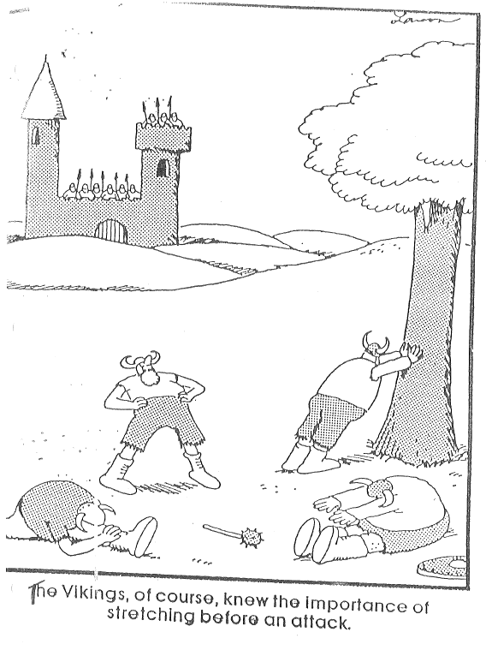

Slide 20
Vikings settle down
Continued raids eventually led to paying tribute → sack (or threaten to sack) Paris 12 times
Charles the Bald of the Franks (aka Charles the Simple) got tired of this, finally offered to give Ralph the Walker (Vikings) land in exchange for protection, allegiance, and conversion to Christianity
Beginning of feudal system of allegiances
Found Normandy (in N. France) and become famous, ferocious horselords
Will eventually conquer England in 1066—becoming the modern English (and last people to conquer it)

Slide 21
What have the Vikings ever done for us?
Found feudal hierarchy and system
Solidify Christianity as the “in” thing in Europe
Changes their religion from pessimistic to optimistic
Discover Iceland, Greenland and N. America
Maybe got as far South as Massachusetts
12 man trial by jury
Staple of Anglo-American justice system
Become the modern English
Eventually Colonize north (York) in 800s-1000s and conquer south (London, etc.) in 1066
Revolutionize shipbuilding theory
Fascinating Sagas (Legend/Epic Poetry combo)

Slide 22
Part IV: In order to cope with these dangers the lower classes gave up freedom to receive protection from the higher classes causing a rigid, hierarchical system to arise to keep balance and order.

Slide 23
Spread of Feudalism
Begins with Vikings: Rollo (Viking) and Charles the Bald (King of France) sign a peace treaty; they were previously enemies
Charles signs over large chunk of land to Rollo in northern France = Normandy
In return, Rollo swore allegiance to the King (and, like most leaders then, became Christian because he wanted to get something—land & $$)
Deals, built on rights and obligations spread all over the continent → led to lords and vassals
Status determined a person’s prestige and power
Class was inherited – very little chance of moving from one to another – and much easier to go down than up (disparaging)

Slide 24
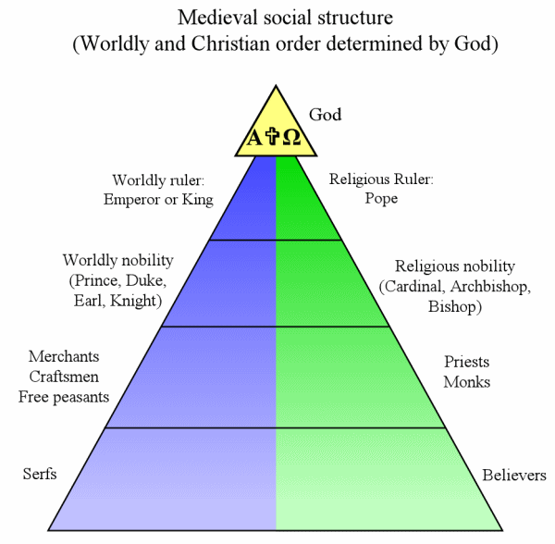
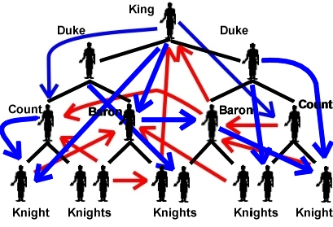
Feudalism
What feudalism is supposed to look like
What feudalism really looked like

Slide 25
Manors
The manor was the lord’s estate of usually a few square miles
Consisted of the lord’s manor house, a church, and workshops.
Usually 15 to 30 families lived there → including some free peasants
Fields, pastures and forests surrounded the manors
Self-sufficient
Peasants rarely traveled more than 25 miles from home
The lord provided serfs with housing, farmland and protection from bandits and other knights → gave up freedom for protection
In return, the serf took care of the land and the animals
All peasants (free or not) owed the lord and church certain duties ,i.e. demesne and tithe

Slide 26
Serfs
Most peasants were considered serfs
Little to no legal rights: representation, due process, etc. (except in England, kind of)
Little to no class mobility
A serf could not lawfully leave the place they were born,
unless away 1 year and 1 day, then became free
Their lords could not buy or sell them

Slide 27
Serfs
A % of whatever they produced belonged to the lord, owed a weekly demesne
Another % went to the church
Very tough, unforgiving life → farming is very, very hard with little technology and food storage system
Production increases with advent of horses (and harnesses) heavy wheeled plow and three-field system
First major (non-war) innovations in a while, ushers in new prosperity and High Middle Ages

Slide 28
Note taking
What formats did you use last year?
Outline
Cornell
Annotated Summary
Mind Map
Main idea is to PROCESS & ORGANIZE, this is what gets it to stick in your brain!
What about textbook reading specifically?
Highly recommend doing more than simply using same headings and copying notes in bulleted list below headings
So what can you do… What about before, during and after…

Slide 29
Before reading the texbook
Think of unit guide and what has been previously studied in the unit
Read the title of the section and think about how it might relate to either
Scan the section closely
Read the “Main Idea”
Read large headings
Read main idea questions in the margins
Look at pictures to make sure you understand what they are
How do the pictures connect

Slide 30
During reading

