Slide 1
From Robespierre to Napoleon
After Thermidor 9 Reign of Terror dismantles itself (some members arrested, jails emptied, committees closed, etc.)
Jacobin and Girondin clubs closed; amnesty extended to all but san-culottes, many of whom executed
“White Terror” or backlash of people committed Reign of Terror ensues. Arrests, “accidental” deaths, assassinations, etc.
Directory established by remaining National Convention when the Revolution was considered ended in 1795

Slide 2
Directory
Run by a 5-man executive (of bourgeoisie)
New constitution written in 1795
Two house legislature (like US) which disfranchised many
Did not mess with religion from Robespierre—i.e. some people still worshipping Marat
Continually worried about royalist resurgence
Tried to be centrists after years of radical rule on both sides → suppressed radicals
Popular with lowest classes because of its stability

Slide 3
Phases of the French Revolution
Not official – just to help understanding
Phase I: Overthrow of the monarchy – Constitutional Monarchy
Phase II: Republic – radicalization and terror
Phase III: Napoleon – empire

Slide 4
Napoleon Jigsaw
What was the impact of Napoleon’s domestic actions & policies?
be sure to include details about the coup of Brumaire, the Code and freedom of speech
What was the general impact of Napoleon’s foreign actions & policies?
be sure to include details about the blockade, the Code and the Battle of Trafalgar
What impact did Napoleon have on Spain?
What impact did Russia have on Napoleon?

Slide 5
Thesis
The mess left by the Reign of Terror and Thermidorian Reaction caused the people of France to be willing to accept any type of rule to make violent upheaval cease. This led to a weak government—the Directory—that did almost nothing. While this was popular at first it did not stamp out any left over revolutionary sentiment, which would eventually lead to its downfall. Napoleon Bonaparte was able to capitalize on this apparent governmental opening, and as the mood of the people swung further away from radical democracy, they became content with his eventual establishment of another absolute monarchy.

Slide 6
Napoleon Bonaparte’s background
Born in Corsica (only famous Corsican in history). Very short.
Lieutenant by age 16 → joined army of new government after onset of French Revolution
Defended the delegates of the National Assembly in 1795 against royalist attack → becomes military hero of Revolution
Successfully invades Italy (and Austrian territories there)—popular in France because Napoleon taxes Italy not France to pay for the invasion
Goes to Egypt to fight British but gets crushed by Admiral Horatio Nelson at the Battle of the Nile → slips blockade and returns to France (1798); never gets in French papers

Slide 7
Rise of Napoleon
Directory gets into fight and rise of Neo-Jacobins becomes a serious threat (=return of terror)
France about to descend into violence, Napoleon’s friends urge him to seize power
Does so in Brumaire Coup (November 1799). Remaining Directory votes to abolish itself, forms consulate with 3 consuls. Bonaparte takes 1st consulship and becomes dictator

Slide 8
Napoleon in France
Originally really rational and did good things for France
Holds a plebiscite (vote of the people) to approve a new constitution. Napoleon now claims legitimate power
Kept many changes from the revolution
Cleaned up corruption, set up tax collection and banking systems; established public schools
Napoleon signs a Concordat, or agreement, with the Pope: Pope gives support to Napoleon in exchange for no French government control over church
Napoleonic Code: Basis of law in France today (but has changed)
Addressed many injustices but chooses protection over freedom

Slide 9
Starting an Empire
Then Napoleon determines to rule all of Europe
Obsessed with Britain, ostracizing Britain, and beating Britain
Known as Continental System—series of blockades and trade embargos
France held territories in North America
Louisiana
Haiti (island of Hispaniola in Caribbean)
In a crunch for cash, Napoleon sells all of Louisiana Territory to US for $15 million
US had approached Napoleon just to sell New Orleans, but now had the chance to buy it all
Also ensured US would survive as a strong nation

Slide 10
Napoleon in Europe
Napoleon annexes the Austrian Netherlands (what later becomes Belgium)
Annexed parts of Italy, controlled Switzerland
Pushes across German states, headed for Austria (Austria and Prussia then switch sides to ally with Napoleon)
By 1805 only great power left was Britain → takes on Nelson at Battle of Trafalgar and loses

Slide 11
Battle of Trafalgar
Has a knack for being able to beat everyone but the British
This loss is more important than any Napoleon victory
Takes place in 1805 off the SW coast of Spain
Spanish and French vs. British (led by Admiral Horatio Nelson)
Nelson splits Franco-Spaniards in two and wins decisive victory
Major results:
1. Assures safety of British Isles from Napoleon—this mad attempt to beat Brits will be his downfall
2. Assures dominance of British Navy for another 100 years
Side note: defeating the superpower/the underdog in the culture

Slide 12
Bonaparte’s benefits to Europe
By 1812, Napoleon controls all of Europe (directly or indirectly) except Britain, Sweden and the Ottoman Empire
Allowed German states to start unifying into one nation
Remember Germany still does not exist as a nation yet
Same thing for Italy
Small independent states, “Italy” still does not exist
Increased nationalism in other key places
Government for Poland
Poland had been carved up by Prussia and Russia in the past, now had a chance to have its own government again
Napoleonic becomes a somewhat fair system of justice throughout most of Europe

Slide 13
Napoleonic mistakes
First mistake: blockade. Continental system.
Napoleon sets up a blockade to prevent all trade between Europe and Great Britain
Britain then stops all ships coming to countries controlled by Napoleon
India, African colonies, United States, Canada
Ends up hurting Napoleon more than Britain
Also causes the War of 1812 between the US and Britain

Slide 14
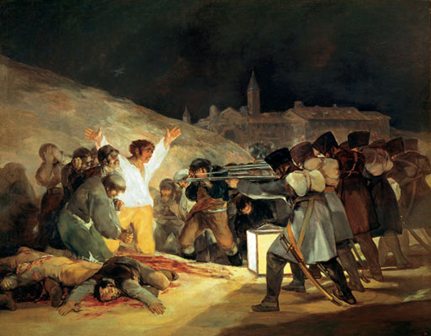

Slide 15
Napoleonic mistakes
Second mistake: Peninsular War
Invades Portugal and Spain
Napoleon makes his own brother King of Spain
Spanish resist, start guerrilla warfare
Peasant fighters, hid in the hills, not an organized army – but VERY effective
Ended up costing Napoleon 300,000 men
Starts to inspire others across Europe to rebel
Biggest mistake of all is invasion of Russia… what can you tell me about it?

Slide 16
Russia
Napoleon marches into Moscow, only to find it totally ablaze
Alexander destroyed it rather than let the French “win” it
What is this strategy called?
In October Napoleon decides to take his troops back to France
They get caught in the winter, most freeze to death or die from enemy attacks
Between10,000 and 35,000 make it back alive (depending on the source you read) of about 350,000

Slide 17
Napoleon’s downfall (The War of the 6th Coalition)
Now Britain has Russia, Prussia and Sweden allied against him
Austria now declares war on France, mainly to help preserve balance of power
Napoleon raises a new army
October 1813 draws at Leipzig (Germany)
January 1814 – allies invade France
March 1814 – King Frederick William of Prussia and Czar Alexander lead troops in a parade through Paris

Slide 18
Exile & 100 Days
Napoleon surrenders in April 1814, goes into exile on island of Elba off coast of Italy
Coalition allows Napoleon to rule Elba (basically play emperor), which he does well at first (much like France)
Louis XVI’s brother Louis XVIII becomes king, monarchy restored
Started to undo most of the reforms of the revolution
Becomes very unpopular
Napoleon returns from exile
Marches from Elba through Italy and over the Alps into France
Crowds cheer him, Louis’s army deserts him and join Napoleon
Napoleon is emperor once again
Europeans quickly get their armies back together

Slide 19
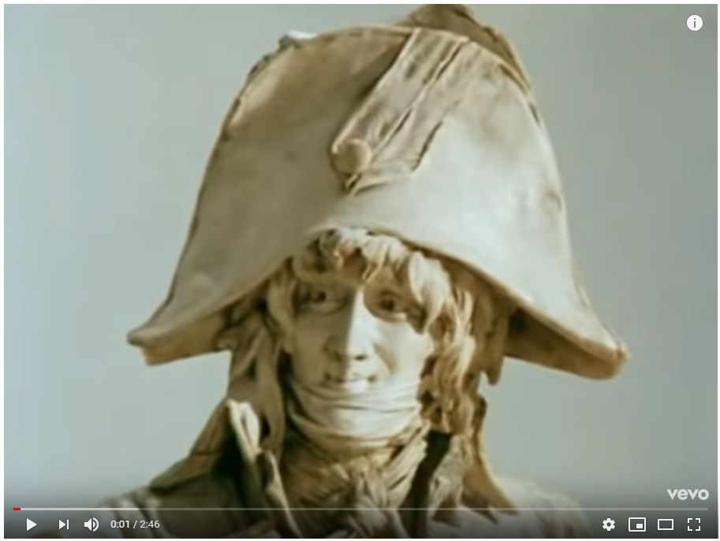
https://www.youtube.com/watch?v=Sj_9CiNkkn4

Slide 20
Waterloo (The War of the 6th Coalition)
British led by the Duke of Wellington masses troops near Waterloo (in Belgium)
Napoleon attacks, but British defend their ground
Prussian troops arrive at the last second to help British
Two days later, French troops start to collapse
Napoleon surrenders
British send him to St. Helena, an island in the South Atlantic and the middle of nowhere
It is literally a rock, the worst possible place in the world
He dies there in 1821

