Slide 1
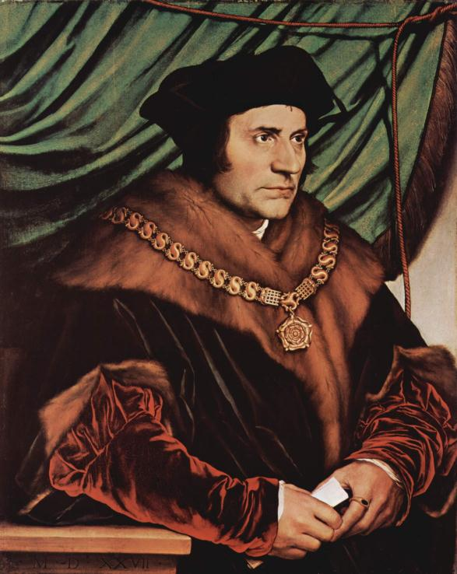
Northern Renaissance Beginnings
Result of trade—Flemish, Dutch, and English merchants made money and began to patronize artists
Church had more of an interest up north—caused Christian Humanism which is an attempt to boil down Christianity to help society
Big Christian humanists: Erasmus of Holland and Thomas More of England. More wrote Utopia; Erasmus wrote Praise of Folly

Slide 2
Life in the North
Politically Northern Europe had moved somewhat past the Middle Ages (into a weird sort of limbo); from a cultural standpoint it was a society in decline:
Fake chivalry, bravery, and tournaments were still the norm
New fascination with relics and idolatry
Increased interest in the macabre—danse macabre style—and fascination with occult communication and resurrection
Devils, witches, and increased superstition—Malleus Maleficarum

Slide 3
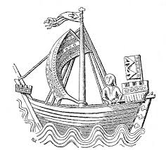
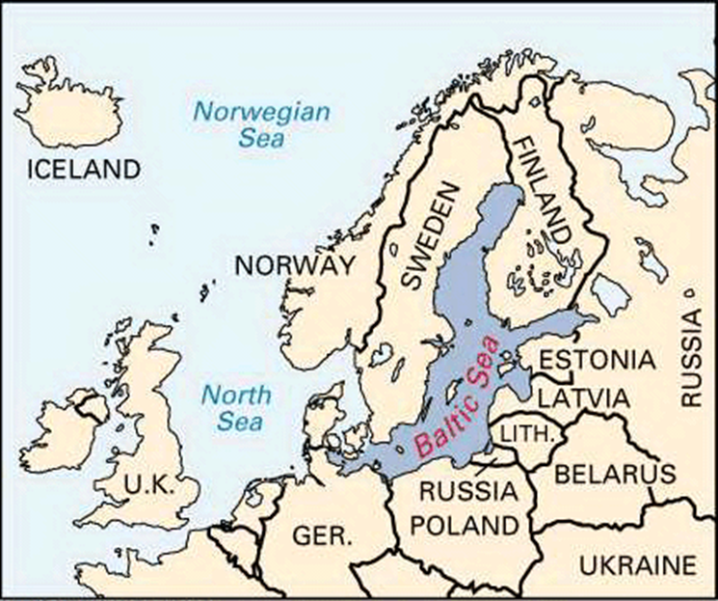
Economics in the North
Growth of cities & merchants had monumental impact on the economy
Commercial Revolution: Money, guilds appear
Entrepreneurship developed, economy now based on money
Cog was invented in 1200s, equated to modern invention of Jumbo Jet
Northern coastal cities set up Hanseatic League of trade along the Baltic Sea
Salt, wool, amber, ale, etc. made up the trade market

Slide 4
THE CHURCH IN THE NORTH…

Slide 5
“Among them are some who make a great thing out of their squalor and beggary, who stand at the door bawling out their demands for bread […] depriving other beggars of no small share of their income. And in this manner these most [dis]agreeable fellows, with their filth, ignorance, coarseness, impudence, [are supposed to] recreate for us, as they say, an image of the apostles.”

Slide 6
Reform in the Church
[After the selection of the new Pope, Pope Leo X] Walking home through the dark and deserted streets, Michelangelo recalled Leo’s line to [a friend] immediately after his coronation: “Since God has seen fit to give me the papacy, I mean to enjoy it.” Leo was going to need money, millions upon millions of ducats, and even more incredible than any pope had need for war. When he begged the cardinal in charge of raising money for the church to be sure that nothing was done to bring to dishonor on the church, the cardinal shrugged and said: “Holy Father you have assigned me the task of financing this world wide business. My first obligation is to keep it [afloat].”

Slide 7
Criticism of the Church
A. What recent ideas laid the foundation for criticism of the Catholic Church and how?
Individualism
Humanism
Education
Secularism

Slide 8
Criticism of the Church
B. What specific examples show the decline in the Church’s political and spiritual power?
Unam Sanctam - 1302
The Babylonian Captivity - 1304 to 1378
Great Schism - 1378 to 1415
John Wycliffe - 1320-1384
Jan Hus - 1373-1415
The CHRISTIAN HUMANISTS

Slide 9
Actively Learn Homework
What problems does Erasmus have with the church?
What are Wycliffe's problems with the church?
What are the links to Dante?

Slide 10
Criticism of the Church
The Humanists of Italy and the Christian Humanists of the North denounced corruption in the church.
The Brethren of the Common Life - Thomas à Kempis
D… Erasmus 1466-1536
Thomas More 1478-1535
Humanist Targets
Clerical Ignorance - 1535 Archbishop of York
Clerical absenteeism - Antoine du Prat, as Archbishop of Sens
Nepotism – Examples?
Simony, Pluralism - Archbishop of Mainz
What other signs of disorder do you know?

Slide 11
Luther’s Early Years
Martin Luther (1483-1546) was the son of a copper miner.
His father sent him to school and then to the University of Erfurt,
1505 To law or not to law.
Why it is not good to make promises in times of danger
Luther was ordained an Augustinian monk in 1507
Augustinian see his talent and dedication
By 1512 District Vicar & Professor of the Scriptures at the new University of Wittenberg.
Crisis Years 1510-17
1510 Rome

Slide 12
Luther’s “Revelation”
Good Monk??
Struggled with the problem of salvation
Lecture on the epistles of the apostle Paul then had a “towering experience”
“[After days of struggle] I saw the inner connection between the two phrases, “The justice of God is revealed in the Gospel,” and “The just shall live by faith alone” [Romans 1:17]
So understanding is based on idea of Justice and Faith
What was this new Doctrine? What were the major beliefs of Luther and how did they differ from the Catholic Church at the time? And when/why did his ideas become public?

Slide 13
Indulgence Scandal (1514-1517)
Indulgences will help… Archbishop of Mainz (AGAIN)
What is an Indulgence? A brief history...
Leo X and St. Peter’s of Rome
Johann Tetzel - the Dominican with a gift
What does Luther think?

Slide 14
And the gloves come off...
In 1517 Leo X’s “Special Jubilee Indulgence”...
October 31, 1517 the Ninety-Five Theses was posted on the door of the Castle Church of Wittenberg
What happens next?!?! Complete the timeline… why is Luther not killed?

Slide 15
Protestant Thought & Conflict
Differences of Luther and the Church
Luther believes in faith Vs. Church’s belief in..?
Where does religious authority reside for Luther and then the church?
Church believes priests should interpret the bible Vs. Luther…?
What is the deal with the sacraments…?

Slide 16
Timeline of Luther’s Reformation
Start with nailing the Ninety-Five Theses
up to his death in 1546

Slide 17
Let’s talk about Luther
What are some amazing things that Martin Luther did to enact positive change?
What are some amazing things that Luther did that do not “sit well” with most people today?
There are 3 I am thinking of… list them in your notes, give details

Slide 18
Let’s talk about Luther
Write for 5 minutes in your notes on the following prompt:
Was Martin Luther an agent of positive social change?

