Slide 1
September 17, 2018
Turn in:
None
Take out:
Mee Article
Place to take discussion notes
Name tags
Agenda:
Fall of the Middle Ages
Black Death
Feudalism Visual – any clarification needed?
Objectives:
*Identify how the Middle Ages helped to create the foundation of modern Europe.
*Understand how & why the Renaissance developed the way it did.
Homework:
9/18: 308-312 & Feudalism Visual
9/20: 334-337 (stop after "Slavery in the Renaissance") & 340-342 (stop at "Warfare in Italy")
9/21: Humanism Article (will assign in class a few days prior)

Slide 2
Middle Ages Renaissance
Where are we going next…
Predict in how/why the following events will cause the Middle Ages end & the Renaissance to begin:
100 Years War
Role of the church (Avignon–“Great” Schism)
The Black Death
Notes:
-Vikings raid Europe, which eventually leads to Feudalism because the Vikings are paid off and given land for their support (military) and conversion to Christianity
-William of Normandy (William the conqueror) leads to King Henry II and common law which in turn leads to King John (the lame) losing the Duchy of Normandy and is forced to sign the Magna Carta to appease his lords and Vassals creating strength in fiefs
-Parliament is then instilled because King Edward (Longshanks, Brave Heart) needs taxes to continue to fight wars and in the spirit of the Magna Carta looks to a body of people to pass laws requiring more taxes solidifying the connection between the Kings and his lords
-The strength of the government and the ability to grow more food leads to a population increase, but does eventually does not have enough food to support the influx in people leading to a famine weakening the overall health of the population making people susceptible to diseases brought back from trading in the East killing massive amount of the population, forcing people to develop technology inspiring new growth and thoughts in science, and the arts

Slide 3
Mee Questions AFTER YOU FINISH – Don’t answer as you go…
1. How was the plague passed through Europe?
2. What were some of the reactions to fight the plague? Which was the most interesting to you and why?
3. How did the coming of the plague affect the church and its believers?
4. What are some of the most significant impacts of the plague talked about in the reading (other than the church – which you already answered in #3)?

Slide 4
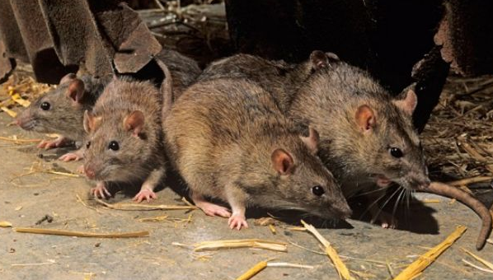
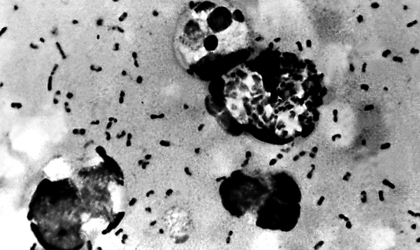
Black Death (the final nail in the coffin)
The Black Death – what is it?

Slide 5
Black Death - Details
How does the plague come to Europe?
How fast did the plague spread throughout Europe once it arrived?
How did people live during the plague, what examples does Mee give? How does Mee explain this behavior?

Slide 6
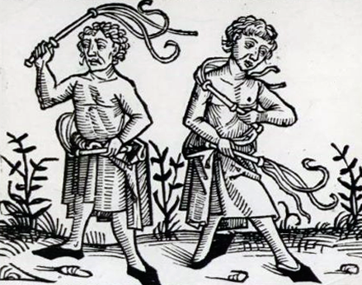
Black Death
Flagellants
What is it?
How did people react to the Flagellants?

Slide 7
Impact of Plague
Spielvogel, on pg. 301 states, “The Black Death of the mid-14th century was the most devastating natural disaster in European history, ravaging Europe’s population and causing economic, social, political and cultural upheaval.”
What evidence from Mee could you give to prove this statement?

Slide 8
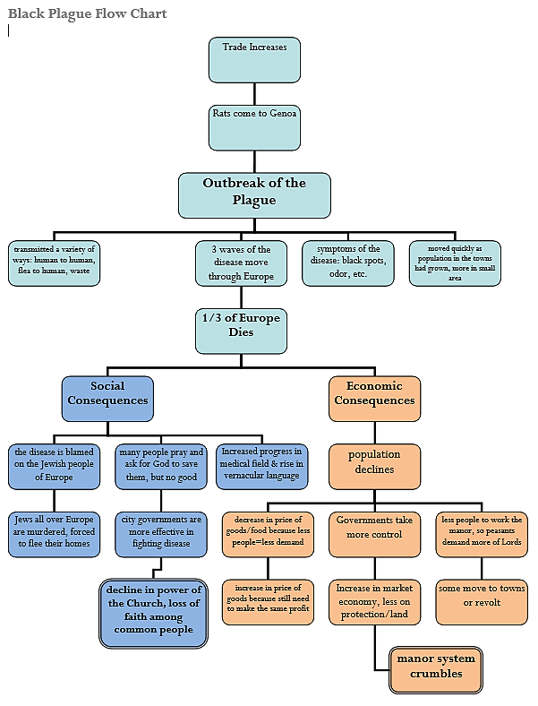

Slide 9
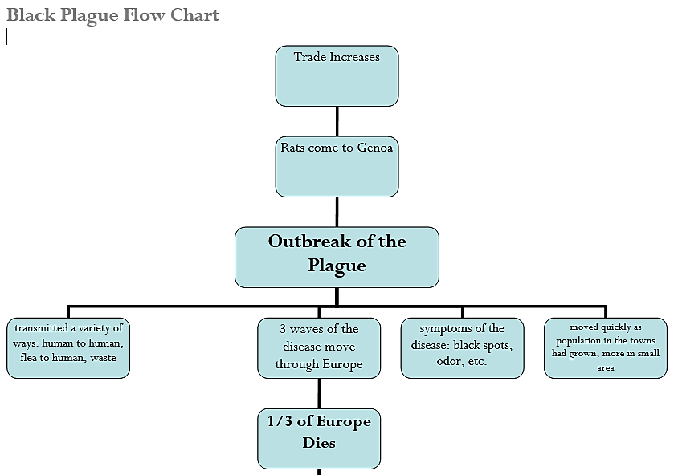

Slide 10
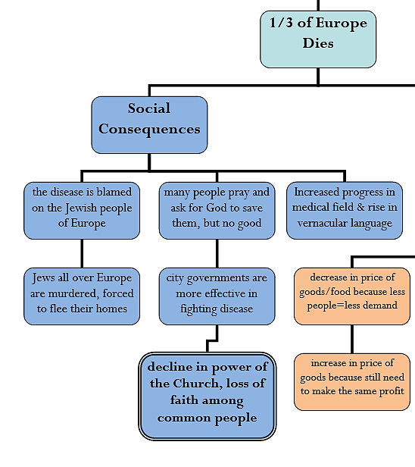

Slide 11
