Slide 1
Spread of Lutheranism in Germany
After Luther is officially excommunicated from the Catholic Church he returns to Germany
There he translates the bible into German
By 1534 the German New Testament sells nearly 200,000 copies
Lutheranism begins to gain popularity through spoken word (remember most people can’t read)
State authorities begin to take notice…

Slide 2
Lutheran Kings/Princes
Conversion of German princes and nobility began in the 1520s
Using what you already know…
How and why did Luther tie himself to state authorities?

Slide 3
The Reformation in the rest of Europe

Slide 4
Thesis
Due to a combination of the Lutheran Reformation and previous prevailing religious sentiment a series of violent conflicts were sparked across Northern and Central Europe. These conflicts would lead the political leaders of Europe to draw distinct battle lines that would haunt them for hundreds of years to come. And while the Reformation would eventually involve nearly every European country, most average European people cared little about the religious conflicts, framing their animosity—if any—along nationalist lines—but generally remaining tolerant of their fellow citizens.

Slide 5
After the Diet of Worms
Lutheranism established → agree with Luther’s ideas to convert
Firmly codified with the Augsburg Confession (and a few Diets)
Most leaders convert for monetary and political purposes (spreads to Scandinavia)
not many peasants outside of Germany convert.
Luther isolates many peasants by bad reaction to revolt
Religious leaders elsewhere pay attention…

Slide 6
The Reformation is on
Occurs at some level in every single country in Europe, except Russia
Many scholars get involved; combine Luther with Erasmus to justify social change.
Example: Urlich Zwingli in Zurich, mainly agrees with Luther, splits on transubstantiation
What is this? What is consubstantiantion?
New radical groups pop up like Hussites, Lollards, Waldensians emerge then Anabaptists → all make Luther, etc. look sane
What can you tell me about the Anabaptists?

Slide 7
Spread of the Reformation
The spread and change of the church does not end in Germany with Luther. Develop a background of information regarding how the Reformation spreads and changes throughout Europe.
Consider…
Protestantism in Switzerland
French Huguenots
Anabaptists
Philip II & revolt of Netherlands

Slide 8
life and teachings of Jesus of Nazareth
missions of Jesus’ disciples
Council of Nicaea & teachings of Augustine
Eastern Orthodox Church(es)
Catholic Church
Mormon
Book of Mormon
Lutheran
Anglican/Episcopalian
Calvinism
Protestant
Methodist
Presbyterian
Baptist
Jehovah’s Witness, Seven Day Adventists, etc.
Puritan/Pilgrims, Quakers, Amish, Mennonites, etc.

Slide 9
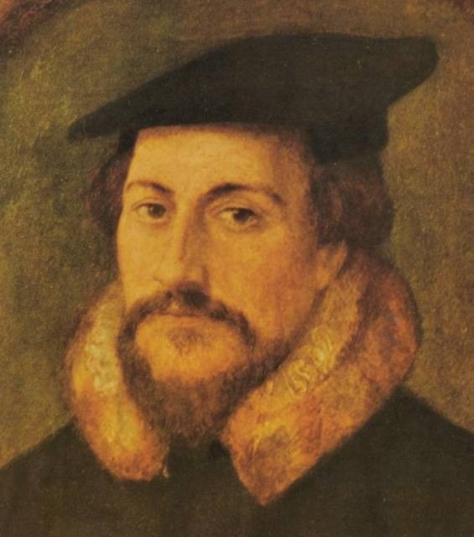
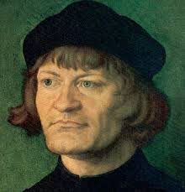
Ulrich Zwingli
John Calvin

Slide 11
Switzerland
Begins with Zwingli who agrees with Luther on almost everything, except…?
Zwingli also gets roots of the state (i.e. city council) to mandate Protestantism
John Calvin follows Zwingli with ideas of predestination and original sin = Calvinism (Presbyterianism)
Both enforce strict moral code, work ethic, and service

Slide 12
The Catholics
Let me tell you about…
Catholic Reformation - Counter Reformation
Ignatius of Loyola & the Jesuits
Council of Trent (1545-63)

Slide 13
Society of Jesus
“Conflict for God”
Education of the young
Conversion of non-Christians (East)

Slide 14
Papal Reform
Paul III
Know he took the first steps to reform, including calling…
Council of Trent & Paul IV
Reaffirmed Catholic teachings
Reaffirmed emphasis on works
Reduce the selling of indulgences
Increase training of priests
Impact of CR?

Slide 15
France
What can you tell me about the French wars of religion?

Slide 16
Cuius Regio, Eius Religio
Translation: whose leader, their religion or whose realm, his religion = the idea that the people of the country will follow the religion of its ruler
Simple move, convert ruler, country will follow. Staple of early Church and missionary policy
Only became an issue when leaders began to exploit it for political purposes, using inciting some group against another, rooted in religion (like in France!)

Slide 17
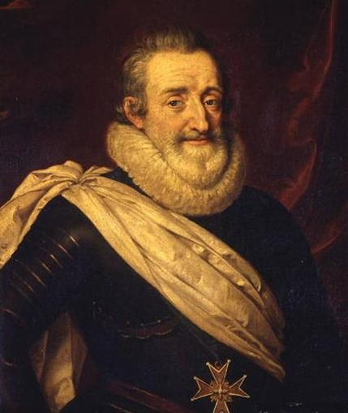
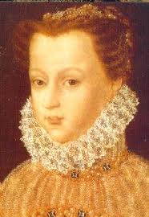
Catherine de’ Medici
Henry of Navarre

Slide 18
France
Huguenots: French Calvinist, mainly exist in Southern France
Three families are fighting for control of France after the reign of the weak King Francis II (Bourbon, Guise & Valois)
In order to isolate Guise family (most powerful family) Catherine Medici (Valois) makes alliances with powerful French Protestants
But the Guise family and Catherine Medici (both Catholic)—the mom of the French king—get antsy try to assassinate a major Huguenot leader
When that fails, they start a 3-day riot killing 3,000 known as St. Bartholomew’s Day Massacre (1572)

Slide 19
France
Starts off 30+ years of French Wars of Religion
Leader of Huguenots, Henry of Navarre (later Henry IV) marries king’s sister to reconcile faiths
They end when Henry of Navarre becomes King and converts
Issues Edict of Nantes in 1598
What is this?

Slide 20
The rest of Europe
Falls basically into 4 categories
1st: hardcore Catholics: Spain, Portugal, Italy, Ireland → Counter Reformation (lots more on this later)
2nd: countries who let in both:
With few problems: Poland, Latvia, Northern Germany, Hungary, Balkans
With lots of problems: Czech Rep., Southern Germany & Austria, Slovakia, etc.
3rd: countries who can covert peacefully: mainly Scandinavia and Estonia
4th: non-starters: Greece, Russia, part of Ukraine and Belarus which are E. Orthodox not Catholic
Still to come: England (Unit #2)

Slide 21
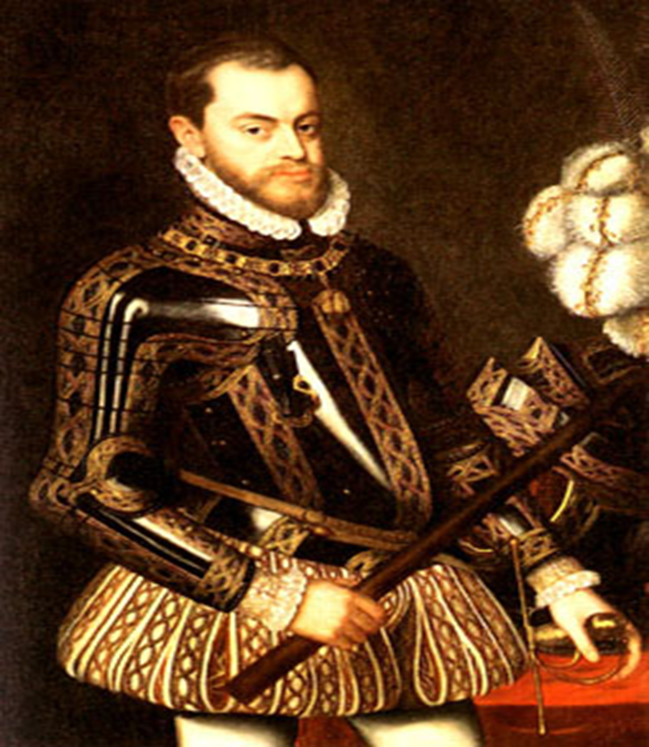
And now for the last topic…
We need to discuss Philip II a bit more here since he interacted with the previous two English monarchs quite a bit…
Who was he?
What did he believe in?
What was significant about his rule?

