Slide 1
Kievan Rus
First Russian state is known as Kievan Rus or the Kievan Empire – 850-1240
Rose out of mutual need
Citizens had common goal of survival
Vikings, Scandinavians, Turks, but mostly Vikings (in the north)
Viking conversion to the Rus
Conversion to monotheism (Christianity) from polytheism
Waring society
Major city was Kiev, those who ruled Kiev had control over the rest of the empire

Slide 2
Kievan Rus
The Kievan Empire was a feudalistic society
Slaves
Smerd class (Serfs)
Empire ultimately falls apart because of the apanage system – division of an estate to a fallen leaders offspring & in their moment of weakness they were attacked by the Mongols
This led to the fall of the Kievan Rus and a broken empire until about 1400

Slide 3
Ivan the Terrible
Russia begins to unify under its first tsar – Ivan IV the Terrible – 1530-1584
During the Muscovite Empire
First ruler to take title of tsar, crushed the old ruling nobility known as the Boyars, unifies Russia until the end of his dynasty in 1598
Boyars still exist, but not in the same capacity
Think of it like the crown in the UK after parliament is ECW/Glorious Rev.
Notes:
Ivan the Terrible actually did very good things for Russian society, his actual name meant Ivan the Awesome or Great. He was labeled as being awesomely terrible or Greatly terrible because the killed his son

Slide 4
Ivan the Terrible
Time of Troubles to Michael Romanov
1598-1613 is a period of time where there is a resurgence in the old assembly of nobility
Lots of bickering, fighting between powers
Literally known as the time of anarchy because there are so many people vying for power
Eventually Romanov is elected as tsar by the Zemsky Sabor (National Assembly)
This starts the Romanov Dynasty which lasts until 1917
Notes:
Ivan the Terrible actually did very good things for Russian society, his actual name meant Ivan the Awesome or Great. He was labeled as being awesomely terrible or Greatly terrible because the killed his son

Slide 5
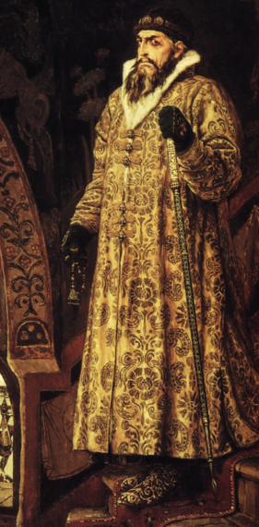

Slide 6
Tsarist Society
Russian Society under the tsars
Society is built around aristocracy and ruling class (absolutism)
Tsar claimed to be divinely ordained
Tsar essentially keeps the Boyars (aristocracy) in check during Romanov Empire
Russia is behind the rest of Europe during the Renaissance and Industrial Revolution, and relatively cut off (not completely, have some trade and are Christian)

Slide 7
Russian Interlude – Peter the Great
Peter the “Great” – 1672-1725
Any questions?
Other notable information regarding crazy Pete – I think he is hilarious/scary crazy
He loved war games
Would literally kill his friends in their “playful” war games
Loved the navy – Had a full size naval ship built on Lake Lagoda just to play boat with

Slide 8
Russian Interlude-Peter the Great
Had St. Petersburg built because he didn’t like Moscow, his father died there (killed by his aunt in front him)
Built on land that was frozen most of the year and a marsh the rest of the year
Forced his nobility to go there, they literally froze to death because he just wanted a castle there
crazy Pete just liked it there more than Moscow (named it after himself), would do anything to maintain a presence there
Somewhat tactical because it is a port city on the river Neva & on the Baltic Sea

Slide 9
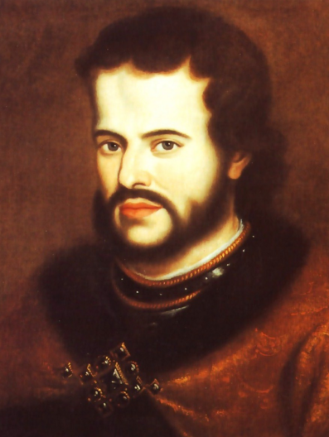
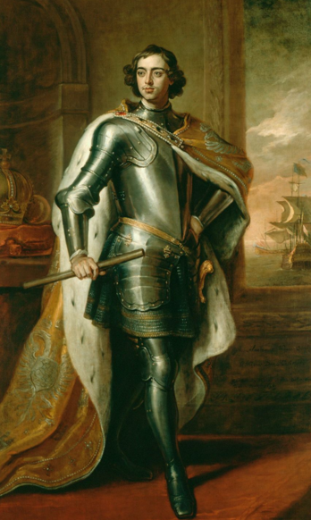
Ivan V
Peter the Great

Slide 10
Peter the Great
Had an older brother (Ivan the V) who should have been tsar
However, he was mentally/physically disabled, both sat on the crown for posterity purposes
Pete & Ivan’s sister (Sophia) had a special window/door she would open on the back of his throne and tell him what to say
Ivan died very young (about 30) and then Pete was able to take over and rule on his own, sent his sister to a convent after Ivan’s death
Wanted to modernize Russia, but did it in a really weird way…
After the passing of his brother he went on a tour of Europe, in “disguise”, to learn about “modernity”

Slide 11
Peter the Great
Wanted to modernize Russia, but did it in a really weird way…
After the passing of his brother he went on a tour of Europe, in “disguise”, to learn about “modernity”
Except, he is almost 7’ tall, traveled with an entourage, and had a heavy Slavic accent
He didn’t fool anybody, but he expected everyone to act like they didn’t know who he was
On the bright side crazy Pete expands Russia, improves their economy, created a strong army/navy, and created alliances (also enemies) all over Europe

Slide 12
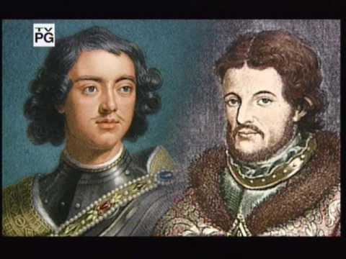
Russia: The Land of the Tsars

Slide 13
Peter the Great!
What were Peter’s biggest accomplishments? Decide 2 and then include specific examples from the textbook.
Was Peter the Great actually good for the Russian people? Give specifics for each side.
How was Peter an absolutist ruler? How was he NOT absolutist?
Compare the rule of Peter and Louis XIV.

Slide 14
1. What were Peter the Great’s biggest accomplishments?
Westernization
Power (Tsar, Russia too)

Slide 15
2. Was Peter the Great good for the Russian people?
YES!
NO!

Slide 16
3. How was Peter an absolutist ruler? Not absolutist?
Absolutist
Not Absolutist

Slide 17
4. Compare the rule of Peter & Louis XIV.
Similar
Different

