Slide 1
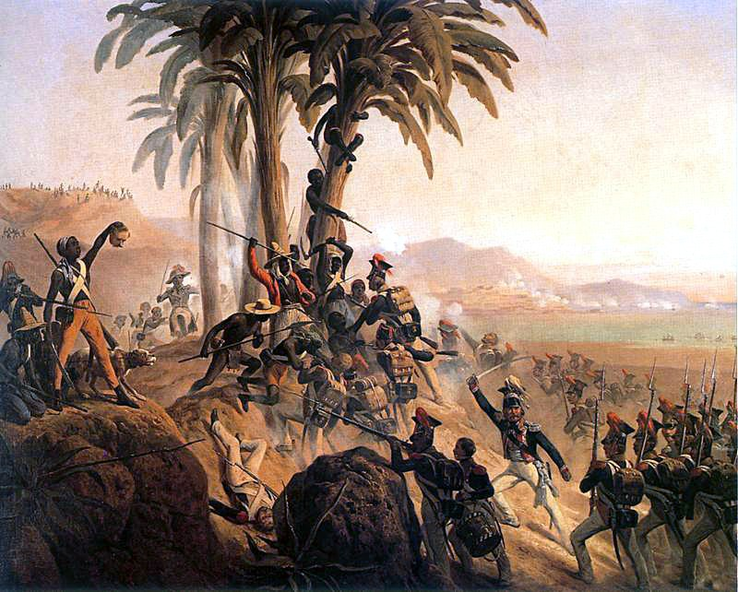
Transatlantic Revolutions
The fever of revolution spreads to the New World

Slide 2
Impact of the Enlightenment, American & French Revolutions
Ideas of the Enlightenment come to Americas around the same time as Europe
Rich peninsulars & creoles were famously “slaves” to European fashion, ideas, culture, etc. until well into the 20th century
Intellectual atmosphere was one that wanted a move to free society, looser caste system, end to slavery, etc., but never really had the stomach to do it
economic (who would produce our resources?),
social (we like having money)
political reasons (church and state tied in Spain so Enlightenment always goes through religion)
American Revolution shows that it is possible for colonies to throw off yoke of colonial power & have pop. sovereignty
French Revolution perpetuates the idea that Europeans are ready for Enlightenment ideals (esp. end to slavery)

Slide 3
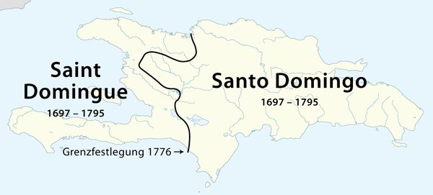
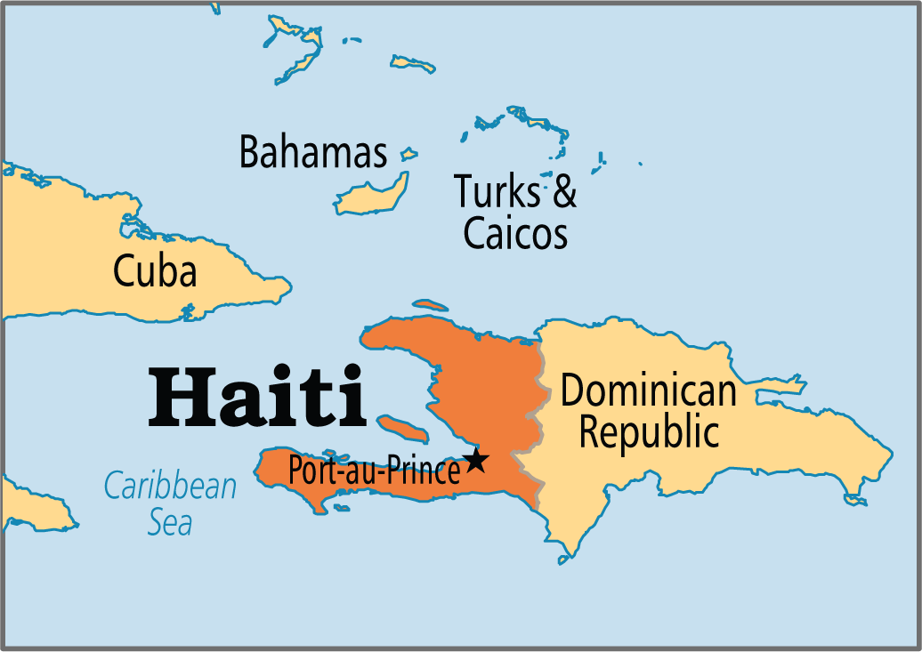

Slide 4
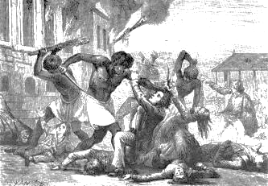
Haitian Revolution Part I
What unique characteristics did the colony of St. Domingue have?
Explain the socio-cultural and political situation prior to the Revolution. Why did it succeed where others have failed?
How did the revolutionaries in France react to the uprising in Haiti?
What do Spain & Britain have to do with the Haitian Revolution?
Who is Toussaint Louverture & why is he important? What was his (and the rest of Haiti’s) style of fighting? What type of governmental system did he establish?

Slide 5
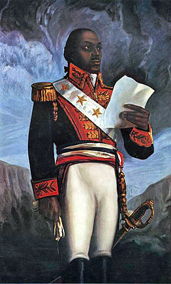
Haitian Revolution Part II
How did Louverture overreach and upset Napoleon? How does this dovetail with the Napoleonic Wars in Europe?
How did Napoleonic France treat slaves and other people of color?
Who ruled Haiti after Louverture? How did he rule & what was his fate?
Why did the Haitian Revolution succeed where other similar revolutions failed?
What was Haiti’s international “status” as a result of the revolution?

Slide 6
Problems in South America
Caste system perpetuates haves vs. have nots
Honor system hampers movement & discussion
Creoles tend to feel stronger nationalism to colonies than homeland
True in American colonies too
Creoles resent Peninsulars for loyalty to the motherland (feels like rule by a foreign power)
Lower classes severely oppressed by both (this is not their Revolution) groups through peonage & encomienda system
Spain and Portugal both tend to rule more absolute & directly than other colonies
Portugal puts virtually no infrastructure beyond money making capacity into colonies
Church still tied closely to state (life more restrictive)
Eventually church will actually side with Revolutionaries & keep strong foothold in Latin America
All the serious money is going back to Europe

Slide 7
Tupac Amaru & other failed attempts
Series of minor revolts throughout Latin America in 18th century
Generally tend to be amongst oppressed workers, natives, or renegade early caudillos outside of cities
Sometimes put down, sometimes not, usually not a major threat till they disrupt the economy or impact cities
Most famous is Tupac Amaru II’s attempted revolt in modern Peru

Slide 8
Tupac Amaru & other failed attempts
Most famous is Tupac Amaru II’s attempted revolt in modern Peru
Amaru was descendent (maybe) of last Incan king, who rallied peasants, natives and lower class creoles in guerilla war
Betrayed & executed (in horrific fashion); led to series of laws by Spanish promising reform (but not delivering) and cracking down on native culture
Led to rebellion in New Grenada
Made Peninsulars uneasy & showed Spanish did not have absolute control

Slide 9
Peninsular War & Bonapartism in South America
Late 1807 Napoleon moves on Iberia
Brings great reforms but underestimates nationalism
Makes brother the King of Spain
Effectively causes Old Spain to lose control on Latin America
Institutes economic reform in Latin America but also causes nationalism to ramp up
Makes Creoles feel like they can and need to take over their countries for themselves rather than be ruled by Napoleon (done in name of popular sovereignty)
Marches on Lisbon
Causes the entire Portuguese court (with help of GB) to relocate to Rio de Janeiro

Slide 10
Latin American Revolutions
Outside of Caribbean can basically be broken down into three key groups:
Mexico
Brazil
Bolivarian Revolutions (rest of Latin America)
Causes variety of different ideas, leaders and results to occur (Bolivar, Hidalgo & Morales, Pedro I, etc.)
Leads to popularity of Caudillos and Conservative Rule → many argue one ruling class replaced another & little changed for a average person
Church generally keeps power it doesn’t have in Europe
Everywhere but Cuba is independent by 1830s

