Slide 1
Some info from yesterday…
Describe the major points (lets say top 3)
Who won?
Any questions?
Gallipoli
Ypres
Isonzo
Jutland
Verdun
Somme
2nd Marne

Slide 2
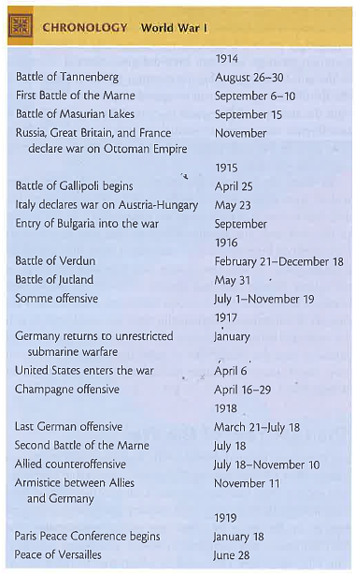

Slide 3
Ending the ‘War to End All Wars’
Table Questions (Spielvogel 787-793 & 803-805)
What factors played a role in breaking the stalemate? why 1917 a turning pt.?
How did the war finally end?
What were the casualties of the war?
What were the problems with:
the war’s ending – Germany, A-H?
with the Paris Peace Conference?
the treaties that were created at the PPC?
Why will these treaties fail?!?!?

Slide 4
Where are we?
Out break of war 1914
Causes
Stalemate by 1915
Italy (A) and Bulgaria (C)
What will break the stalemate?
Verdun and Somme, 1916-1917
But ultimately need…
More Resources – Total War
Mobilization – Total War
US Entry, 1917 – Russia Leaving, 1917

Slide 5
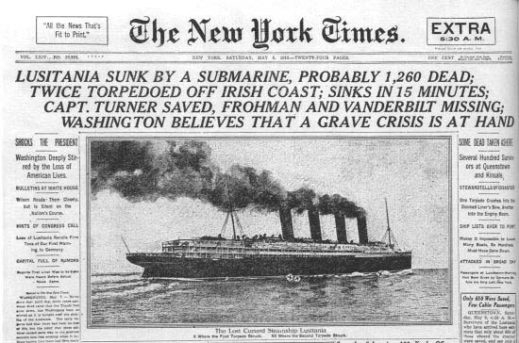
Why does the US enter the War?
Early anti-German sentiment
English blockade of Germany
US really only trades with Allies (can’t get to Germany)
Unrestricted Submarine Warfare by Germany- Sinking of the Lusitania – Sussex Pledge
Zimmerman Note

Slide 6
How did the war end?
Eastern Front
Russia Revolution, calls truce in 1917
Treaty of Brest-Litovsk
US enters the war in April, 1917
German offensive 1918
How far do they get? What goes wrong?
Collapse
Bulgarians collapse, then Ottoman Turks collapse
Austria collapsed – significance?
End of Hapsburg Empire

Slide 7
How did the war end?
Nov. 9th – the German Army tells the Kaiser the war can not continue – he abdicates
Nov. 11th – The 11th day, of the 11th month, at the 11th hour
Socialists take over, declare Germany a Republic – significance?
Born out of defeat…

Slide 8
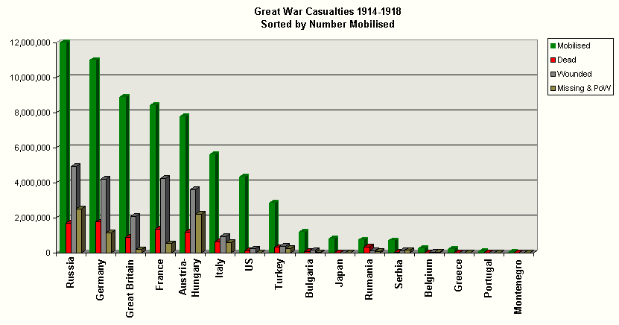
What was the LEGACY of WWI?
What was the legacy of the war?
Why is this significant – why does it matter?

Slide 9
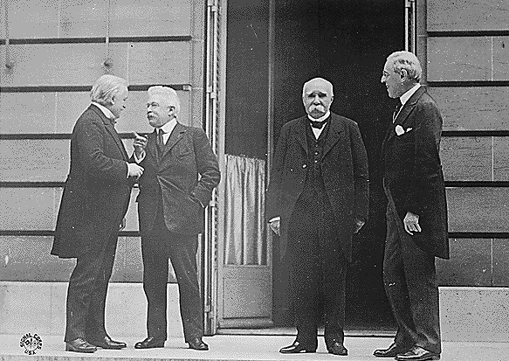
“A Peace Built on Quicksand”
“Peace without victors”
At Versailles – where German Empire born
Closed door session from 1919-1920
excludes both Germany and Soviet Union
Treaty of Versailles
With Germany
Separate for other Central Powers
David Lloyd
George
(Britain)
Georges
Clemenceau
(France)
Woodrow
Wilson
(US)
Although there were delegates from 39 nations at the conference, the important decisions were made by the leaders of the three strongest Allied powers: the US, Britain, and France.

Slide 10
Wilson’s Fourteen Points
Not all 14, but you get the idea…
End to secret treaties
Free trade
Freedom of the seas
Reduced size of armies and navies
Self-determination
League of Nations

Slide 11
“A Peace Built on Quicksand”
What did the Allies want?
US – Wilson wanted?
14 Points
League of Nations
France – Opposite of Wilson
Crush Germany so they never invade France again
GB – middle ground
wanted Germans to pay without ruining Europe
Compromiser
David Lloyd
George
(Britain)
Georges
Clemenceau
(France)
Woodrow
Wilson
(US)
Although there were delegates from 39 nations at the conference, the important decisions were made by the leaders of the three strongest Allied powers: the US, Britain, and France.

Slide 12
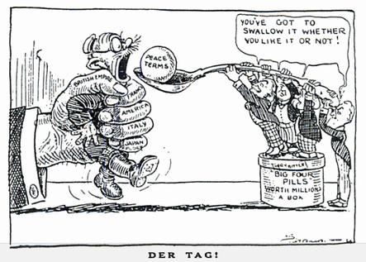
The Treaty a.k.a “DIKTAT”
Rejection of many of Wilson’s ideas -a treaty of punishment
Germans lose 1/3 of land
Germans lose all colonies
Germans lose all territory gained in the east with B-L Treaty
Pay 5 billion until 1921
then a set amount would be determined
Called reparations
Army limited to 100,000, no navy or air force
Article 231 – War Guilt Clause

Slide 13
Punishing the
Central Powers
Germany’s punishment in the ToV can be remembered as:
BRAT
1. Germany had to accept the Blame for starting the war in the form of a “war guilt” clause.
2. Germany had to pay Reparations
3. Germany was forbidden to have an Army over 100,000 men, no navy, and no air force.
4. Germany lost Territory and colonies.

Slide 14
Unstable peace
Treaties also signed with Austria and with the Ottoman Empire
Austria-Hungary broken up into four:
Austria, Hungary Czechoslovakia & Yugoslavia
What does Spievogel say about these treaties?

Slide 15
Unstable peace
Ottoman Empire broken up
Ottomans keep what becomes Turkey
Palestine, Iraq, Jordan go to Britain
Syria and Lebanon go to France
Russian Empire broken up
Finland, Estonia, Latvia, Lithuania, Ukraine (briefly) all become independent of Russia

Slide 16
Legacy of bitterness
No one but France & Britain are happy
Germans bitter and can’t pay reparations
Italians and Japanese bitter
Former colonies in Africa and ex-Ottoman states bitter
Self-determination? BS they say…
Twenty years later…

