Slide 1
Battles & Presentation Dates
Case White & the Invasion of Poland – Maners
Phony War & the Winter War – April 26
Operation Weserübung–April 26
Case Yellow & Case Red, Operation Dynamo, & rest of the Battle of France – April 29
Battle of Britain & Operation Sea Lion – April 29
Operation 25 & Operation Marita – April 30
Battle of the Atlantic–May 1
Battle of the Baltics – Baltic Offensive (German) & Baltic Operation (USSR) – May 2
Operation Barbarossa, the Siege of Leningrad, and the Battle of Stalingrad – May 2
Battle of El-Alamein & Operation Torch – May 3
Operation Citadel & the Red Army’s advance West – May 3
Italian campaign – May 6
Operation Overlord – May 6
Operation Market Garden – May 7
Ardennes Offensive – May 8
Firebombing of Dresden – May 9
Fall of Berlin – May 9

Slide 2
Beginning of World War II

Slide 3
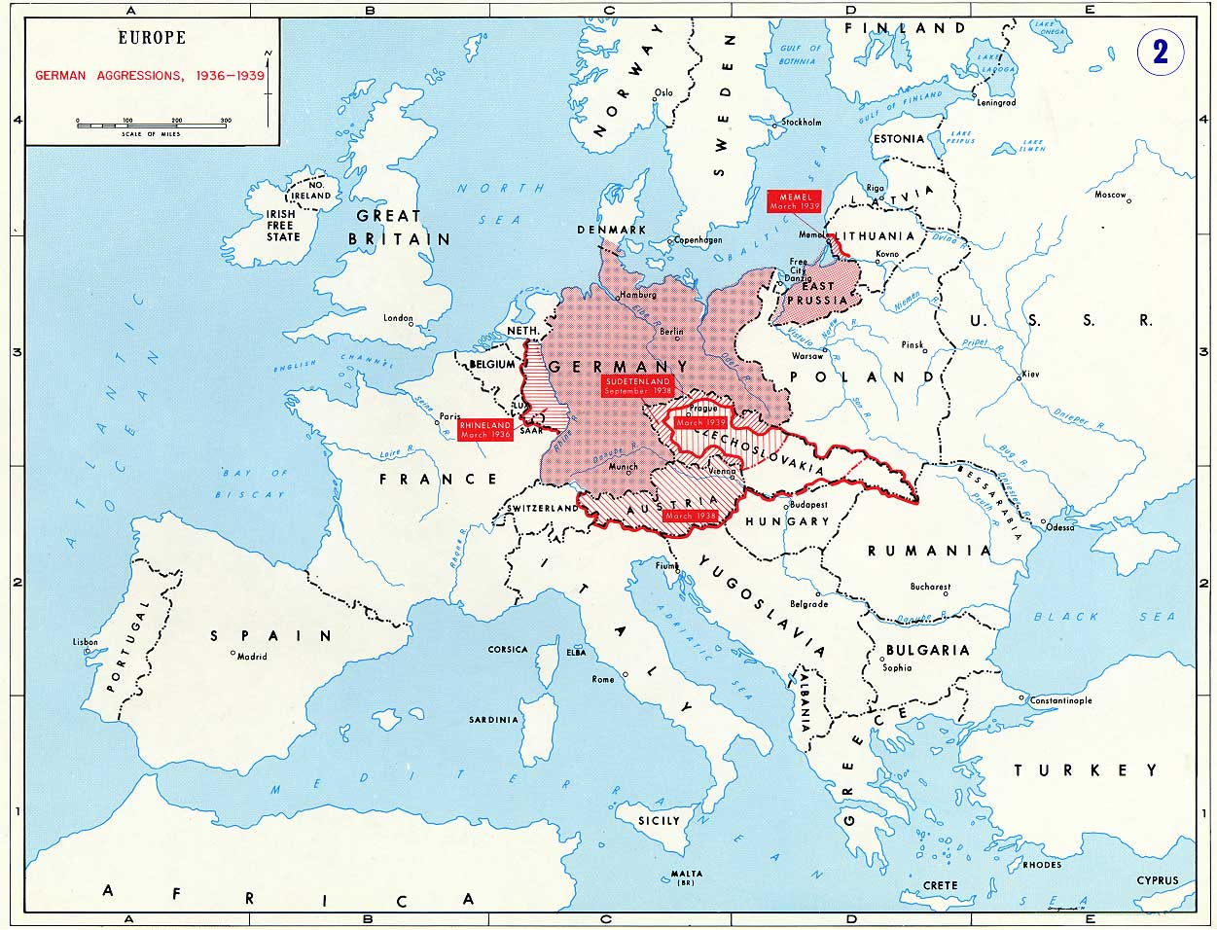

Slide 4
Case White - Thesis
Although the fall of Poland through the Nazi campaign of Case White was speedy and decisive, it demonstrated Hitler’s paranoia as a major weakness in Nazi Germany – ultimately leading to the eventual downfall of the Nazi empire.

Slide 5
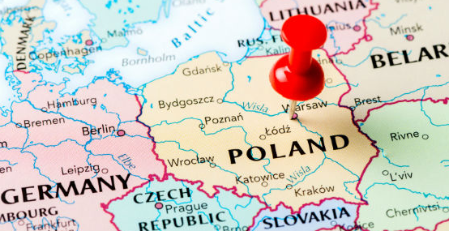
Campaign Background
Case White – The Germany campaign to take Poland starting on September 1st 1939
Known in German as Polenfeldzug (Polish Campaign) or Fall Weiss
Campaign lasts from September 1st through October 5th 1939
Notes:
Talk about the screw up that started on August 26th – Wanted to start but there was mass confusion regarding when to actually start
Hitler gave the official order on the evening of August 31 to start early in the morning on Sept. 1

Slide 6
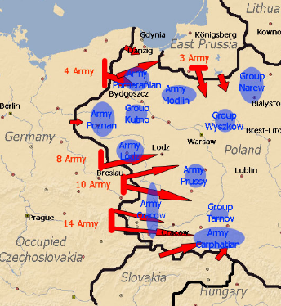
Invasion Plan
Take Warsaw with a weak center division and two strong flanking divisions
Army Group North led by Bock
Take Danzig and work south
Unite with central Army and take Warsaw
Army Group South led by Rundstedt
Take majority of Polish forces in south and punch through and help with Warsaw
Notes:
Battle plan is believed to have come from Schlieffen’s research of Hannibal’s battle tactics at the battle of Cannae – Punic Wars (Romans v Carthage) in others words he studied old battle plans, saw success and implemented
Plan worked extremely well

Slide 7
Case White - Thesis
Although the fall of Poland through the Nazi campaign of Case White was speedy and decisive, it demonstrated Hitler’s paranoia as a major weakness in Nazi Germany – ultimately leading to the eventual downfall of the Nazi empire.

Slide 8
Blitzkrieg
Germans used Blitzkrieg tactics to take Poland
“Relied on very close radio-controlled contact between fast moving tank columns, motorized artillery, Luftwaffe bombers and fighters and truck-born infantry, swept all before them.” (Roberts, 15)
It was these fast moving tactics which used new technology including the Panzer tanks and incredibly fast moving aircraft, the Messerschmitt Me-109 (top speed of 292 MPH) to dominate their opponent and display their superiority.
Nazi’s knew the weapons were superior because of the Spanish Civil War, but now this was an opportunity to test the might of the German soldier on a relatively flat dry piece of land what was not well defended (Roberts, 19).

Slide 9
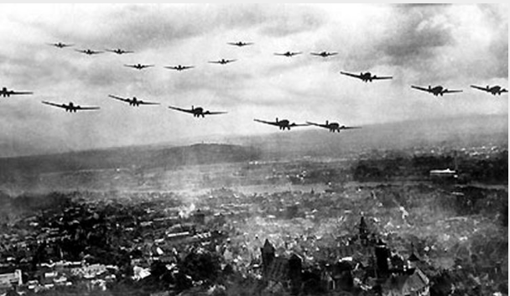
Impact of Blitzkrieg
Why does the style in which the Germans take Poland really matter, thoughts?
Analyze this quote, see if your answer changes
“Blitzkrieg required extraordinary close co-operation between the services, and the Germans achieved it triumphantly. It took the allies half a war to catch up.”
(Roberts, 25)

Slide 10
Impact of Blitzkrieg
The Blitzkrieg tactics used by the Germans were critical for two reasons in the larger picture...
First, the Germans were fast, used new and brilliant technology, and they worked together flawlessly. This would ultimately give them success for the first half of the war (Roberts, 25).
Second, because they were using all of this new technology with these new tactics the rest of the world would struggle to catch up slowing the pace for allied victory (Roberts, 25).
In Poland - The German offensive included heavy air attacks against Polish air bases and military targets in Warsaw
Collateral damage and civilian casualties were high

Slide 11
French & British Response
Prior to the start of Case White the Polish government was fearful of German invasion, April 1, 1939
Create a pact with France and UK for help if Germany invades – Both agree reluctantly
This was public knowledge so Hitler leaves his weakest troops on the Siegfried Line with only 3 days worth of ammo
France & UK declare war on Germany September 3, 1939
Once Case White ensues the French attack the Germans (kind of) on Sept. 6th
The British don’t even show up until on continent until September 10th
Notes:
Both France and UK are afraid of bombing raids on Paris and London – Both declare war on September 3rd (again reluctantly)
France sends a few troops over the Siegfried Line and they take 12 abandoned villages, then retreat 15 days later
Needless to say the French and UK don’t really do anything
Hitler didn’t even send reinforcements to the German troops on the Siegfried line

Slide 12
French & British Response
Britain and France honored their promise to the Poles and declared war on Germany
Hitler had thought Britain and France would not go to war
He had said, he had seen his “enemies at Munich and they were worms”
The Allies were unprepared to launch an offensive into Germany at this point in the war
Instead of trying to relieve Poland, the British and French concentrated on mobilizing and preparing to halt the Germans when they turned toward the west
The failure to exert any real pressure on the Germans allowed Germany to continue building its industrial might and prepare for its 1940 offensive
Notes:
Both France and UK are afraid of bombing raids on Paris and London – Both declare war on September 3rd (again reluctantly)
France sends a few troops over the Siegfried Line and they take 12 abandoned villages, then retreat 15 days later
Needless to say the French and UK don’t really do anything
Hitler didn’t even send reinforcements to the German troops on the Siegfried line

Slide 13
Hitler’s Paranoia
Hitler was one of the most (documented) paranoid leaders in history.
How does his placing troops on the Siegfried Line prove that?
Analyze the quote and see if you can figure out why he is paranoid? (Page 22)
The quote proves Hitler’s paranoia for a couple of reasons
First, both Belgium and Holland were neutral
Second, this scheme is incredibly far fetched and would have been very challenging to coordinate

Slide 14
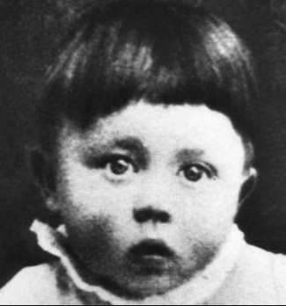

Slide 15
Soviet Involvement
To make matters worse, the Soviet Union moved into eastern Poland on September 17 to “protect” the local population
September 17th USSR invades and takes the eastern half of Poland
Stalin revenge against the Poles from previous 1920 engagement, access to the Baltic, and a buffer between Germany and USSR
Only lose 734 men
Red Army transports and executes 4,100 Polish Officers
Ultimately executes about 22,000 Polish soldiers – Katyn Massacre
Blame the Germans late in the war, which was also supported by the Allied powers even though they were aware that the Soviets were responsible
Not recognized until 1972 by British

Slide 16
German-Soviet Relations
Why would the German/Russian alliance be doomed from the start?
Old relationship (WWI)
Stalin and Hitler - paranoid
“An alliance whose aim does not embrace a plan for war is senseless and worthless. Alliances are concluded only for struggle.” – Mein Kampf

Slide 17
Case White Results
Poland falls, split between Germany and USSR
Molotov-Ribbentrop Pact enacted
France and Britain declare war on Germany/USSR
Enacts the last part of Lebensraum – “Danzig is not the real issue; the real point is for us to open up our Lebensraum to the east and ensure our supplies of foodstuffs.”
Starts the subjugation of slavs, Jews, etc… Untermenschen (subhumans) according to Mein Kampf

Slide 18
Case White Results
Starts the demise of Polish citizens – over 17% of the nations population was lost during WWII
Germans only lose 8,082 soldiers and have 27,278 wounded
Poles lose 25,000 civilians, 70,000 soldiers, and have 130,000 soldiers wounded
Proves to the world that Germany’s Blitzkrieg tactics were successful and their soldiers were now battle tested
“The operations were of considerable value in blooding our troops…and teaching them the difference between real war with live ammunition and peacetime maneuvers”
SS begin doing their dirty work… (page 27-29)

Slide 19
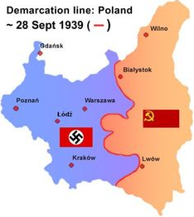

Slide 20
Case White & Invasion of Poland
The end!

