Slide 1
https://www.youtube.com/watch?v=1uapVCH6hjU watch 2:10 to 22:00 minutes

Slide 2
Berlin Crisis
2. Why did Khrushchev decide to make Berlin an issue?
3. Describe the events leading up to the building of the wall.
Nov 1958-Khrushchev demands Berlin… why?
Ulbricht complains… more $ & political freedom in West German part of Berlin
East not a prosperous as the West
2 million + flee, resulting Brain Drain
Disrupt US-West German alliances (Washington-Bonn access)
West unites-Khrushchev backs down-goes to US for meeting in August 1959 which goes well, BUT…
Kennedy comes in & Khrushchev pounces
August 31, 1961 the wall goes up
US does nothing for a long time… eventually steps in, but not to halt the building of the wall in any way

Slide 3
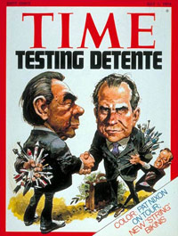
Détente: An easing of tensions?
The Cold War: 1968-1982

Slide 4
Thesis
Realizing that the Cold War was having a varied, but unnecessarily heavy influence on their economies, the US & USSR tacitly agreed to a détente, or easing of tensions. However, neither side was willing to give up the fight, & both secretly did not adhere to all of the measures agreed upon in their various treaties (they liked the spirit of détente more than the actual actions, & no one was willing to risk losing any power or hegemony). The result, was that when it became economically & politically expedient, both sides abandoned détente in favor of renewed tensions & a revived Cold War.

Slide 5
Détente
The idea that the US and USSR enter a period where neither side wants to escalate, and although unspoken, both sides attempt avoid conflict
The easing of tensions
This period lasts from 1962-1982ish
Both sides don’t really want to lose this fight
In reality both sides are willing to either create new tensions, or renew old tensions in order to maintain power

Slide 6
Demise of Nikita Khrushchev
March of 1964, USSR’s economy is in a bit of a depression
No injection of new cash from satellite states, and having to drop tons of money in Cuba
Hardliners within the party are also upset he stood down when faced with pressure in Cuban Missile Crisis
Feel Soviet influence in the world is waning
Sino-Soviet split only furthers this (more on this later)
With Khrushchev out of the country, his understudy, Leonid Brezhnev begins conspiring with other key members of the Politburo

Slide 7
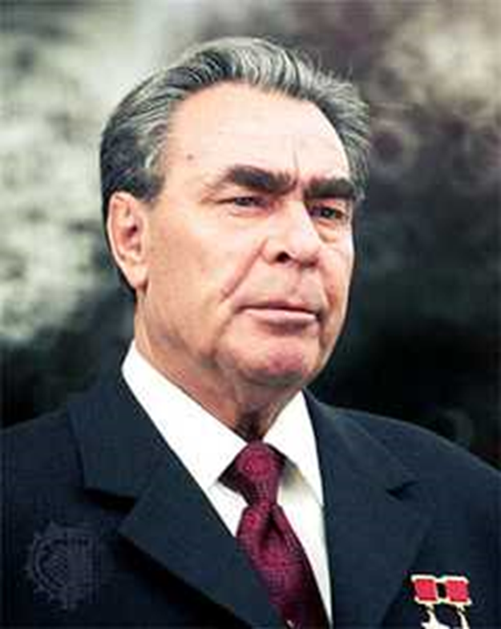
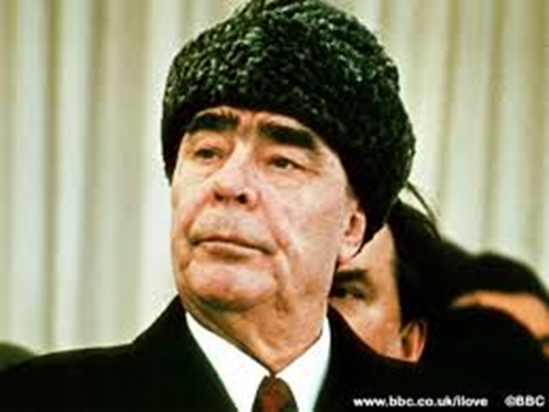
Demise of Nikita Khrushchev
Brezhnev strikes when Khrushchev is on vacation in the Black Sea (October ’64)
Khrushchev put up no resistance, goes into retirement:
"I'm old and tired. Let them cope by themselves. I've done the main thing. Could anyone have dreamed of telling Stalin that he didn't suit us anymore and suggesting he retire? Not even a wet spot would have remained where we had been standing. Now everything is different. The fear is gone, and we can talk as equals. That's my contribution. I won't put up a fight.”
Brezhnev now General Secretary, will be till 1982

Slide 8
Subversion & Radio Free Europe
After the events of 50s & early 60s, part of Eastern Europe are getting restless
General rule of thumb: closer you are geographically and culturally to the West, the more restless you get.
USSR does some stuff to crack down (Berlin Wall, etc.) but fear from Stalin era no longer exists
Becoming a clear socioeconomic gap between West & East & people are starting to notice
West foments subversion with Radio Free Europe → station funded by the US that gives Western info (and propaganda) to places “where the free flow of information is either banned by government authorities or not fully developed”

Slide 9
Prague Spring 1968
What was the new economic reform and what occurred as a result of it?
What did Dubček do in April of 1968? Why is this important?
Why did the events in Czechoslovakia bother the USSR? How did the USSR invoke the Warsaw Pact to do something about it? (Be sure to explain the Bratislava Declaration.)
Describe the surprise invasion of Czechoslovakia in August of 1968 in detail. How does it compare to the invasion in Hungary in 1956?
Who replaced Dubček and what did he do to the results of the 1968?

Slide 10
Prague & its aftermath
August 3rd – Dubček meets with Soviet leadership to defend program
Bratislava Declaration – what is this?
August 20th 1968 members of the Warsaw Pact invaded Prague
Mainly just the Red Army
To avoid bloodshed the Czechs were told not to resist the invasion
Dubček summoned to Moscow then declares that reform program would becoming to an end.
Spring of ’69 Gustáv Husák replaced Alexander Dubček.
USSR issues the Brezhnev Doctrine – what is this?
Havel and others regroup and continue their non-violent dissent
Havel does this through a number of plays, most famously “The Memorandum”
Publishes Charter 77 Manifesto (w/ “Power of the Powerless”) after the arrest of Plastic People of the Universe
Reinvents group as Civic Forum

Slide 11
https://www.youtube.com/watch?v=54Cvqxjtr9w 32:32 to end

Slide 12
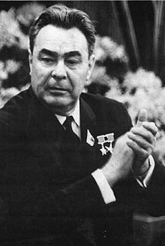
Brezhnev Doctrine
When forces that are hostile to socialism try to turn the development of some socialist country towards capitalism, it becomes not only a problem of the country concerned, but a common problem and concern of all socialist countries.

Slide 13
Man on the Moon: The Space Race
October 4, 1957 USSR had stunned the world and launched Sputnik
Caused a massive panic in the US—people thought we were now behind USSR in technology
Between this and the US being “stunned” by USSR atomic tests, we’re feeling fairly behind
Led to criticism & reform of the US education system
April 12, 1961 Yuri Gagarin becomes the first man in space
Hurts US pride even more
Seeing that the USSR has beaten the US in lots of other areas in space, then president Kennedy directs NASA to begin focusing on landing a man on the moon
Finally comes to fruition under Nixon (Law ’37) administration on July 21, 1969 when US lands on the moon
Restores American pride; Americans realizes they're not behind the USSR
Starts USSR overspending to catch up (part of USSR’s eventual downfall)

Slide 14
Détente & SALT I & Helsinki
Détente: An easing on tensions. Generally agreed upon dates are roughly 1969-1979
Begins under the Nixon (Law ’37) administration
Nixon (Law ’37) is a foreign policy genius (see: China) and his Sec of State is Henry Kissinger, who is too
Kissinger is obsessed with RealPolitik and its use in European History
Meanwhile USSR’s economy is stagnating and they’re following a policy of simply keeping pace with US on nukes
US is also mired in Vietnam which the USSR wants to exploit
Both sides could stand some extra cash, and with MAD theory assured several times over, there is nothing to gain from more nukes
Two sides tacitly agree to meet and after two years of talks they sign the first Strategic Arms Limitations Treaty (SALT I)
Freezes the number of nukes and sets a cap that each country can have
In August of 1975 they meet again and sign Helsinki Accords, which calls for improved relations between East & West

Slide 15
Pope John Paul II
October 1978 College of Cardinals elects Karol Wojtyła Pope John Paul II
Direct affront to Eastern Bloc
Traveled to Poland in 1979; popularity resonated with the Polish people
It was this trip that caused Joseph Nye to coin the term “soft power”
“When Pope John Paul II kissed the ground at the Warsaw airport he began the process by which Communism in Poland—and ultimately elsewhere in Europe—would come to an end” –John Lewis Gaddis
Rejuvenated the Polish people and led to the formation of Solidarity

Slide 16
Solidarity & Poland
Solidarity is a Polish self-governing trade union led by Lech Wałęsa that developed into an anti-communist movement
Begins: August 14, 1980: Wałęsa leads a strike at the Lenin Shipyard in Gdansk with 17,000 people
Strike was illegal; Polish gov’t will ok strikes by the end of the month (known as Gdansk Agreement)
Sept 1980, Wałęsa founds Solidarity
Protests continue & by Dec 1981, Solidarity and strikes are illegal
By this point 1 in 3 working Poles is a member of Solidarity
US is secretly funneling them lots of money
Polish gov’t imposes martial law, arrests Wałęsa
Would have gone further but the Pope threatens to go back to Poland and march with Solidarity if USSR sends in troops
By 1983, Pope John Paul II is supporting Solidarity; US and UK begin open support by 1985

Slide 17
Vietnam, Afghanistan, & the end of the Brezhnev era
Despite the era of détente, US & USSR have been fighting two huge proxy wars: Vietnam and Afghanistan
US gets involved in Vietnam with ground troop March 8, 1965 → war lasts in some way till 1974
USSR get involved in Afghanistan in 1979 → lasts in some way till 1989
Both countries fund groups, train soldiers, funnel money, etc. in an attempt to hurt their opposite
US leads boycott of 1980 Summer Olympics to protest Afghan war—generally seen as the end of détente
Arms races, etc., begin again
Brezhnev dies in 1982
Eventually succeeded by Mikhail Gorbachev; meanwhile US has elected a new president: Ronald Reagan

