Slide 1
The End of World War II
May 8, 1945
(MEMORIZE IT)

Slide 2
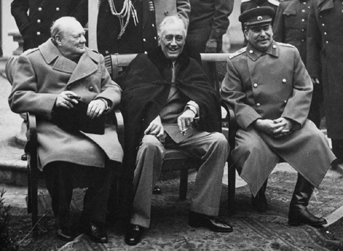
Yalta & Potsdam
Churchill, Stalin, FDR meet at Yalta (Russia) & agree to divide up Germany @ end of the war
Truman, Atlee, & Stalin meet again at Potsdam & agree:
free & fair election in Europe after war
USSR jumps in and helps in Japan
Side note: Neither of these happen
Truman tries to scare Stalin
by telling him about bomb,
but Stalin knows because of
his spies

Slide 3
End of the war
Russians invading from the east
6 million troops
Britain, France and US invade from the west
3 million troops
Hitler commits suicide
Berlin is pounded into rubble by Soviets
Germany surrenders May 7, 1945
New Chancellor Karl Doenitz signs unconditional surrender papers May 8, 1945

Slide 4
Aftermath
Many great cities left undamaged
Brussels, Paris, Rome, Prague
Many others severely damaged or destroyed
Huge sections of London in ruins
Warsaw – 95% destroyed
Central Berlin – 95% destroyed
Rotterdam (Netherlands) – 90% destroyed

Slide 5
Aftermath
Millions of people displaced
Homes, cities, families lost
Survivors of concentration and labor camps = DPs
Agriculture disrupted
Famine and starvation become widespread right after the war
No infrastructure for economics to resume
Some governments survived
Scandinavian countries, Netherlands, Belgium, Britain
Some of course did not
Germany, Italy
France – Vichy France was a puppet state
Communism becomes very attractive…

Slide 6
Marshall Plan
Created by Sec. of State George Marshall
13 billion $ (roughly 5% of GDP) went to rebuilding Western Europe
Would have been more but USSR would not let Eastern Europe take it
Europe did not have to pay it back
Most went to Britain and France
Mainly from 1947-1951
Helped contain communism

Slide 7
Divided Germany
Originally divided into 4 zones…
UK, US, and France combine to form West Germany and hold free and fair elections
USSR installs puppet government into East Germany—the country will not fully reunite until 1989
Problem is, Berlin is also divided and it sits in the heart of the USSR zone (now East Germany)

Slide 8
United Nations
Wilson’s League of Nations had failed
US never joined it
Unable to prevent WW II
Allies create United Nations at meeting in SF
HQ in NY
April 1, 1945 – UN Charter approved
US, China, USSR, Britain and France are the five permanent members of the Security Council
Sec. General (António Guterres of Portugal – 9th SG)
Can veto any policy approved by the General Assembly
Mostly still works today

Slide 9
Nuremberg Trials
Allied Military Tribunal = first trials of war criminals in history
Choose Nuremberg because it was location of famous Nazi party rallies
4 countries (USA, France, UK, USSR) each have one judge and a legal team (head judge = UK head lawyer = USA)
US has most of key Nazis so USSR has to work with US
22 Nazi leaders put on trial
Conspiracy to wage war
Waging aggressive war
War crimes
Crimes against humanity
Some commit suicide before standing trial (Hitler, Goebbels, Himmler, Bormann, Rommel, Ley, etc.)
Eleven sentenced to death, 10 (Goering commits suicide) Nazi officers hanged in October 1946
Other acquitted (3) or given varying sentences
Precedent for future war criminals and ICC today

