Slide 1
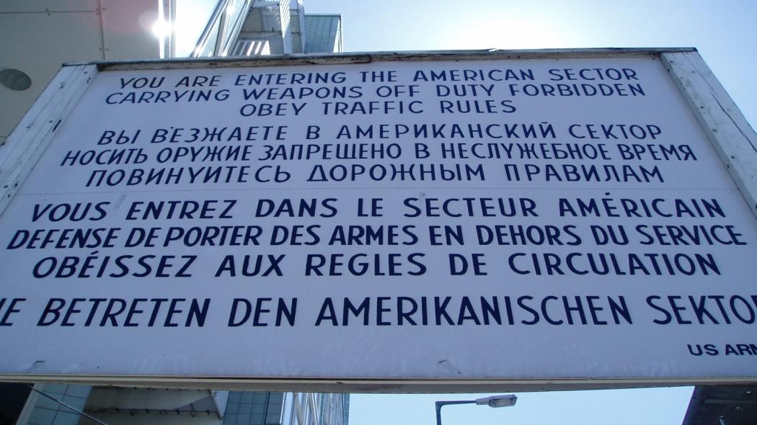
The Cold War: An Introduction
From Allies to Enemies & Cold War Theory

Slide 2
Thesis
The West's fear of communism and perception that the USSR reneged on a series of deals made at various conferences at the end of World War II, coupled with Joseph Stalin's paranoia about at Third World War led to an increasing divided between the Allies at the end of World War II. This caused tacit escalation on both sides resulting in the perception that two ideologies were opposite and incompatible. The result was a series of moves isolation and dividing Europe between East and West, resulting in the Cold War.

Slide 3
What is the Cold War?
The Cold War is a series of escalated diplomatic and economic conflicts centering around a feud between the USA & the USSR. It is called the Cold War because there was never direct declared conflict between the two countries (i.e. "hot war"). Having said that, the Cold War contained a series of proxy wars to go along with the economic and diplomatic discord—it was a conflict of hard and soft power.

Slide 4
What’s going on at the end of WWII in Europe?

Slide 5
At first, there are signs of cooperation…

Slide 6
United Nations
Wilson’s League of Nations had failed
US never joined it
Unable to prevent WWII
Allies create United Nations at meeting in SF
HQ in NYC
April 1, 1945 – UN Charter approved
US, China, USSR, Britain and France are the five permanent members of the Security Council
Can veto any policy approved by the General Assembly & have veto power on Security Council
Led by Secretary General
Currently Antonio Guterres of Portugal
Mostly still works today (in the sense of not causing WWIII, not really in the sense of efficiency ☺)

Slide 7
Nuremberg Trials
Allied Military Tribunal = first trials of war criminals in history
Choose Nuremberg because it was location of famous Nazi party rallies
4 countries (USA, France, UK, USSR) each have one judge and a legal team (head judge = UK; head lawyer = USA)
US has most of key Nazis so USSR has to work with us
22 Nazi leaders put on trial for various crimes including: conspiracy to wage war, waging aggressive war, war crimes, crimes against humanity
Some commit suicide before standing trial (Hitler, Goebbels, Himmler, Bormann, Rommel, Ley, etc.)
Eleven sentenced to death, 10 (Goering commits suicide) Nazi officers hanged in October 1946
Others acquitted (3) or given varying sentences
Precedent for future war criminals and ICC today

Slide 8
But things go downhill fast… (US/Britain trying to avoid the same mistakes as Versailles; USSR is more out for revenge; France is just chilling trying to get a voice at the table—generally tend to side with US & Britain—generally)

Slide 9
Marshall Plan – 1947
US realizes it is in its best interest to have an economically strong Europe (huge trade partner) and they want to avoid a second Versailles (massive inflation in Germany)
Created by Sec. of State George Marshall the plan involved 13 billion $ (roughly 5% of GDP) to rebuild Western Europe
Would have been more but USSR would not let Eastern Europe take it
Europe did not have to pay it back
Results
Most went to Britain, France, and (the future) West Germany
Mainly from 1947-1951
Helped contain communism

Slide 10
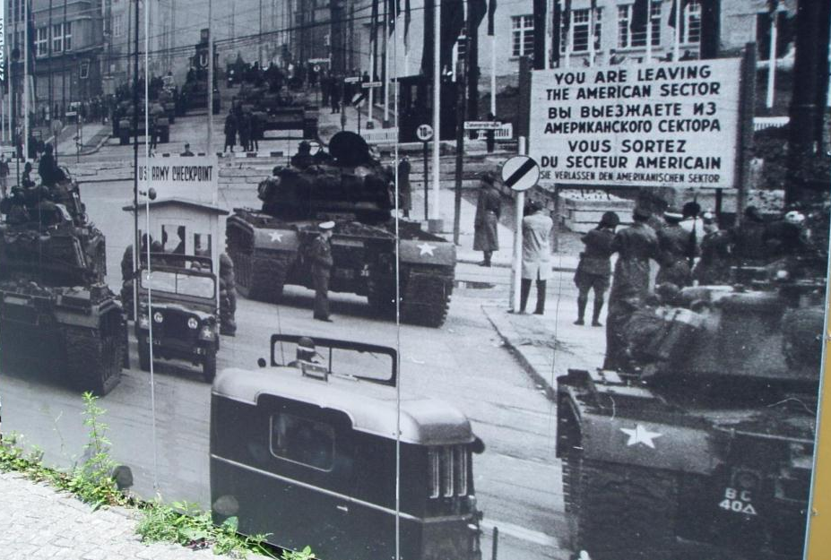
Divided Germany
Germany divided in four zones, one for each of the conquering powers
USSR gets there first & claims the “best” zone (E. Prussia & fashionable end of Berlin)
UK, US, & France eventually combine to form West Germany and hold free and fair elections (1949)
USSR “elects” puppet government into East Germany
The country will not fully reunite until 1990
Problem is, Berlin is also divided & sits in the heart of the USSR zone (now East Germany)

Slide 11
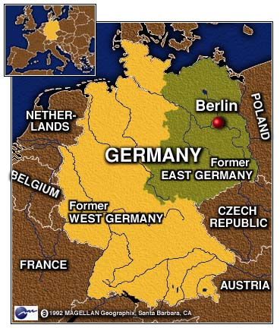
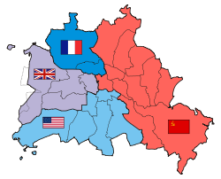
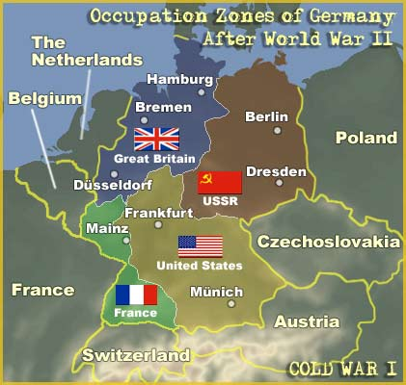
A divided Germany, a divided Berlin

Slide 12
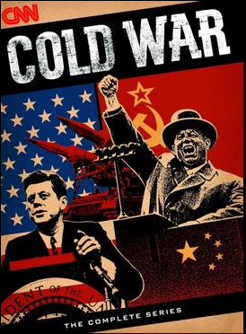
CNN – Cold War Series
Will watch a few episodes
Older, but GREAT information
Episode 2 – “Iron Curtain”
Post war and origins of the rise of the Cold War
Fill out viewing guide & pay attention to:
Greece and Turkey
Satellite States
Poland and Germany
George Kennan’s Telegram
Clifford-Elsey Report

Slide 13
Greece & Turkey
Who was governing/funding Greece and Turkey at the end the of the war?
Why did they pull out?
What happened in Greece? Be specific
Why did this happen?
What was the US afraid would happen in Turkey and why?
Why did the United State not feel like it could “lose” Greece and Turkey? (analyze this in terms of Cold War Theory)
What did the US do as a result of this fear?
What was the outcome of these incidents?

Slide 14
Long Telegram & Iron Curtain Speech
Let’s look at your answers from the CCN program you just watched…

Slide 15
Berlin Airlift – 1949
US proposes to extend Marshall Plan to Germany—first step in creating West Germany—which upsets USSR, which wants a weak German state
Comes to a headway with Currency Crisis:
Allies proposed to re-center and create a new Deutschemark to replace to the Reichmark and restabilize the German economy
Stalin wanted a weak Germany (saw this as only way to prevent WWIII) & opposed it
At this point, USSR starts mini-blockade, claiming that everything going in and out on rails has to be searched by Soviet troops
Causes US to start “Little lift” & begins building up food supplies
Allies began introducing it anyway…

Slide 16
Berlin Airlift
Soviet response is to blockade, beginning in full on 6/24/48
Other Allies had not signed a formal agreement with USSR on ground routes, relying on goodwill
In 1945 they had signed a formal agreement on air routes and open access to Berlin
Truman and other Allies decide to respond with an airlift
This would not be easy, they’d need to bring in 1,534 tons of food & 3,457 tons of coal/gas, to support West Berlin’s 2 million citizens, a day
Planes took off/landed in Berlin every 30 seconds, flying 300,000+ flights
Airlift ended when USSR backed down 4/15/49

Slide 17
Truman Doctrine, Domino Theory, & NSC 68
First step in “dealing with” the Red Threat is the Truman Doctrine →
What does it say?
What was is based on?
Why does it matter?
Policy of Containment, issued in March 1947
Shifts the US from policy of détente
Becomes backbone of US foreign policy for the Cold War

Slide 18
Truman Doctrine, Domino Theory, & NSC 68
Second Step: Domino Theory
In the years right after WWII, it seems, to the US, that communism is spreading a lot
Stalin has now flipped sides and embraced Trotsky’s Permanent Revolution (the opposite of Socialism in One Country) and is spreading communism through Eastern Europe
China is in the process of a long Communist Revolution
Greece and Turkey are threatened
Berlin Crisis
Common idea that comes out of the State department by 1950s in Domino Theory → Containing Communism is like a game of dominos, if you let one country fall, other around it will fall, etc., till they all fall

Slide 19
Truman Doctrine, Domino Theory, & NSC 68
Final step: NSC-68
Committee of the best minds on the National Security Council (NSC) studies both containment & domino theory - concludes those are the best policies to follow
Solidifies this in NCS-68 a top secret memo that makes these official US policy
Will be US policy through 1980s (though it’s reigned in some)
Direct reason for involvement in Korean and Vietnam War

Slide 20
NATO & the Warsaw Pact
By 1948 “elections” have been held in Eastern Europe (places under USSR control after the war) and have been swept by Communists, who outlaw other parties
To try a solidify their partners and contain communism to the so-called Eastern Bloc, US creates a new international organization called the North Atlantic Treaty Organization (NATO)
Have to be a democracy (both nominally and partially in practice)
Have to be in N America and Europe (we create SEATO for Asia)

Slide 21
NATO & the Warsaw Pact
To try a solidify their partners and contain communism to the so-called Eastern Bloc, US creates a new international organization called the North Atlantic Treaty Organization (NATO)
Have to agree to have 2% of GDP go to military
Have to agree to collective defense → “attack on one is an attack on all”
Have to be anti-communist and liked by the US for either historical or strategic purposes (this is the unwritten rule)
By 1955, USSR has responded by having its satellite states sign the Warsaw Pact and Europe is very, very clearly divided

Slide 22
Soviet Bomb & Mutually Assured Destruction Theory (MAD)
August 29, 1949 Soviet detonate their first test atomic bomb
US thought they were about 10 years behind that
World now has two nuclear powers, and a stockpile begins
This leads us to Mutually Assured Destruction Theory, which is illustrated in The Butter Battle Book by Dr. Seuss (may read later in the unit… time permitting)

Slide 23
Keylor 292-297
Why does Soviet foreign policy change in the mid to late 50s? (hint: there are multiple reasons)
What were the actual changes in policy? (hint: this is the WHAT, not the WHY – that is the previous question)
What is de-Stalinization?
What is the impact of de-Stalinization?
Why were the results different between Poland and Hungary?

Slide 24
CNN – After Stalin (Episode 7)
Picks up right after Khrushchev's Speech @ the Twentieth Congress
Keep in mind the following questions…
Add more complete answers to your notes
4. What is the impact of de-Stalinization?
5. Why were the results different between Poland and Hungary?
21:46 to end
or 28 to end for just Hungary

