Slide 1
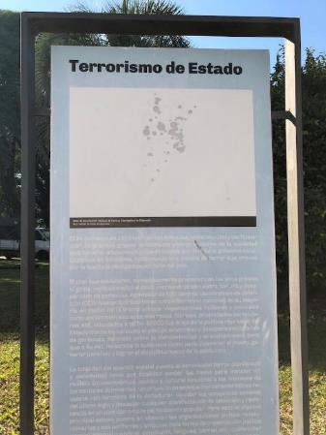
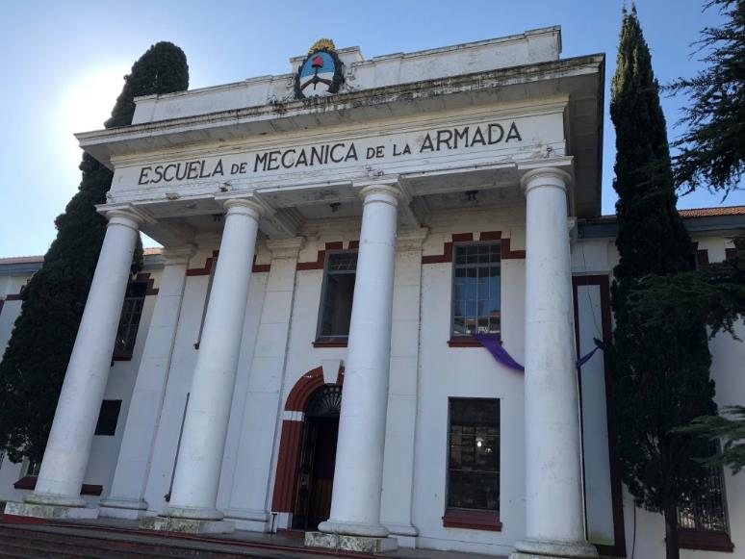
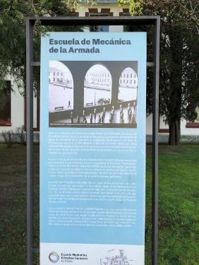
The ESMA

Slide 2
a note
While it is a massive tragedy on a lot of levels, the Dirty War in Argentina is most famous for one thing: abducting pregnant women, imprisoning them until they gave birth, murdering them, and giving their newborn to a “worthy Argentine family”—usually one with close ties to the Navy. There was an official list. Of the over 400 children abducted, about 25%’s true identity have been discovered.

Slide 3
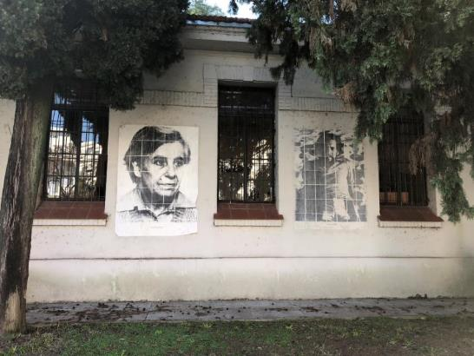
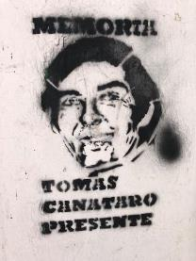
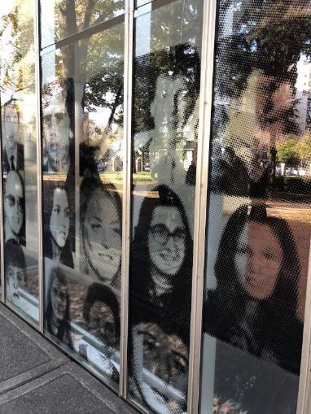
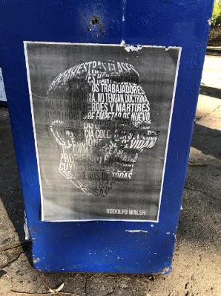
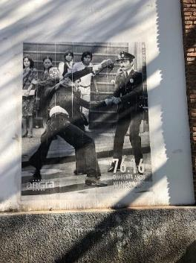
The outside of various buildings and the grounds of the ESMA: pictures of the Disappeared.

Slide 4
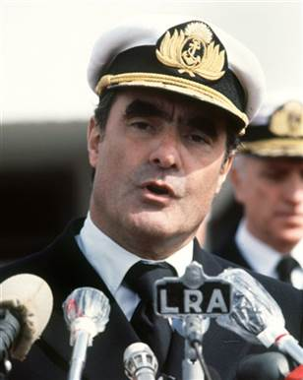
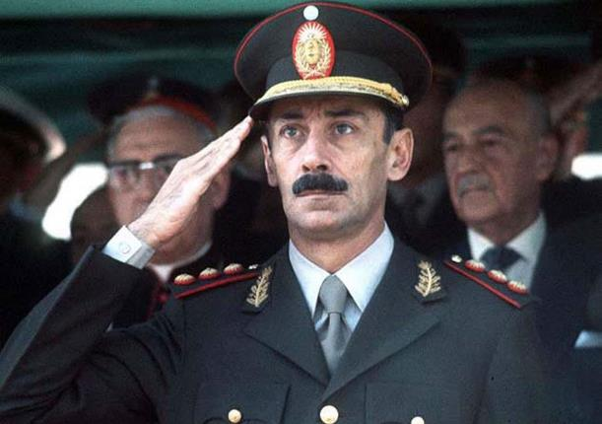
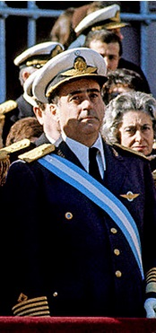
The original junta of the Last Dictatorship
On March 24, 1976, after several months of civil unrest and secret planning, the Argentine military deposed President Isabel Peron, a move that was met with massive popularity. Author Jorge Luis Borges commented after the coup, “now we can be ruled by gentlemen.” In order to keep up appearances of unity and separation of powers the each branch of the military nominated its head to share power in a junta. From left to right Emilio Massera, Navy; Jorge Rafael Videla, Army; Orlando Agosti, Air Force. Massera took control of propaganda, Videla was named President of Argentina and of the junta from 1976-1981, and Agosti had the smallest role.

Slide 5
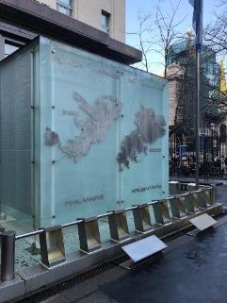
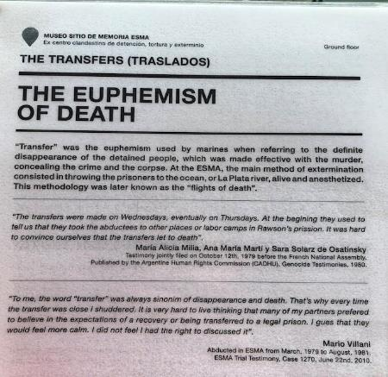
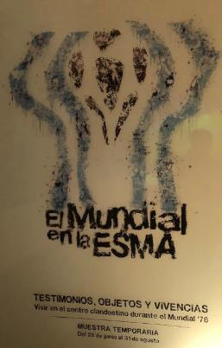
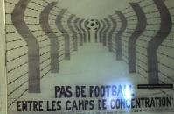
The Process
Proceso de Reorganización Nacional or The National Reorganization Process, or simply el Proceso, The Process, was a euphemism developed by its “grand orator,” Emilio Massera, for the state sanctioned terror that occurred under the junta between 1976-1983, when disaster in the Falkland Islands war led to the collapse of military rule, and the return of democracy. The state terror—abductions, torture, and “transfers”—a euphemism for drugged flights of death—was directed at leftist groups in an effort to “save Argentina and Western Civilization from World War III.” This was during the height of the US anti-communism policy in Latin America known as Operation Condor. At least 9,000 people, but no more than 30,000 people were “disappeared” during this time. The terror was greatest from 1976-1979 and the junta most popular in 1978 with a decent economy and Argentina’s victory in the World Cup, which they hosted that year.

Slide 6
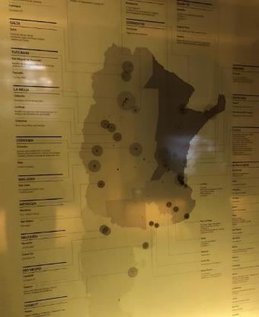
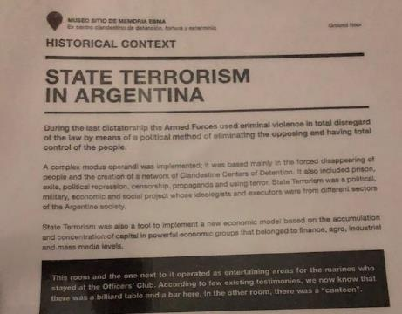
The Process, which included a network on clandestine camps was originally aimed at left-wing groups, but most of those had been eradicated by 1979, which allowed the government to focus on anyone it didn’t like—anyone without “Catholic Western Christian values”. The largest and most feared was at the Escuela de Mecanica de la Armada (ESMA) in Buenos Aires, sometimes called the “Argentine Auschwitz.”

Slide 7
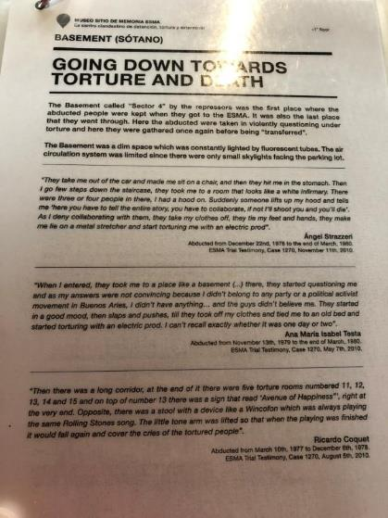
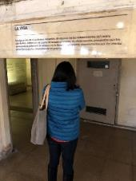
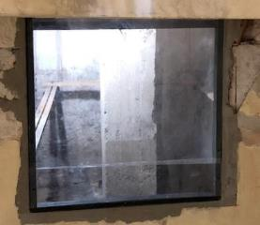
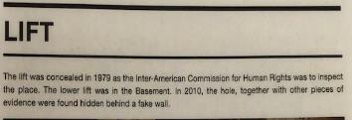
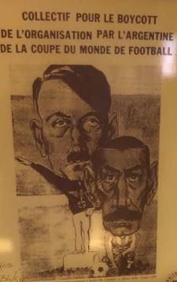
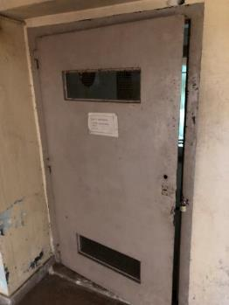
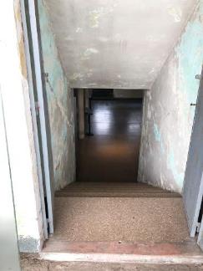
Starting in 1976 people began disappearing, something that soon became a proper noun during this terror. They were taken by the military or local police, off the streets, at school, or in the homes, usually at night, much like early Nazi abductions, which that led to early comparisons between Videla and Hitler. After being taken they were driven to the ESMA, and their introductory torture began.

Slide 8
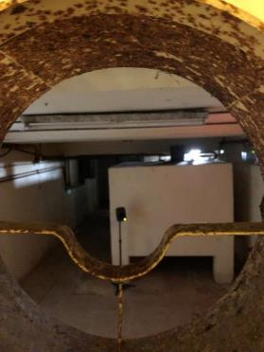
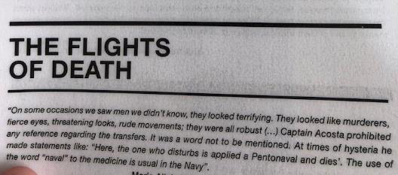
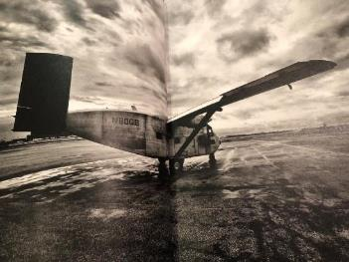
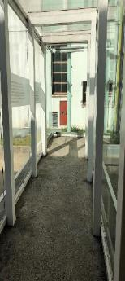
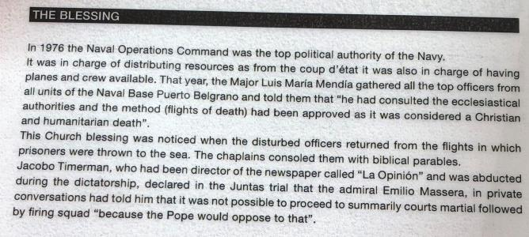
After the initial torture, victims were placed in one of two categories: those selected for immediate “transfer”, and those who would stay at ESMA, in a holding room, perpetually wearing hoods, known as the Hood. Those in the Hood could be ”transferred” at any time. “Transfer” was the dreaded euphemism for death. Prisoners selected for transfer** would be drugged with pentobarbital unconscious, loaded into a plane, stripped naked, and dropped, alive but unconscious into the Rio de la Plata.
**this method of murder was chosen because it was approved by the Argentine Catholic*** clergy as an acceptable, merciful death.
***During this time a very high ranking clergy member was Jorge Bergoglio, now Pope Francis. While there is no evidence he knew of this, he was very high ranking (bishop), it was sanctioned, and there is no evidence he didn’t…

Slide 9
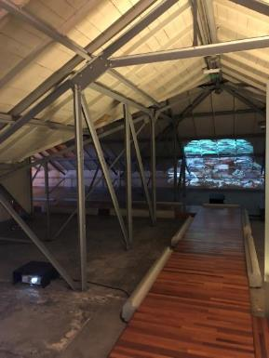
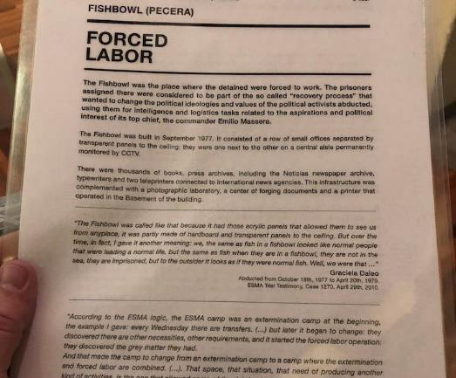
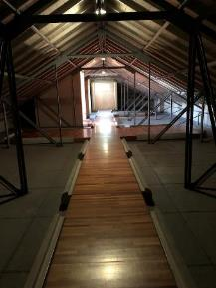
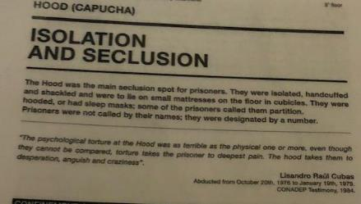
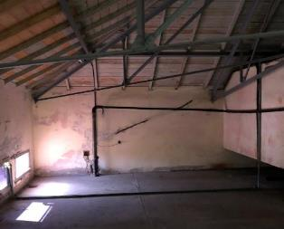
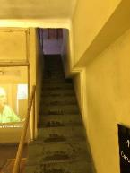
For those that were not initially transferred, the waiting game began: After their initial torture, some of their clothes were returned and they were brought to a room and placed in a hood. The rooms, one big, one smaller, derive their name from that, the Small and Large Hood—which were really attics in one building of the ESMA. Prisoners had no habeus corpus or due process rights, and when their families asked questions they were deflected, like, “are you sure your loved one didn’t run away?” Except for meals, most prisoners remained hooded during their entire lockup. Many were tortured, formally and informally, further. Those that managed to earn the trust of the guards could be placed into positions of forced—usually not hard—labor that allowed them more privileges. However, almost all were eventually transferred: of the roughly 5,000 people brought to the ESMA from 1976-1983 about 200 survived.

Slide 10
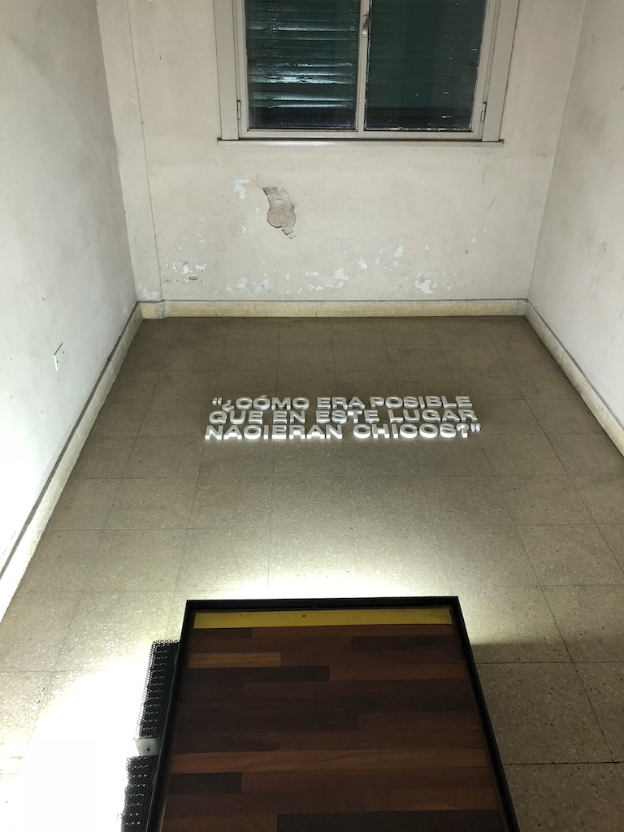
“How could children be born in a place like this?”

Slide 11
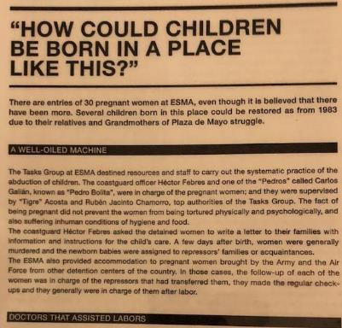
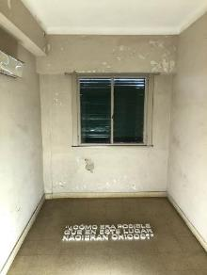
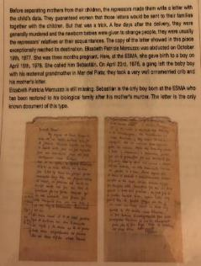
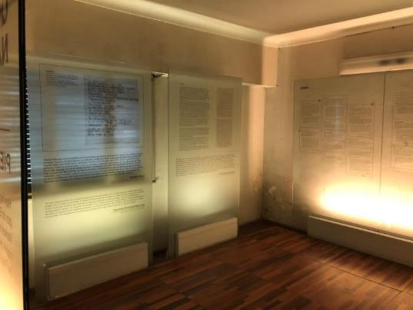
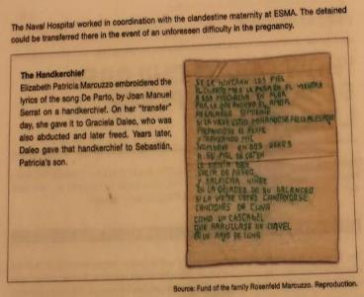
The one exception to all this was pregnant women. Since most of the Disappeared were young, active liberals, about 400 of them were pregnant when abducted during the Dirty War. At least 30 came to the ESMA, probably more, records are bad. After being tortured they were escorted upstairs to the hospital wing where they remained, under the care of physicians, until giving birth. (Note: medical professionals were complicit in this.) The birth was done under medical supervision, off the grid, in a special “birthing room”—previous slide. Once giving birth, the women spent about three days with their baby. The women were told to write a letter to their family, explaining they were in good health and this was their child, and that the child would be given to the family. The child was taken and within hours, the women “transferred.” Of the 400ish who gave birth in custody, one baby was given to the proper family, the others were given to “loyal Argentine families,” who were childless, usually those with ties to the Navy. At the ESMA, and other camps, there was an official list of acceptable families.

Slide 12
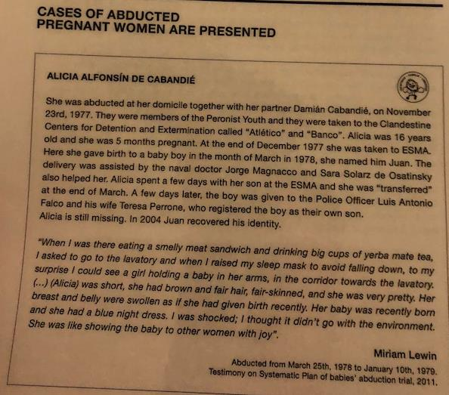
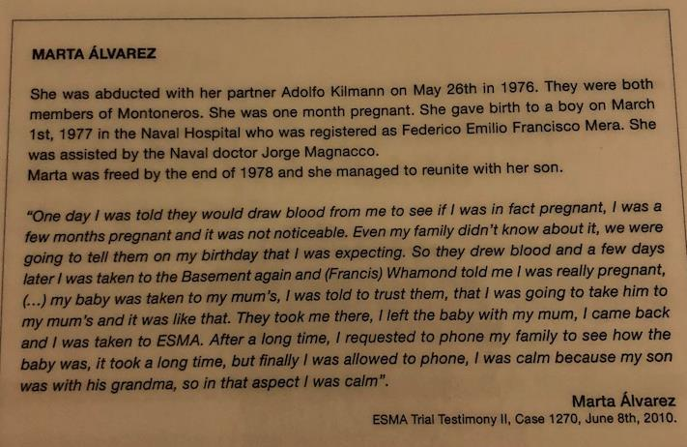

Slide 13
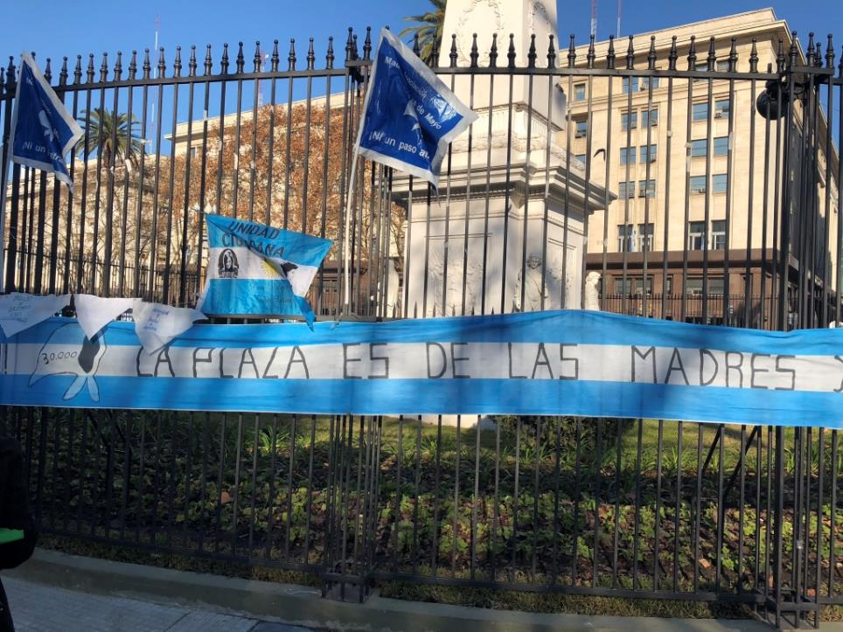
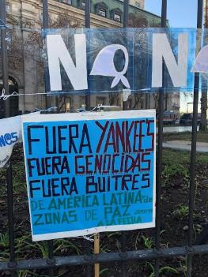

Slide 14
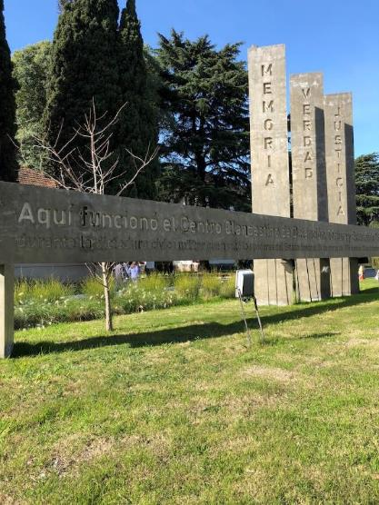
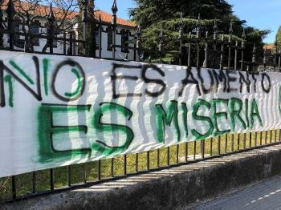
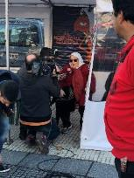
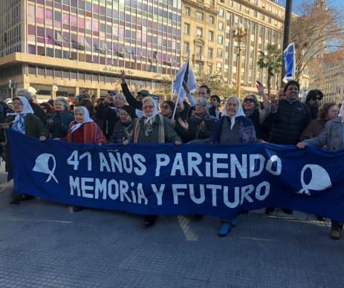
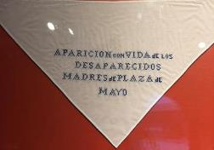
While the disappearances were terrible, it was “birthing” aspect of the Dirty War that first led to public outcry in Argentina, beginning with the Mothers of the Plaza de Mayo. These were mothers of the pregnant women who were abducted and gave birth, and are still currently missing their grandchildren. (They are also missing their daughters/sons-in-law, but most of them have accepted they were “transferred.”) As of 2018, about 111 missing children—of 400, so about 27%--have been successfully reunited with their biological families. For 41 years they have been protesting, asking the government and Argentine people to do more to find their grandchildren. At first the junta also tried to suppress and disappear them as well, but the outcry, this time internationally, was too great. They were forced to let the protest continue. This still occurs every Thursday on the Plaza de Mayo at 3:30 pm.

