Slide 1
February 5, 2019
Objectives:
* Explore the causes, battles, weapons, effects and conclusions of the “Great War”
Upcoming dates:
2/6: Spiel.: 775-781; horrors of the trenches - 1, 2, 3, 4 - print one set of documents per person
2/8: critically read ONE of the following: "What 1914 can teach us about 2014" or "The Christmas Truce & Soccer"
2/12: Key. 58-62 & Spiel. 787-789 (“Last Years…” & “Rev. Upheavals”)
2/14: Battles Presentations – LET ME KNOW ASAP IF YOU WILL BE GONE so you don’t get a zero
Turn in: None
Take out:
*Spielvogel HW
*Lecture notes
Agenda:
*Marne & Tannenburg
*Battles Assignment

Slide 2
WWI Battles:
1st Marne & Tannenberg

Slide 3
Thesis
Following the Schlieffen Plan, the Germans began World War I with a strategic offensive on Paris. To do this successfully required the invasion of Belgium & Luxembourg, a mistake that would ultimately lead to Britain entering the Great War. The result was a stalemate at the Marne tipping the balance of power on the Western Front, resulting in trench warfare and the eventual failure of the Schlieffen Plan. While this was occurring the Germans dominated the Russians on the Eastern side, and would eventually “not lose” the Eastern Front a point of contention internally within Germany by the end of the war.

Slide 4
First Battle of the Marne - setup
Occurs near the Marne River just E of Paris
Culmination of 1st half of Schlieffen Plan → supposed to end w/ German capture of Paris
Idea was that France would attack Alsace-Lorraine, and while holding them at bay there, Germans would flank them
To execute plan Germans had to invade neutral Belgium and Luxembourg – led to British declaration of war

Slide 5
First Battle of the Marne - setup
Germany’s treatment of Belgium and Luxembourg led to public relation disaster – start of total war
What did the Death of Glory say about it yesterday?
Known as the Rape of Belgium
One reason US joined was on Allied side (though this was 3+ years later)

Slide 6
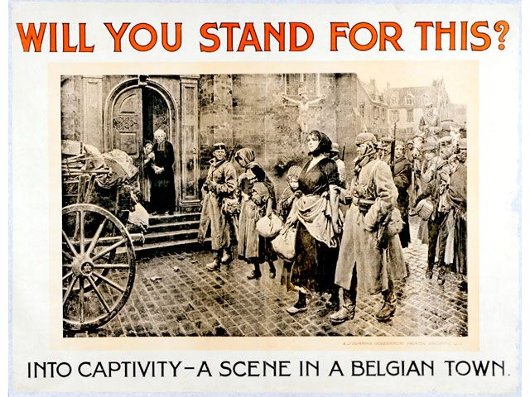

Slide 8
First Battle of the Marne
French do better than expected at Alsace-Lorraine
Hear of invasion via Belgium from Brits—Brits will make it to help but not soon enough to save Paris
Led by Joffre and under ideas of Gallieni, French mount “all hands on deck defensive” - most famously using taxi cabs to transport to front
Battle Germans to a stalemate and then w/ Brits push them back a few more miles into N France/Lux./Belgium

Slide 9
First Battle of the Marne
Importance
One of few non-trench battles on Western Front
Led to dig in, trench warfare and Race to Sea
1st use of planes for reconnaissance
Called by some historians most important battle of 20th century (set tone for WWI & WWII)

Slide 10
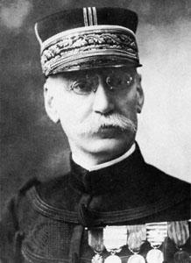
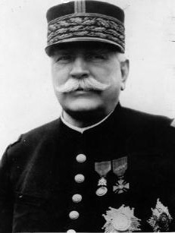
Joseph Gallieni
Joseph Joffre

Slide 11
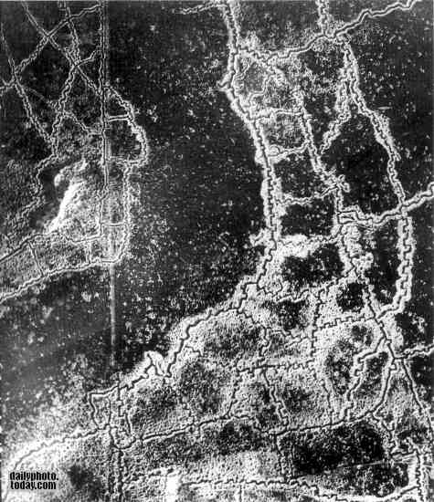

Slide 12
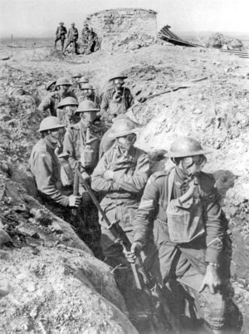

Slide 13
Tannenberg Forest
What did Death of Glory say about this?
Fought between Germans and Russians → first major battle of Eastern Front in what is now Poland
Russians outnumbered Germans 400,000 to 160,000
Led by Hindenburg, Ludendorff, and Hoffmann Germans circle Russians
½ the Russian army falls apart and runs away
Other half is encircled w/ 100,000 dead, 78,000 prisoner and 10,000 escape; Germans capture 500+ artillery

Slide 14
Tannenberg Forest
Importance:
Brings Hindenburg and Ludendorff to power
Establishes German dominance in Eastern Front—a front they will never lose
Exposes weakness of Russian Army—Samsonov suicide
Unites Germany via nationalism

Slide 15
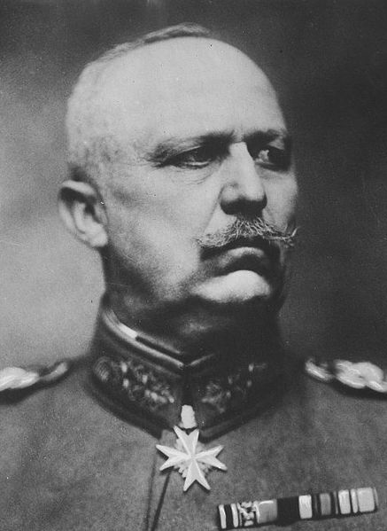
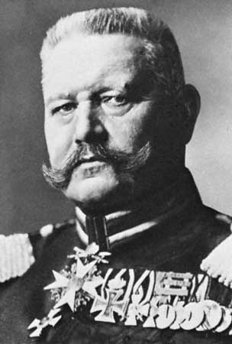
Erich Ludendorff
Paul von Hindenburg

Slide 16
WWI Mini Battles Assignment
Your job on February 14th will be to present a battle of WWI with your group – you will see in a minute.
This should be a short presentation, no more than five minutes. This is preparation for your major WWII Battle project
If you are out on a prearranged absence on the 14th you must present by your self to me before you leave (so do not join a group)
To do this you will need to research & familiarize yourself with your battle
We will have class work time on Thursday (2/7) and part of Wednesday (2/13)
Your WWI battle project should contain key information & be a scaled down version of what I just taught about 1st Marne and Tannenberg
You do not have to follow my format in any way, just info wise
This will be a 25-point culminating grade

Slide 17
WWI Mini Battles Details
Groups
You will find out group size in a minute
Choose wisely as this is a group grade – there will be no individual component this time – DO NOT FACTOR IN ANYONE WHO IS ABSENT!
Once you have your group decided…
Choose a Field Marshall – main communicator w/teacher
Come pick a battle out of the box (take note of A or B)
Decide how you will communicate during the project
Group text – what happens if someone doesn’t respond
Set up an out of class time to chat early to make sure everyone is free
Commit to HONESTY & KINDNESS! – talk about what that will look like
Battles will be presented in chronological order on the 14th: Gallipoli, Ypres (x4), Isonzo (x12), Jutland, Verdun, Somme, 2nd Marne
This will be a 25-point culminating group grade & serve as the mid-unit quiz
Group size will be… no more, no less-otherwise come and see me ASAP!

Slide 18
WWI Mini Battles Details
Groups
You must have 3 people in your group, there are NO student selected groups of 2 or 4
Choose wisely as this is a group grade – there will be no individual component this time
See me ASAP if you do not have 3 people as you may be broken up or assigned someone & we will also have extra people
Once you have your group decided…
Come pick a battle out of the box (take note of A or B)
Decide how you will communicate during the project
Group text – what happens if someone doesn’t respond
Set up an out of class time to chat early to make sure everyone is free
Commit to HONESTY & KINDNESS! – talk about what that will look like
Battles will be presented in chronological order on the 14th: Gallipoli, Ypres (x4), Isonzo (x12), Jutland, Verdun, Somme, 2nd Marne
Again, this will be a 25-point culminating group grade & serve as the mid-unit quiz

Slide 19
WWI Mini Battles Assignment
IF YOU KNOW YOU ARE GOING TO BE GONE for a pre-arranged absence on the 14th
You will present on your own to me BEFORE you leave for the break
Do not join a group – come to me for your topic
Schedule a time with me to present with me ASAP
Failure to do this will result in a ZERO on the assignment and cannot be made up after

