Slide 1
Lenin to Stalin
1922/24 – Lenin Stroke
Stalin v. Trotsky for “control” of the party
What was the name of the group that governed the party?
What were the differences between S & T – character, philosophical, political positions, etc. (will use cards in a minute-be prepared)

Slide 2
Lenin to Stalin
1922/24 – Lenin Stroke
Stalin v. Trotsky
Lenin Testament
1928 – full power to Stalin
Five Year Plan. Announced 1927 (but adopted 1929)
Ran from October 1928 to December 1932
Focused on 3 things:
Industrial
increase
Agriculture
Collectivization
1933 – Full control of industry and agriculture
Plan was declared complete six months early.

Slide 3
Stalin Questions
How did Stalin take control of the party after Lenin’s death?
What ideas/policies did Stalin enact while leading the USSR?
What were they meant to accomplish?
Why is Stalin’s government considered totalitarian?
What further questions do you have about the revolution and Stalin?

Slide 4
Thesis
After the creation of the USSR and ensuing power struggle, Joseph Stalin emerged as the dominant political force through a mixture of false alliances and lies. Continuing this style of ruling—and seeing what he, and therefore others, could and would do to keep power— caused Stalin to become both paranoid and vindictive. This manifested itself multiple times throughout the course of his terror, beginning with Holodomor in Ukraine and the Great Purges of the early USSR.

Slide 5
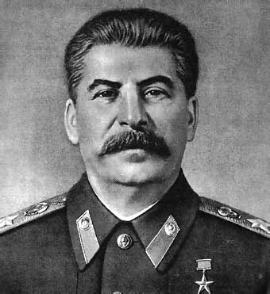
Stalin – Man of Steel
1879-1953

Slide 6
Totalitarianism
Government control over all aspects of economic, social, political, cultural, and intellectual life
The subordination of the individual to the state, and the insistence that the masses be actively involved in the regime’s goals
Enforced through propaganda through state-controlled mass media
A single political party that controls the state
Cult of Personality
Regulation/restriction of free speech, use of mass surveillance, and widespread use of terrorism
Origins in total warfare
– even democratic nations took control of economic, political, and personal freedom to gain victory
But most prominent in Stalin’s USSR, Nazi Germany, and Fascist Italy

Slide 7
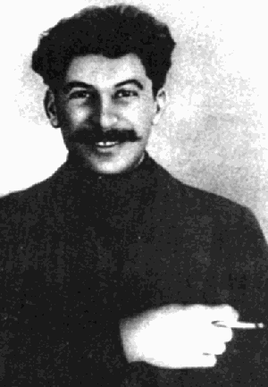
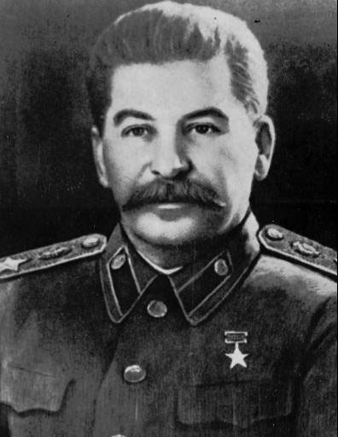
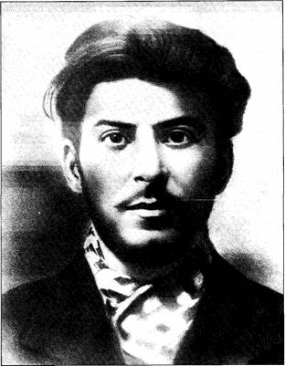
Stalin
Personal:
Iosif Vissarionovich Dzhugashvili
Georgia
A revolutionary, vs. tsarist regime, exiled
Joined Bolshevik party, met Lenin (1905)

Slide 8
Creation of the USSR
Old grievances stem from the Treaty of Brest-Litovsk
1919-1921 USSR and Ukraine communists fight war against Polish and Ukrainian nationalists.
Trotsky in charge; Stalin’s segment of army disobeys him
Polish kick their butt; Treaty of Riga splits territory
Two countries sign nonaggression pact
Temporarily ends USSR expansion (Trotsky’s argument)
Ukraine (the rest of it), Belarus, Transcaucasia and Russia unite to form USSR in 1922
These two events leaves a variety of different ethic peoples transplanted into different areas and no one happy about it (ripe for ethnic violence)
Stalin assumes full power by 1927, expelling Trotsky
Initiates first 5-year plan in 1928

Slide 9
(1st) Five-year plan
Reaction to the “failed” NEP (New Economic Policy)
Stalin “steals” Trotsky’s idea of industrialization
Involved command economy with emphasis on collective farms and heavy industrialization
Side goal = to destroy kulaks as a class
People were relocated sometimes based on old skills and profession, sometimes not; industry consolidated
With command economy creativity and incentives got lost
To ensure work ridiculous quotas (average of +250%), with strict punishments put into place
Workers were allowed to sell extra goods, but quotas were too high to do this

Slide 10
Soviet starvation
Forced collectivization and dekulakization (most kulaks in fertile farms of Ukraine) +
Results of less work incentive, sale of valuables
Stock market crash 10/29/29 hurts entire world +
No money and nowhere to sell the excess
Quota system w/ penalties = starvation
Leads to less people farming w/ same quotas
Law of Spikelets claims all farming stuff for the state, makes offenses as drastic as execution
Authorities blame kolkhozs and accuse them of sabotage
Won’t lower quotas or give them food, leads to starvation
Government denies it exists and still sells grain so capitalists won’t see a failing communist society
Occurs mainly in Ukraine and the Caucuses

Slide 11
Holodomor
Means “killing by hunger”
Steps:
1931: Farmers have promised excess grain from incentives seized
Those who fail quotas lose livestock and 15 times their grain and get blacklisted and cannot trade
Stalinists look for way to get revenge on Ukraine from war
Ukraine given ridiculous quota (1/3 of USSRs food)
Citizens don’t meet quota in 1932
Moscow claims reason is nationalistic, class sabotage; seals borders
Moscow limits food to Ukraine severely; sells excess to Germany; continues to collect even when quota is met
Moscow then requires a quota round up/deportation/execution of “kulaks” on top of this
At this point kulak means anyone the gov’t doesn’t like
Starving begins in cities with bread lines; spreads to country
6-7 million die (some death tolls up to 10 million)

Slide 12
National Terror
Still upset at loss to Poles (1919-1921 talked about yesterday), Stalinists exact revenge and begins purging based on historical ethnic background
More Soviet Poles (600,000) ostracized than German Jews (400,000) during 1930s
Begins during famines (only real Russians should eat) and continues during Great Purges of 1930s
New NKVD leader Nikolai Yezhov invents “Polish Military Organization” and claims Poles are being funneled money and weapons by relatives or other capitalists
Stalin is, as always paranoid and sees conspiracies everywhere
Yezhov wanted to use this to consolidate and get rid of NKVD rivals
US/UK want peace and don’t intervene, Poland tries to honor its nonaggression pact
Issues order NKVD 00485 = most sent to Gulags in Siberia, some executed by NKVD
Even come up with quota system for arrests, imprisonments and executions

Slide 13
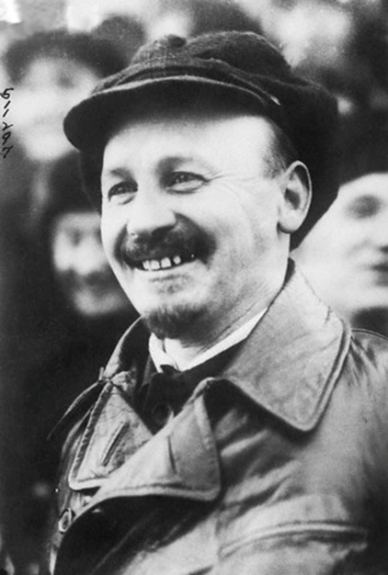
Great Purge
Stalin begins purging key Soviets from 1936-1938
Historians debate if this is shrewd politics or increased paranoia
Begins with questionable “murder” of Sergei Kirov
First official move is to liquidate two former allies who helped rise to power: Zinoviev and Kamenev
Followed up “Trotskyites” (on the left) and more conservative leaders (Nikolai Bukharin) on the right—who also helped Stalin get into power
Bukharin is massively tortured into confession so Stalin can have a show trial for him
Slows down for bit until Stalin decides to kill NKVD leaders who did this just in case they try to talk and/or blackmail him.

Slide 14
Great Purge
Picks back up with murder of intelligentsia (too bourgeoisie) and purge of army generals (could control army and challenge Stalin) and finally all remaining kulaks (for good measure)
Virtually all people accused did nothing wrong; all confessions obtained via torture
Quite a few were so in love with Stalin’s cult of personality they went to their grave with “his name on their lips”
Ends with second purge of NKVD and new leader Yezhov (who he unpersons)
Final blow is death of Trotsky in Mexico City 1940

Slide 15
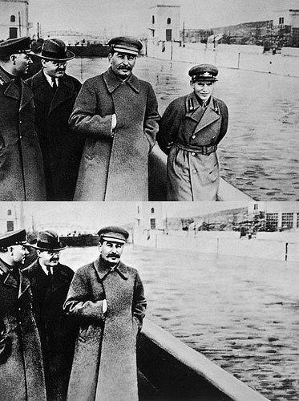

Slide 16
Is it Genocide?
This begins the massive death toll of 1930-1945 Europe; ranges from 25-75 million
Genocide is systematic attempt to eliminate a group of people
UN defines it as an eight stage process, which is a good place to start
Classification
Symbolization
Dehumanization
Organization
Polarization
Preparation
Extermination
Denial
Big debate among historians is what parts of the 1933-1945 Europe are genocides and which ones are not

Slide 17
Trotsky v. Stalin

Slide 18
Lenin/Trotsky v. Stalin
Lenin/Trotsky’ism
Stalinism
Political
Permanent revolution – that you have to wait for the stages…
Vanguard party (Bolsheviks)
Social
Permanent revolution
Economic
Natural progression to industrialization
War communism
NEP (Lenin – Trotsky against)
Political
Socialism in one country
One packed party
Force communism
Social
Social terrorism-gulags, holo…
Collectivization
Women & education go back – lost gains
Economic
Collectivization
5 year plans (no personal profit)

