Slide 1
Latin America in Depression & War
1929-1945

Slide 2
Discuss the following questions in your table groups
Make sure you have people from both readings at your table
Write out answers on a sheet of paper you may turn in at the end of class
Take turns writing answers and leading the discussion

Slide 3
Keylor 211-218 ISI Article
Describe the course of foreign policy FDR chose to pursue in Latin America in the 1930s.
What is Pan-Americanism & how was it fostered by both the United States and Latin America?
Quickly summarize the general outcome of the various conferences the American countries conducted during the 30s & early 40s.
How did the Americas try to organize a defense against the Axis threat? How did they support the US during WWII?
Define and explain ISI.
How and why did Latin American have a different experience from most of the rest of the world during the Great Depression?
Who is Getulio Vargas and how did he impact Brazil during the Depression?
Explain Estado Novo. How did it impact Brazil? What “ism” did it appeal to?

Slide 4
Now…
Write a quick thesis about the changes in Latin America in the 1930s based on the evidence we just discussed.

Slide 5
Thesis
While the rest of the world was experiencing the Great Depression, much of Latin America used the lack of economic imperialism to replace their economic systems with ISI, softening the blow of Depression significantly. This allowed Latin Americans to begin to throw off the yoke of the United States—which was forced to move from “Big Stick” to “Good Neighbor Policy” to retain some influence in the region. Without the domineering US, many Latin American countries began to further their own economic systems and governments, to mixed results.

Slide 6
Questions (from Born in Blood & Fire excerpt)
Define and explain ISI.
How and why did Latin American have a different experience from most of the rest of the world during the Great Depression?
Who is Getulio Vargas and how did he impact Brazil during the Depression?
Explain Estado Novo. How did it impact Brazil? What “ism” did it appeal to?

Slide 7
Import-Substitution Industrialization (ISI)
What is ISI, and what caused it?
ISI is the process by which Latin American countries were able to fill the gap left by USA/European countries during the great depression.

Slide 8
What does ISI do for Latin American countries economic legitimacy?
Latin American countries go from struggling economically to growing in a huge way.

Slide 9
How were governments able to control the economy in Latin America during the 1930/40s?
Set wages & prices
Manipulated exchange rates
Passed labor laws
Owned public works projects

Slide 10
Which countries were impacted most by ISI, why?
Larger countries such as Brazil, Argentina, etc… because they had the economic strength to take advantage of failing markets in Europe and the US.

Slide 11
Which goods were the most profitable for LA countries because of ISI, why?
Light goods (soap, beer, shoes etc…) because it was to costly to develop heavy goods
This is only early on heavy goods are produced later…

Slide 12
Questions (from Born in Blood & Fire excerpt)
Define and explain ISI.
How and why did Latin American have a different experience from most of the rest of the world during the Great Depression?
Who is Getulio Vargas and how did he impact Brazil during the Depression?
Explain Estado Novo (or New State). How did it impact Brazil? What “ism” did it appeal to?

Slide 13
Getulio Vargas & Brazil
Brazil experiences a “revolution” in 1930
Mostly non violent, but Old Republic President Washington Luis leaves power
Most of this had to with the Brazilian government subsidizing the coffee industry to keep it vibrant and prices good → falls apart when world experiences Depression
Succeeded by Getulio Vargas—a landed Populist—who seizes power after disputed election
1st Vargas Presidency can be divided into three phases:
Provisional Government (1930-1934)
Constitution & Presidency (1934-1937)
Estado Novo (1937-1945)
Vargas is only actually legally elected during the second phase of 1st presidency
Will be legally elected President of Brazil in 1951, where he will remain until he commits suicide, while in office in 1954

Slide 14
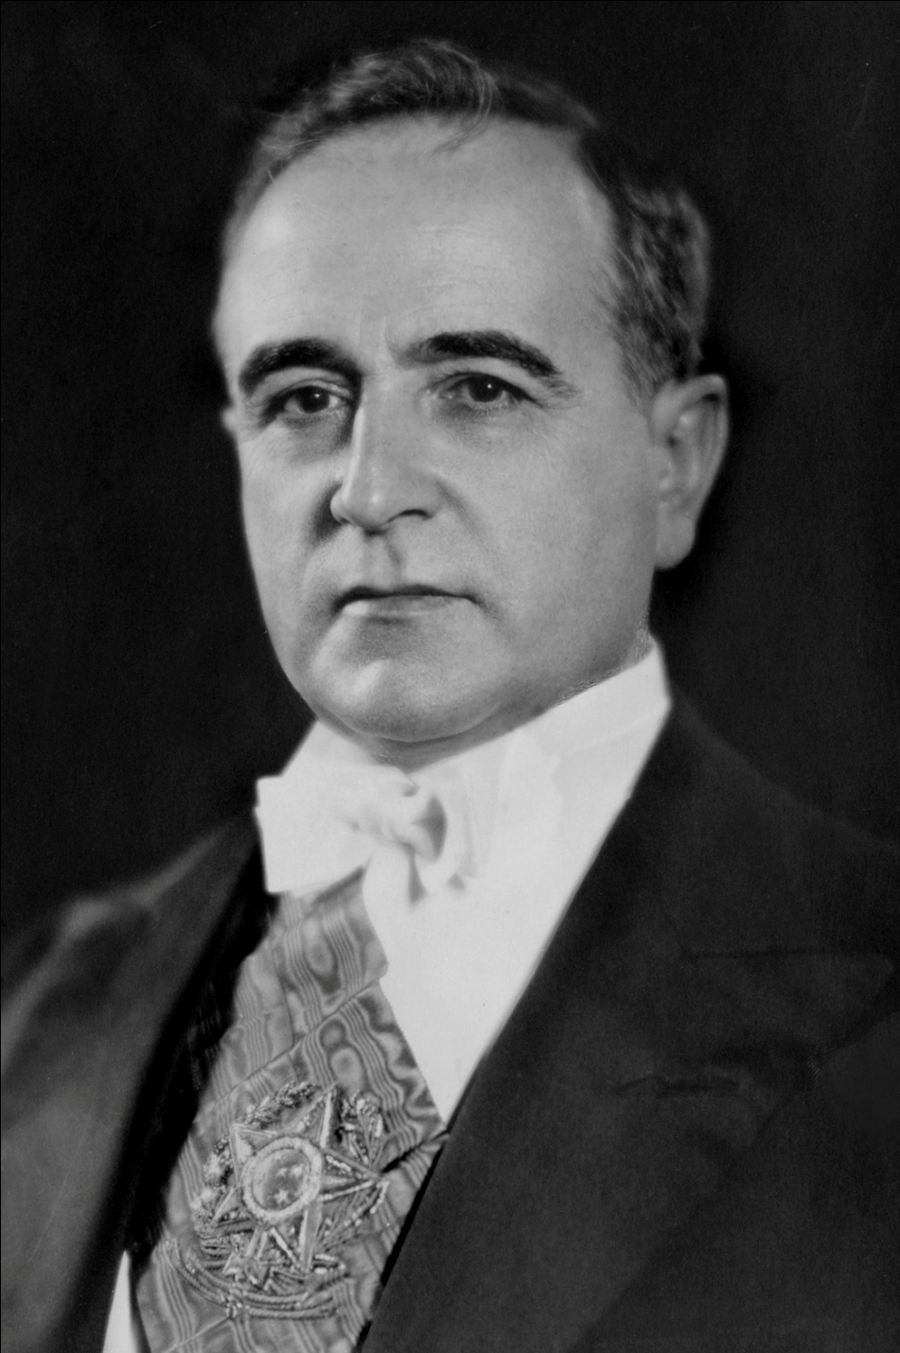

Slide 15
Estado Novo
Means “the new state”—taken from the name of the Portuguese dictatorship that sprung up in the wake of fascism & Franco
By ’34 Vargas is starting to lose control of his coalitions and begins to copy some fascist tactics—curtailing press freedoms, violent crackdowns—to keep power
By posturing himself as the opposite of communism he wins the 1934 election, barely
Term will expire in 1938, barred from running again by new constitution
He then centralizes his authority in Rio, instituting a command economy that does succeed in getting investment and manufacturing going
Nov. 10, 1937 comes on radio and announces there is a “communist” plot to overthrow him and seizes power in a coup (of sorts)
Disbands other political parties, stops critically presses—but stays Populist
Creates a number of central organizations to look after the people (almost like the beginning of a welfare state)
Makes good with the US where he becomes very popular; enters WWII on side of Allies
Remains very popular with people of Brazil
Finally forced out by own minsters after the war (dictatorships are not popular anymore) who return Brazil to democracy

Slide 16
The Rest of Latin America
US continues Good Neighbor Policy in most dealings with Latin America
Many countries use increased wealth to kick out foreign corporations and nationalize their key industries like oil
This upsets Europeans and US some, but there a bit preoccupied with Hitler
Install puppet governments in some states, but only the smaller ones
But… industrialization slows significantly with the end of World War II,
which leads to Revolution…

Slide 17
Our America
As you read, try to answer the following…
1. What is Jose Marti’s argument?
2. Why does Marti believe what he believes (what are his supporting arguments?)
3. What does Marti think the general feeling that natives have in Latin America?
4. What does Marti think that the colonial powers should do?

Slide 18
What is Jose Marti’s argument?
Simply put Marti believes that the Spanish rulers do not understand, or really care about the best interests of the people in Latin America, and that natives in Latin America have the ability to rule themselves much better than the colonial powers could.

Slide 19
2. Why does Marti believe what he believes (what are his supporting arguments?)
- What are some quotes that you might find in this article supporting his overall argument?

Slide 20
3. What does Marti think the general feeling that natives have in Latin America?

Slide 21
4. What does Marti think that the colonial powers should do?

