Slide 1
Latin America in the 1800s
Create some sort of visual that depicts what happened in Latin America during the 1800s
Could be cartoon, boxes for different themes, etc.
On the back side write a thesis regarding Latin America in the 1800s
Put your names on it and turn it in to the A inbox by 11:23

Slide 2
Latin America Thesis
Faced with the possibility to create modern liberal states, post-revolutionary Latin American governments tried, but did not have the political or social backing to make radical change. The result was a lapse back into conservative rule. When that became unpopular, liberals turned the tide & tried to benefit the people of Latin America. However, new Victorian values or industry, free trade, Progress, & social class only curtailed the rights of the lowest classes, causing the rich to get richer & consigning Latin America to a status a supplier of materials but not a producer of important goods and services.

Slide 3
The “liberation” of Cuba
Starting in 1868, Cuba began a series of three wars for Independence
Cuba was the only country not “freed” from Europe by 1830
Also, until 1959 Cuba was the closest ally to the US in the Americas
First one changed little, but Spain did have to release control some, most notably outlawing slavery in 1886
Real insurrection begins in 1895 with the following proclamation:
1.) The war will be waged by both blacks and whites—participation by all is necessary; 2.) Spaniards who did not object to the war would be spared; 3.) economic life should be brought to Cuba
Lead by José Martí, a poet, and founder of Our American movement (more on this later)
Killed in battle in 1895→elevates him to martyr status
Spain does not spare the civilians, leading to bad PR
The extent of this in unclear because of journalistic sensationalism (known as Yellow Journalism)
USS Maine explodes in the Havana harbor under unclear circumstances—Remember the Maine—giving mild pretext for war
US takes down 500 year old empire in 17 weeks
Promises Cuba independence but never fully gives it
Cuba remains US client state until the Castros, etc. land in 1953

Slide 4
Europe Thesis
The new unification of the working class, coupled with conservative reforms of the Congress of Vienna, led to a new unity within the oppressed classes. This coupled, with the Industrial Revolution caused the lower classes to form an adversarial relationship with the “fat cats” of capitalism. As a way to reclaim power the lower classes rallied around the new idea of the nation-state causing an outburst of Nationalism and eventually resulting the unification of Italy and Germany.

Slide 5
Europe in the 1830s
Pre-1830
Conservatism is ruling Europe
Metternich and the Quadruple Alliance is born
Great Britain, Russia, Prussia, and Austria agreed to work together to maintain control and power over the territories and areas they had gained
Used the Principle of Intervention to maintain “order” in Europe
1830s
What is happening?
France
Britain – what was the deal with the laws?
Why does this matter? What is important?

Slide 6
Liberalism & Conservatism – Europeans Clash
Citizens of Europe recognize the need for change (again) and it causes multiple smaller revolutions
Mostly in response to IR and Conservatism (Principle of Intervention played a big role in this)
France goes through another revolution - 1830
1830 Charles X attempts to censor the legislative assembly
Causes July Revolution, Charles X is overthrown and fled to Britain
Louis – Philippe (1830-1848) becomes king
Selected by liberals (upper middle class bourgeoisie), former duke of Orleans
Removes voting restrictions that heavily favor upper middle class
Severely disappoints the lower class, as result Chamber of Deputies is dominated by The Party of Resistance, which believed that France had reached the perfect governmental structure

Slide 7
Revolutions of 1848
Talk with your table mates about the following:
What are the goals of the revolutions across Europe around 1846-48, what are some common themes amongst the revolutions?
Why does Spielvogel feel as if there are “failures” in 1848?
In reference to the Revolutions of 1848, historian A.J.P. Taylor noted “history reached a turning point & failed to turn”. Discuss to what extent you agree with this statement.

Slide 8
Revolutions of 1848 “history reached a turning point & failed to turn” - A.J.P. Taylor
1846/1847 – France
Problems?
New Napoleon?
Prussia
Problems with big and little Germans
Results?
Austria
Diverse empire (strict control)
Hungarian gains… er, wait… what was that? Why would Russia aide Austria?!?
Italy…

Slide 9
Nationalism Unification of Italy
Italians were very interested in the revolutions of 1830 and 1848
Kingdom of Piedmont-Sardinia (basically western Italy) had a liberal constitution
This appealed to middle class Italians all over the region
Young Italy movement: founded by Giuseppe Mazzini
Rose up and revolted against Austria & other powers in Italy
Wanted a democratic, republican form of government
Anti-monarchy
Revolt didn’t work out (you read about it) because not all of Italy agreed and eventually Austria has presence in Italy again
Basically divided into three main areas
Northern Italy, Southern Italy, the Papal State
Keep this in mind when reading about unification

Slide 10
Failures of 1848?
Why does Spielvogel feel the revolutions of 1848 failed?
Unity of revolutionaries
Idea of self government
Do you agree with Taylor - “history reached a turning point & failed to turn”?

Slide 11
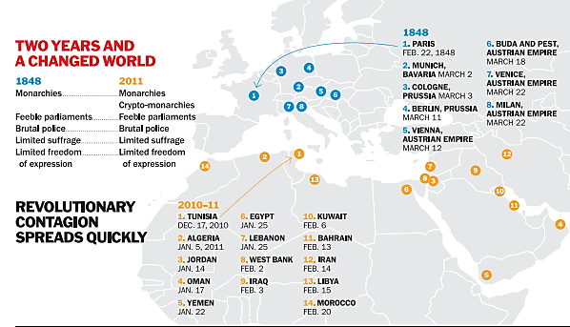

Slide 12
1848 vs. 2011?
Read the article linked on the website, do a little research, and be able to answer the following:
What happened in 2011?
Why compare it to 1848?
The article ends with, “And in 2011? We’ll know soon enough.” Do some quick research… is the ending the same?

Slide 13
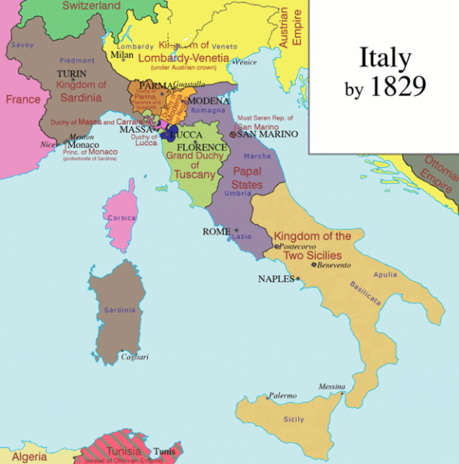
Nationalism Unification of Italy
Sardinia’s (NI) King appoints Camillo di Cavour as Prime Minister
Goal: gain control over northern Italy
Obstacle: most of northern Italy controlled by Austrian Empire
Tactic: get Napoleon III of France to help drive the Austrians out; it works

Slide 14
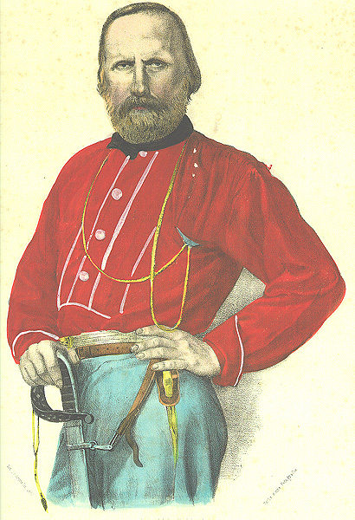
Nationalism Unification of Italy
Southern Italy
Giuseppe Garibaldi leads nationalist rebels (redshirts) and takes over Sicily (secretly aided by Sardinia)
Garibaldi and his troops march north, Cavour has his king meet Garibaldi in Naples, they unite the south to Sardinia
Garibaldi steps aside and lets the king rule over both parts in 1860

Slide 15
Nationalism Unification of Italy
The rest (Rome):
Venice leaves Austria (they let it go) and joins Italy in 1866
Garibaldi then threatens to conquer to Papal States; marches army in, Pope gives up and they give him Vatican City in return
The French have a presence in Rome until 1870 when the Franco-Prussian War forces them to withdraw completely leaving Rome to the Italians - Who make Rome their capital

Slide 16
Mazzini On Nationality
According to Mazzini – what is nationalism (give total definition)?
Paraphrase his ideas
What is Mazzini’s argument? How does he lay it out?
Paraphrase and find quote(s) to support it
How does this reading fit in with your textbook reading 663-669 (beyond obvious Italy connection)?

Slide 17
Realpolitik
Bismarck
conservative, aristocrat, minister Wilhelm I in 1862
Chancellor of Northern Germany Confederation & then Germany from 1867-1890
Realistic politics based on the needs of the state
Power more important than principles
Whatever actions necessary to achieve his desired goals.
Rules with an IRON FIST

Slide 18
Realpolitik
Goal – Prussian control of a united Germany
Steps to Unification
Confederation – Prussia strongest after 1848
Zollverein – open trade
Make the public scared – Prussia puts down liberal rebellions
Blood and Iron

Slide 19
Realpolitik
“Blood and Iron” Philosophy
He wanted to eliminate Austrian influence and bring about unification on Prussian terms.
Expand Germany’s economic and industrial base with use of its resources.
Put down liberals
Expand and unify though war
Increase the power and influence of the army
Not make the same mistake of 1848 – this won’t happen via conferences, speeches and majority voting

Slide 20
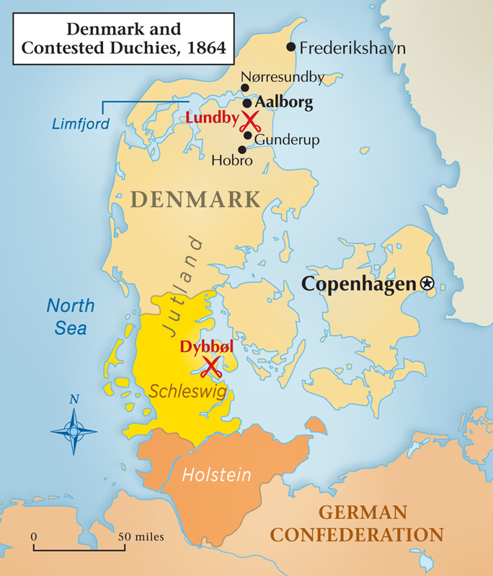
3 Wars for Unification
1st: An Austrian-Prussian invasion of Schleswig-Holstein
The Danish War (1864)
End of Danish control of these provinces.
Prussia gained a lot of support especially among German nationalists who wanted to see these provinces come under German control.
Sets up strange peace arrangement to promote discord, to lead to…

Slide 21
3 Wars for Unification
2nd: Austro-Prussian War (1866)
results in Prussian control of several northern German states.
Dissolved the old confederation and establishes a new one dominated by Prussia
Southern states were left independent, form military alliances with Prussia
3rd: Franco-Prussian War (1870-1871)
results in the completion of German Unification
Pay & give up Alsace & Lorraine
Wilhelm I of Prussia assumes the role of Kaiser of Germany, with Otto von Bismarck as Chancellor.
Treaty signed at….

Slide 22
German Racial Nationalism
What does Teutonic mean?
Why would Germans be attracted to these types of theories at this time? (& historically other places too, not limited to Germany)
Why would I assign you to read these excerpts?

Slide 23
Types of Nationalist Movements
Unification
Mergers of politically divided but culturally similar lands
19th century Germany
19th century Italy
Separation
Culturally distant group resists being added to a state or tries to break away
Balkans in the Ottoman Empire
French-Canadians in Canada
Ireland
State-building
Culturally distinct groups form into a new state by accepting a single culture
The United States
Turkey
USSR

Slide 24
What is happening-late 1800’s?
Share starting w/person who has pink table number on their desk, then rotate clock wise
Person #1: Germany
Among many other things – see if anyone had read ahead and can tell you about the Bismarckian System
#2. Austria–Hungary
#3. Great Britain
#4. Italy & France (if only 3 people at table all share for this)
What are common themes you are pulling from what is happening in these areas?
Come up with at least 3 to 4 themes

Slide 25
Other nationalist movements
Ireland tries to break with UK after the famine (and then tries again, and again, and again)—leads to Rebellion, Civil War, IRA, etc.
Balkans (most notably Serbia) try to break with Ottoman Empire and/or Austria Hungary—forming something called Greater Serbia (lots more on this later) which is still and issue today
France tries to rally against “foreign” issues and united in Anti-Semitism, Dreyfus Affair
Russia has to deal with autocrats ruling a huge, decaying empire

Slide 26
New face of Europe
Britain and Germany now the most powerful nations in Europe
France defeated, but still fairly strong
Austria and Russia lagged far behind, and were falling apart
Seeds are sown for the biggest conflict “the world had ever seen”
Next: Britain, France, colonialism in Africa – all leading up to World War I

Slide 27
Feminism & Zionism
What was the most interesting aspect of each that you learned in the reading?
Predict how these things will “fuel” the coming on World War I?
Are these still issues today?

