Slide 1
Russian Revolution
From Nicholas II to Lenin & Civil War

Slide 2
Russian Revolution - Causes
Capitalism had not taken hold in Russia
Serfs
Religion
Agricultural
Poor Leadership
Reactionary Cycle – Liberal to conservative reaction
Nicholas II
What do you already know?
Did not want to be ruler
Absolute power
Poor choices

Slide 3
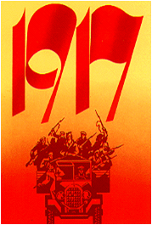
Russian Revolution Causes
1905 a bad year
Russo-Japanese War
Revolution
Father Gapon - Myth of Tsar destroyed
Duma eventually created… or not…
More bad years
Son
Rasputin
War
National Duty
Poorly supplied
Goes to the front – who is “in charge”?

Slide 4
The March Revolution
March 8 – hangry people in the capital (is there a life lesson in here somewhere…?!?!)
Women riot over bread (sound familiar?) - riots spread
Troops join the rioters
March 12 - Duma declares government control
3 days later Tsar abdicates & Duma sets up provisional govt.
Provisional government doomed to fail
Stay in the war
No agenda or plan
Fails to fully enact reforms – time for reforms after war
Petrograd Soviet – what is a Soviet?
Mensheviks v. Bolsheviks?

Slide 5
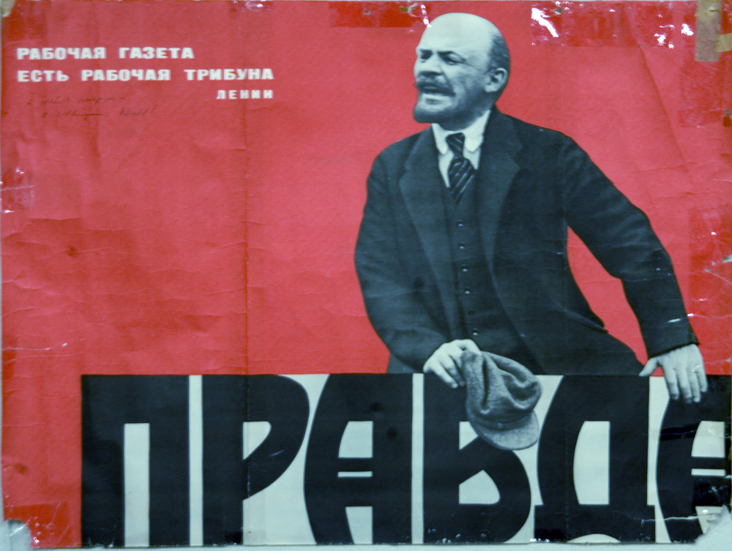
Bolshevik Revolution
Lenin’s beliefs
Marx
Violent Revolution
Humans can “make conditions” with power of party
April takeover
All power to the soviets
All land to the peasants
Stop the war now
Army Order No. 1 (what is this?)
Failure, goes into hiding
Trotsky executes takeover in October
Powerful Speaker
Organizer

Slide 6
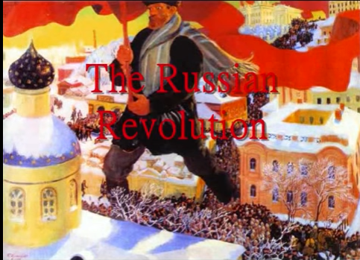
Bolshevik Revolution
The take over… (October/November?)
Trotsky & Petrograd Soviet-special military committee
Takes over government buildings and members of provisional government
Congress of Soviets declare power to the soviets
Lenin declared head of new government
Successful because…
Lack of effective Provisional Gov’t
War bitterness
Effective leadership
Red Army Choir

Slide 7
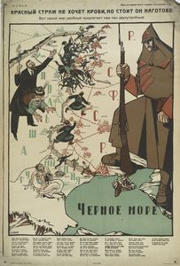
Civil War
What did Bolsheviks do once in power? (Gaining Power vs. Keeping Power)
Redistribute land
Worker control of factories
Pull out of the war
Treaty of Brest-Livtosk
What was the Civil War (1918-1920)?
White=Anti-Bolshevik
Not unified
Foreign aide
Red=Bolsheviks
Leadership - Trotsky
War Communism-what is this?
Checka
Red Guard does not want blood, but he stands at the ready

Slide 8
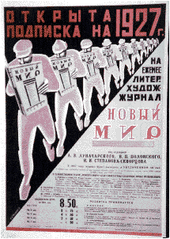
Lenin
1921, at peace, but wars…
almost total economic collapse
famine and bitter discontent
In desperation, Lenin introduced the New Economic Policy (NEP) – what is this?!?
Some private enterprise
Small farms and businesses flourished
State Control
Industry
Transport
Foreign Trade

