Slide 1
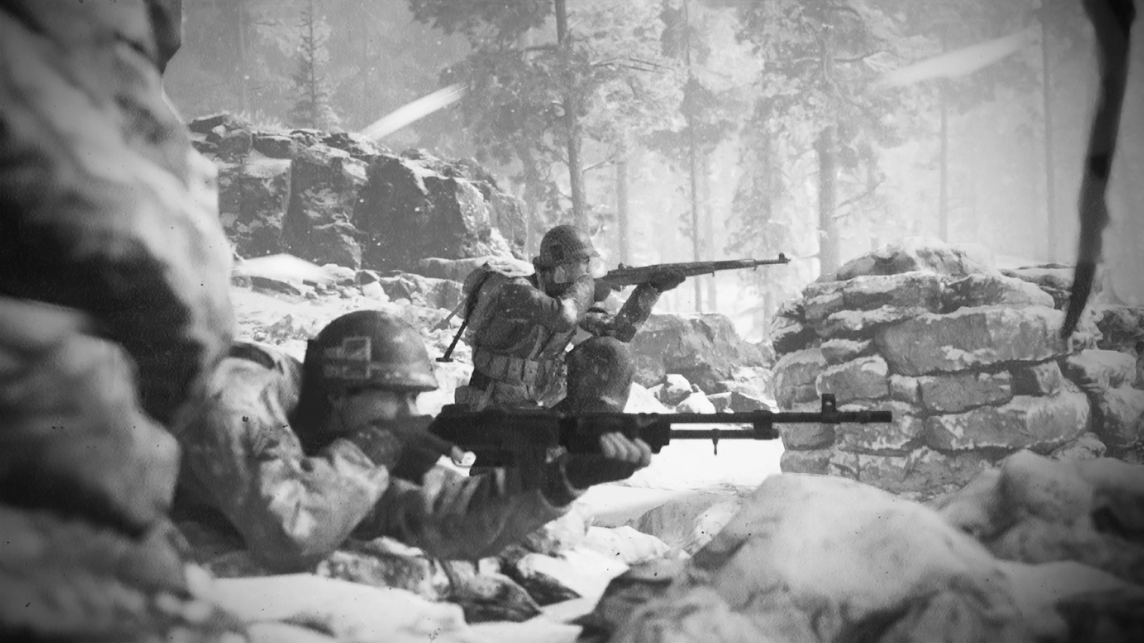
The Ardennes Offensive
By: S K, S C, S E

Slide 2
Thesis
Germany’s poorly planned push as well as the American strategic leadership in the 1944 Ardennes Offensive trounced any hope for a German counterattack, and opened the way for both an Russo-American two front invasion of Germany, leading to the Allied victory of WW2
Notes:
Siddhu

Slide 3
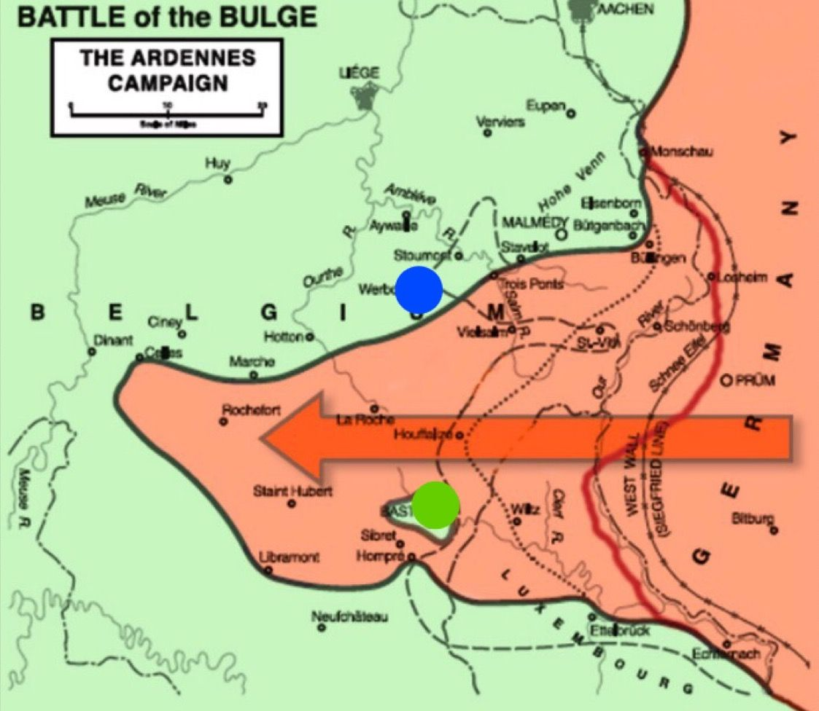
Background
Also known as the Battle of the Bulge.
Took place Dec 16, 1944 - Jan 25, 1945 in Ardennes Forest
Germany had lost tons of land in Operation Overlord and Liberation of France
Allies began asserting presence on mainland Europe
Last German offensive on Western Front in the war
Notes:
Bulge refers to the shape of that the offensive made
Soham

Slide 4
Thesis
Germany’s poorly planned push as well as the American strategic leadership in the 1944 Ardennes Offensive trounced any hope for a German counterattack, and opened the way for both an Russo-American two front invasion of Germany, leading to the Allied victory of WW2
Notes:
Soham

Slide 5
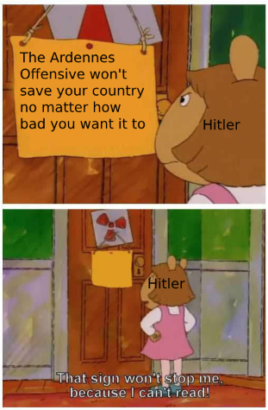
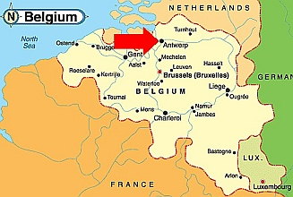
German Objective
The Germans wanted to recapture Antwerp (American Battle Monuments Commision)
Heavily discouraged by advisors
“The genesis of Hitler's plans to launch the Bulge is his grappling to retain control of the direction of military affairs and prove to the Third Reich that he's still the man at the top”(Caddick-Adams)
Notes:
Planned by Hitler and was discouraged by his top officials such as von Rundstedt
Commanders on the Eastern front begged Hitler for supplies in east, mounting concerns over Russian attack,( Refused)
Hitler thought the Allies would never expect an invasion from the dense ardenn
Ardennes forrest could also hide number of troops
Called Operation Autumn Mist
Antwerp was crucial to Allied supplies chain
Shane

Slide 6
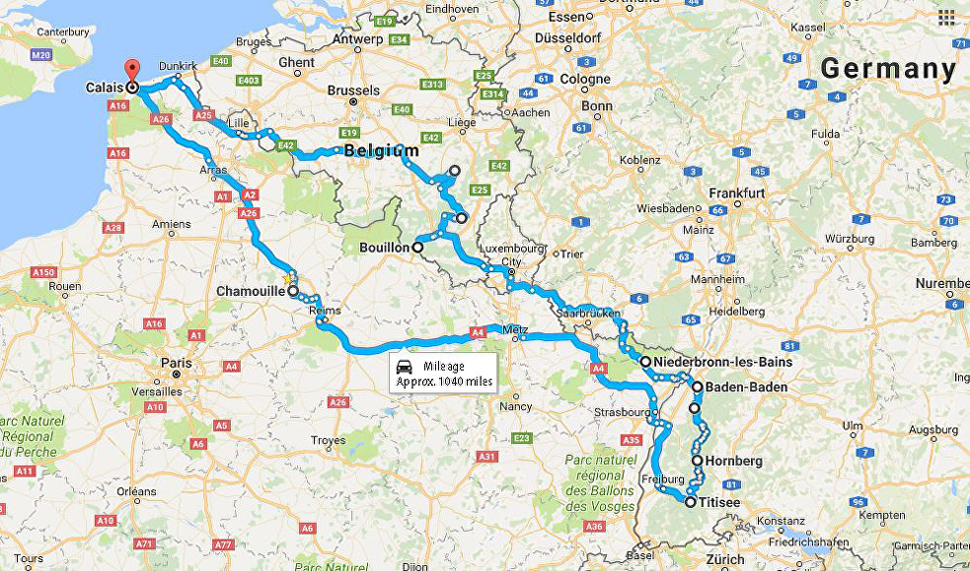
Leading up to the Battle
Intel foresaw German attack but General Patton dismissed claims
Offensive did not provide enough fuel to the Panzer tanks for a sustained mission
Foggy weather encouraged Hitler to launch his plan
Notes:
-Plan relied on picking up fuel reserves from defeated American units as the offensive went along
-Shane

Slide 7
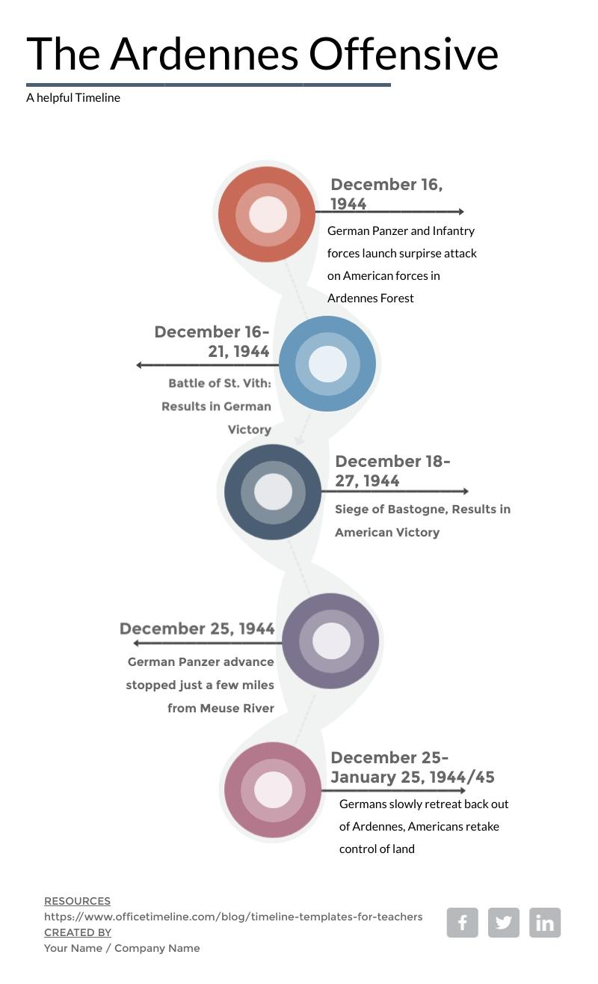
Notes:
SIddu

Slide 8
Thesis
Germany’s poorly planned push as well as the American strategic leadership in the 1944 Ardennes Offensive trounced any hope for a German counterattack, and opened the way for both an American and Russian two front invasion of Germany, leading to the Allied victory of WW2
Notes:
Soham

Slide 9
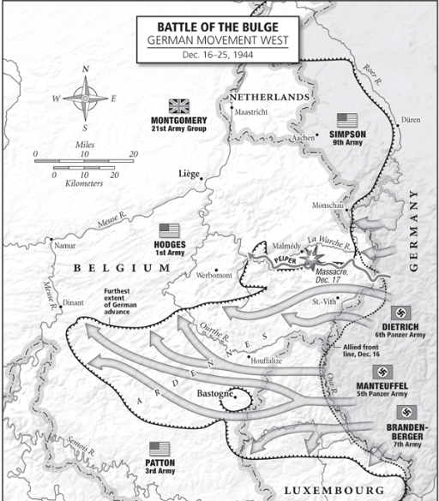
Initial German Counter Offensive
Germans had two initial advantages: Surprise and weather
Patton and Hodges 90 degree turn was crucial
“There is a great confusion an all signs of a full scale withdrawal. There is a definite lack of grip and confusion, and no one has a clear picture….Everyone knows something has gone wrong and no one knows what or why” (Unnamed American GI)
Battle of St Vith: Loss for Americans, but slowed down German plans
Notes:
Spear like tank formation pushed created wedge in Allied lines, spreading them out and allowing the Germans to break through
Main goal was to break through the right flank( 85 mile stretch with just 3 divisions)
St. Vith: Allies success in pushing back Germans and good positioning allowed them to delay German plans by a week. Because of the minimalist nature of Operation Mist, the timeline for the Offensive had to perfect down to the hour in which certain events happened in order to be successful
Used American dialect speaking spies to throw off Allies
Speaker NOTE ASK QUESTION ABOUT RIGHT FLANK
Siddhu

Slide 10
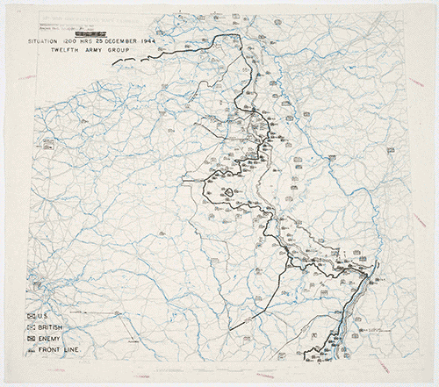
Siege Of Bastogne
Huge American success
Small town surrounded by German forces
Held down by 101st Airborne Division
Traps, Anti-Tank guns, and resilience
“Pattons Counter offensive not only broke the ring enclosing Bastogne but also destroyed a portion of the German penetrating force, eliminating hundreds of enemy vehicles and thousands of troops” (Irzyk)
Notes:
Had to feed 3000, civilians +18,000 troops
Initially, Germans tried to take city with men, didn’t work, so they switched to tanks
Used barbed wire as mantraps, Soham
Limited Artillery specifically positioned so that they could hit enemies coming from multiple directions
Only fired when enemies got close and were all bunched up together
“Rundstedt Chief of staff would later list the failure to conquer bastogne as the first among seven factors that caused [The Ardennes Offensive] to fail”
Patton's 4th Armored Division attack from south, destroying German encirclment
Soham

Slide 11
Thesis
Germany’s poorly planned push as well as the American strategic leadership in the 1944 Ardennes Offensive trounced any hope for a German comeback, and opened the way for both Russo-American two front invasion of Germany, leading to the Allied victory of WW2
Notes:
Shane

Slide 12
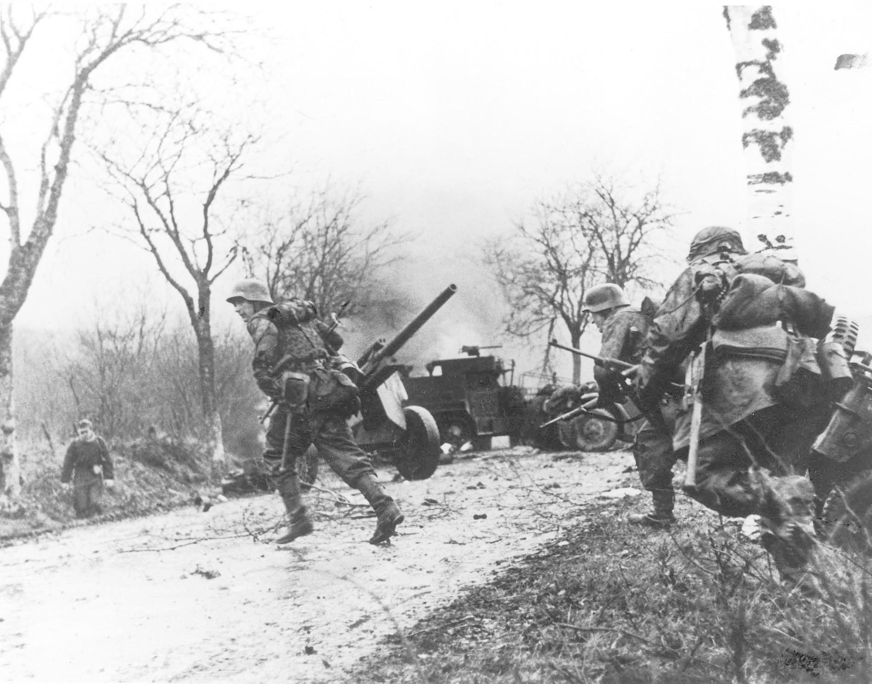
German Offensive Slows down
Weather and Terrain turned against Nazis
“Bastogne was a poisonous thorn in [Germany’s] left flank, St Vith a prickly nettle on his right”
Air attacks completely failed
Major ammo and fuel shortages, Panzer “Cannibalism” ensued
Notes:
(shorter days thick forests) + snow and cold
Panzers destroyed by Germans in order to salvage whatever fuel and parts they could to supply the rest of the Panzers
New Pozit shells made Air attacks useless. They used radio waves to tell when a plane was near the shells blast radius, so it could explode
Shane

Slide 13
German Retreat
German Panzer forces completely exhausted and out of supplies, Hitler orders steady retreat
American Forces slowly begin to take back land lost, with help from Cavalry backup
By January 25th most of German forces returned to Siegfried Line, severely battered
Significant losses made western and eastern front forces even harder to defend allowing for the Fall of Berlin
Notes:
There weren’t any big allied attacks in this battle. Biggest thing that helped allies win was defensive tactics and German poor resource management
-Siddhu

Slide 14
PARTICIPATION TIME
Notes:
-Siddhu

Slide 15
1. What Belgian city did the Germans want to capture
Notes:
Soham

Slide 16
2. What was the effect of the Battle of St. Vith
Notes:
Soham

Slide 17
3. What big factors allowed the Germans to be initially successful
Notes:
Siddhu

Slide 18
4. What was the town the Americans held for the entire battle
Notes:
Siddhu

Slide 19
5. Why were the German air attacks unsuccessful
Notes:
Shane

Slide 20
6. Predict what effect that the battle had on the war as a whole
Notes:
Shane

Slide 21
Thesis
Germany’s poorly planned push as well as the American strategic leadership in the 1944 Ardennes Offensive trounced any hope for a German comeback, and opened the way for Russo-American two front invasion of Germany, leading to the Allied victory of WW2
Notes:
Shane

Slide 22
Aftermath and Effects
American Losses stood at 105,000 casualties with 20,000 dead
Germany losses unclear, estimated 98-120,000 casualties anywhere from 11,000-25,000 dead
Morale, ammo, armor, and fuel extremely low
Lack of German resistance on Eastern front pushed forward Soviet invasion of Poland by 6 weeks
“When you catch a carp and put him on a boat, he flips his tail just before he dies. I think this was Germany’s last flip”(Patton)
Notes:
For german casualties: American interwar estimate 120k, post war estimate 98k
Real loss was armor: Germany lost 700 tanks, cannibalism, left behind in retreat, or straight up destroyed
Soham

