Slide 1
Operation Barbarossa
Battle of Stalingrad
Siege of Leningrad
Largest Invasion in Human History
AS, AS, & KH

Slide 2
Thesis
Operation Barbarossa, in 1941 was one of the largest modern day military operations, ending in the tactical German failures at Leningrad and Stalingrad, sparking the turning point of the war and ending the German dream of Lebensraum alongside highlighting the Russian’s resilience and their idea of self-sacrifice.

Slide 3
Hitler’s Reasons
Hitler invaded the USSR for 4 main reasons
Hitler hated the Bolsheviks(Hartman 19)
Eliminate Britain allies(Jones 119)
Gain resources and land(Lebensraum)(Roberts 144)
The Russian were a weak and easy target

Slide 4
Where It All Went Down
German Start
Germans Farthest Position
German goal

Slide 5
German Dream of Lebensraum
Hitler main goal with the invasion was to secure Lebensraum or living space as:
Germany's had limited resources of food and raw materials
“Secure for the German people the land and soil they are entitled on this earth.”(Bower 171)
Exterminate the Slavs who unworthy of the land
This Dream was ended by the failure of the Operation

Slide 6
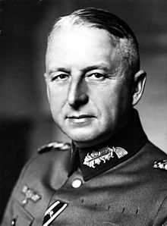
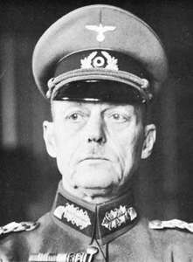
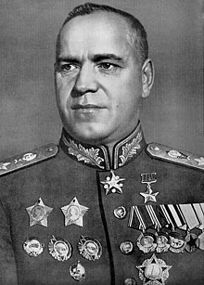
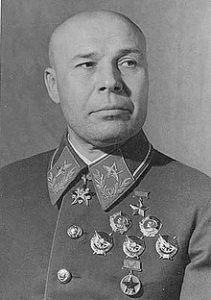
Who’s Who
Axis
Allies

Slide 7
Who’s Who
Axis
Allies

Slide 8
Who’s Who
Axis
Allies
Erich Von Manstein
He led the Axis forces
Was promoted to field marshal
Participated in the Siege of Leningrad.
Tried to break the siege at Stalingrad

Slide 9
Who’s Who
Axis
Allies
Gerd von Rundstedt
He was also promoted to the rank of Field Marshal
Commanded Army Group South during the invasion(Stalingrad)

Slide 10
Who’s Who
Axis
Allies
Georgy Zhukov
Commanded the 1st Belorussian Front
Pushed the Germans out of Russia

Slide 11
Who’s Who
Axis
Allies
Semyon Timoshenko
Was critically defeated in the beginning of the operation
Replaced by Zhukov

Slide 12
Timeline
1941-December - Winter Campaign of 1941–1942, USSR’s counter offensive begins
1941-June - start of Operation Barbarossa
1944-January – Siege of Leningrad raised
1941-1944
1941-September - Siege of Leningrad – the city of Leningrad and armies of the Leningrad Front encircled
1942-September - Battle of Stalingrad starts– Bloodiest battle in history
1944-April – The USSR pushes the Germans out of Russia

Slide 13
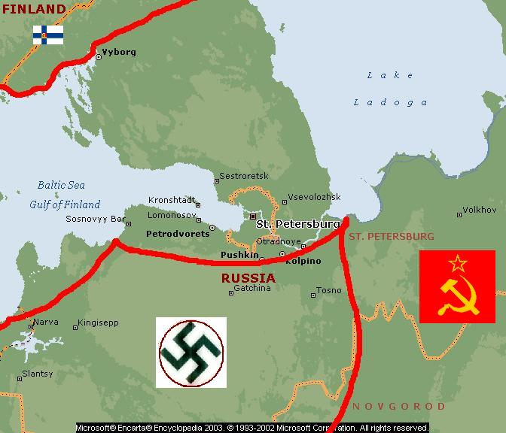
Siege of Leningrad
Lasted 900-days
One of the longest and most destructive sieges of all time
Highlights Russian resilience through the longevity of their stand
Russian Civilians Volunteered and built defenses

Slide 14
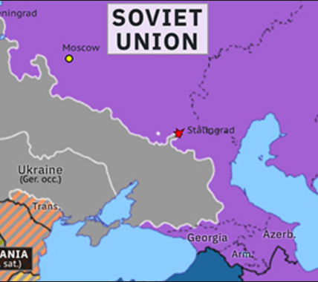
Battle of Stalingrad
Soviet army defends against German 6th army
Important hub for transportation
It was close to the oil fields,
Germans fail to break the Russian lines
Turning point of the war
The Russian people fought house by house and street by Street

Slide 15
Overall effect on the War
Over 1 million Germans and 5 million Soviets died
Germans lose many key member of their army
600,000 square mile taken in 4 months
Turning the tide of the war towards the Allies side

Slide 16
Thesis
Operation Barbarossa, in 1941 was one of the largest modern day military operations, ending in the tactical German failures at Leningrad and Stalingrad, sparking the turning point of the war and ending the German dream of Lebensraum alongside highlighting the Russian’s resilience and their idea of self-sacrifice.

Slide 17
Timeline
1941-December - Winter Campaign of 1941–1942, USSR’s counter offensive begins
1941-June - start of Operation Barbarossa
1944-January – Siege of Leningrad raised
1941-1944
1941-September - Siege of Leningrad – the city of Leningrad and armies of the Leningrad Front encircled
1942-September - Battle of Stalingrad starts– Bloodiest battle in history
1944-April – The USSR pushes the Germans out of Russia

Slide 18
Review
1) Manstein
2) Rundstedt
3)Zhukov
1) By implementing General Plan Ost and taking over the bloodlands by invading the Soviet Union and exterminating the Slavs that lived there.
2)Stalingrad was the turning point of the War
3)The Russian Resolve and the will of the people turned the war in the favor of the Russians

Slide 19
Works Cited
Beevor, Antony. Stalingrad: the Fateful Siege: 1942-1943. The Easton Press, 2004.
Britannica, The Editors of Encyclopaedia. “Siege of Leningrad.” Encyclopædia Britannica,
Encyclopædia Britannica, Inc., 1 Sept. 2018, www.britannica.com/event/Siege-of-Leningrad.
HARTMANN, CHRISTIAN. OPERATION BARBAROSSA: Nazi Germany's War in the East,
1941-1945. OXFORD UNIV PRESS, 2018.
DUGARM, A. DELANO. "Operation Barbarossa." Encyclopedia of Russian History, edited by
James R. Millar, vol. 3, Macmillan Reference USA, 2004, pp. 1110-1111. Gale Virtual Reference Library https://link.galegroup.com/apps/doc/CX3404100956/GVRL?u=kcls_main&sid=GVRL&xid=86bf3e08
Frame, Arthur T. "Soviet Union, Invasion of (Operation BARBAROSSA) (June 22, 1941–September 20, 1941)." Germany at War: 400 Years of Military History, edited by David T. Zabecki, vol. 3, ABC-CLIO, 2014, pp. 1216- 1221. Gale Virtual Reference Library,https://link.galegroup.com/apps/doc/CX6174900890/GVRL? u=kcls_main&sid=GVRL&xid=3969c22b.
Hellbeck, Jochen. Stalingrad: the City That Defeated the Third Reich. PublicAffairs, 2016.
Jones, Michael K. Stalingrad: How the Red Army Survived the German Onslaught. Casemate, 2007.

Slide 20
Works Cited Cont.
Jones, Michael K. Total War: from Stalingrad to Berlin. John Murray, 2012.
Limbach, Raymond. “Battle of Stalingrad.” Encyclopædia Britannica, Encyclopædia Britannica,
Inc., 18 Jan. 2019, www.britannica.com/event/Battle-of-Stalingrad.
“Operation 'Barbarossa' And Germany's Failure In The Soviet Union.” Imperial War Museums,
www.iwm.org.uk/history/operation-barbarossa-and-germanys-failure-in-the-soviet-union.
Roberts, Andrew. The Storm of War: a New History of the Second World War. Harper
Perennial, 2012.
Royde-Smith, John Graham. “Operation Barbarossa.” Encyclopædia Britannica, Encyclopædia Britannica, Inc., 15 June 2018, www.britannica.com/event/Operation-Barbarossa.
Tumarkin, Nina. "The Great Patriotic War as myth and memory: in Soviet eyes the Second
World War is being transformed from heroic farce to grotesque tragedy." The Atlantic, June 1991, p. 26+. Opposing Viewpoints in Context, https://link.galegroup.com/apps/doc/A201491078/OVIC?u=kcls_main&sid=OVIC&xid=28004010
Ziemke, Earl F., and Magna E. Bauer. Moscow to Stalingrad: Decision in the East. Center of
Military History, United States Army, 1987.
"Operation Barbarossa." Europe Since 1914: Encyclopedia of the Age of War and
Reconstruction, edited by John Merriman and Jay Winter, vol. 4, Charles Scribner's Sons, 2006, pp. 1923-1926. Gale Virtual Reference Library, https://link.galegroup.com/apps/doc/CX3447000662/GVRL?u=kcls_main&sid=GVRL&xid=2a13c82c
"Resistance to Nazis." UXL Protests, Riots, and Rebellions: Civil Unrest in the Modern World, edited by Tracey Vasil Biscontini, vol. 3, UXL, 2018, pp. 585-615. Opposing Viewpoints in Context, https://link.galegroup.com/apps/doc/CX3662400026/OVIC?u=kcls_main&sid=OVIC&xid=3cd04586

