Slide 1
The Battles of France
CR, VK, KW

Slide 2
THESIS
During the Battle of France, the implementation of Case Red and Case Yellow into Germany's battle plan allowed them to overrun Allied forces and occupy France, displaying the advanced and aggressive tactics of the Germans leading to the creation of Vichy France and the events at Dunkirk, boosting the morale of the Allies.
Notes:
Don’t read directly off thesis
Summarize the thesis to main points
Using case red+case yellow, germans were able to crush the Allies in France which led to the creation of two “different” frances (not just one), and the Miracle of Dunkirk, which boosted the Allies morale
Will explain how the morale boosted later

Slide 3
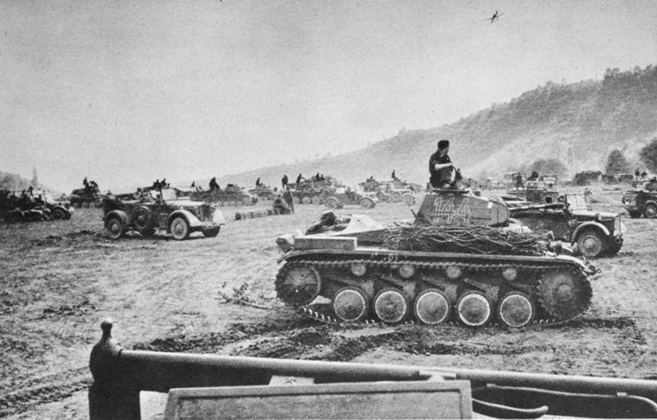
Background of the Operations
The Battle of France was split into three different operations, the execution of Case Yellow, Operation Dynamo and Case Red.
Case Yellow and Case Red were the battle plans of the Germans in the Battle of France.
Operation Dynamo was the Allied plan to evacuate its soldiers out of Dunkirk.
It occurred in the earlier parts of the war
The Battle of France itself lasted from May 10th, 1940 to June 25th, 1940

Slide 4
Timeline (1940)
Start of Invasion and Manstein Plan (Fall Gelb)
Start of Case Red (Fall Rot)
June 22-25
May 27
May 10
June 5-14
Operation Dynamo
End of the Invasion and Armistice signed

Slide 5
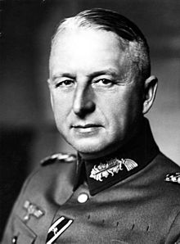
Case Yellow/Fall Gelb: May 10, 1940
Was the initial plan of attack of the Germans for the Battle of France.
Developed by Erich von Manstein
It was a modified version of the Schlieffen plan, modified to work with Blitzkrieg.
Consisted of multiple attack groups, consolidated and named Group A, B, and C.
The plan was to have a decoy attack in the north to draw the attention of the Allies, then attack from the south.
“There would be a faint in strength in Belgium and Holland… But the real German attack would come through Southeastern Belgium.” (Stone)

Slide 6
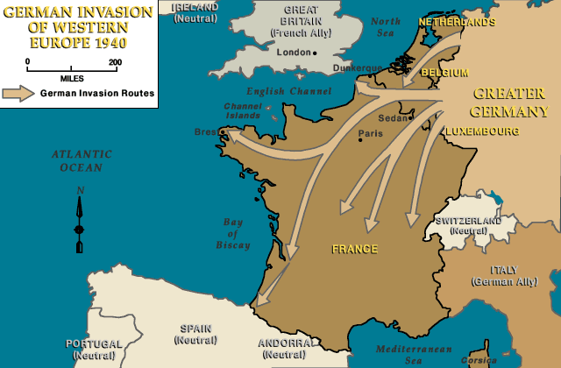
The Execution and Results of Fall Gelb
Each of the German attack groups had a specific task
Case Yellow directly led to the occurence of Operation Dynamo
Indirectly was a factor in the German victory in the Battle of France leading to the creation of Vichy France.
Was a huge testament to the advanced, highly effective battle strategies of Erich von Manstein and Nazis.

Slide 7
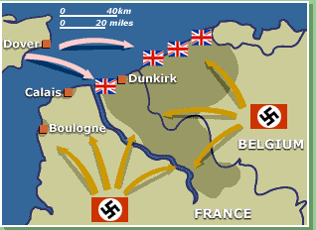
Operation Dynamo: May 27, 1940
Caused by the Allied forces being entrapped into Dunkirk by the the pincer movement of the German army groups.
Allies realized they needed to evacuate and made plans to get away on boats.
Evacuated 338,226 Allied troops from the beaches of Normandy.
Lost lots of supplies, tanks, etc.
Big morale boost for British, sparked temporary pride, propelled them to next battles.
Winston Churchill played a large role in coordinating the Operation
Notes:
What was Dynamo?
Dynamo was the evacuation plan of Britain to get Allied troops out of France because of the invasion
They used civilian passenger boats and other unusual tactics to get troops out
Troops were being bombed out on the beaches of Normandy by the German Air Force, or Luftwaffe
Evacuated 338,226 troops, but sadly many supplies and tanks were lost due to the evacuation
Big morale boost BECAUSE they were able to save so many lives
Propelled them through the rest of the war

Slide 8
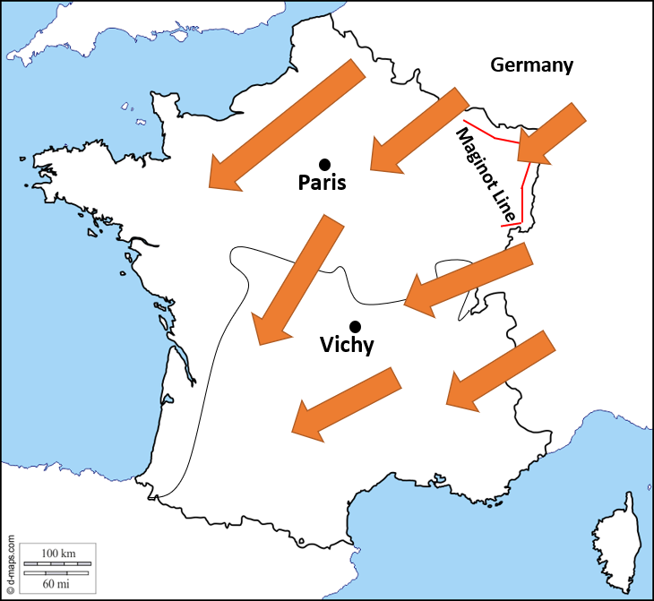
Case Red/Fall Rot: June 5-14, 1940
Goal: 2nd phase of conquest of France by Germany
Consisted of two sub-operations:
Preliminary attack: June 5th on Somme River
Main Offensive by Group A: June 9th on Aisne River
Germany penetrated the Maginot line allowing German troops to cut off French troops in the bunkers taking away French defensive assets.
Result: German victory and led to French armistice.
Map made from scratch

Slide 9
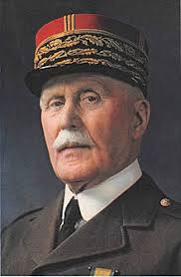
Vichy, France
After the Battles of France, the Nazi installment in the French government led to the creation of southern Vichy France under the regime of Marshal Phillipe Petain.
Its creation was a result of the German’s decisive victory of the Battle of France
Acted as a puppet government for France as many of its leaders fled to this city
A right-wing, authoritarian government
“There was no other occupied country during the second world war which contributed more to the initial efficiency of Nazi rule in Europe than France.” (Roberts)

Slide 10
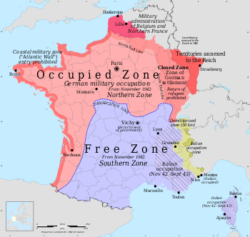
Occupied France
The part of France that was controlled by the Nazi military
The north/northwestern parts of France
Full military administration that controlled Occupied France
Opposite of Vichy France
Not a puppet government but the actual one
“In the occupied part of France the German Reich exercises all rights of an occupying power. The French Government obligates itself.”(Goldberg)
Notes:
The second part of France was Occupied France
This was mainly in the north and west parts of france.
This was called occupied france because it was occupied and controlled solely by the military
Vichy frnce in the south was controlled by a puppet govt but occupied france was secretly by militaary
Everyone knew the military was really in control not the govt at vichy
Very important to know that OCCUPIED FRANCE AND VICHY FRANCE WERE MADE BECAUSE OF GERMAN OCCUPATION

Slide 11
Works Cited
"The Battles of France." Royal AirForce Museum, www.rafmuseum.org.uk/research/online-exhibitions/history-of-the-battle-of-britain/the-battle-of-france.aspx. Accessed 28 Apr. 2019.
Discover Ideas about Dunkirk Map. www.pinterest.com/pin/239464905170200967/. Accessed 28 Apr. 2019.
"Dunkirk evacuation." Britannica Library, Encyclopædia Britannica, 12 July. 2017. library-eb-com.ezproxy.kcls.org/levels/referencecenter/article/Dunkirk-evacuation/472239#337607.toc. Accessed 25 Apr. 2019
Forczyk, Robert. Case Red: The Collapse of France. Bloomsbury Publishing PLC, 2019.
Goldberg, Harold J. Competing Voices from World War II in Europe. Santa Barbara,
ABC-Clio, 2010.
"Invasion of Poland, Fall 1939." United States Holocaust Memorial Museum. United States Holocaust Memorial Council, 20 June 2014. Web. 14 May 2015.
Miller, Donald L., and Henry Steele Commager. The Story of World War II. New
York, Simon & Schuster, 2001.
Roberts, Andrew. The Storm of War: A New History of the Second World War. New
York, Harper, 2011.
Stone, Norman. World War Two: A Short History. New York, Basic Books, 2013.
Tucker, Spencer. Encyclopedia of World War II: A Political, Social and Military
History: D - K. Santa Barbara, ABC-Clio, 2005.
Wikipedia contributors. "Erich von Manstein." Wikipedia, The Free Encyclopedia. Wikipedia, The Free Encyclopedia, 19 Apr. 2019. Web. 28 Apr. 2019.
Wikipedia contributors. "Philippe Pétain." Wikipedia, The Free Encyclopedia. Wikipedia, The Free Encyclopedia, 20 Apr. 2019. Web. 29 Apr. 2019.

