Slide 1
Battle of the Atlantic

Slide 2
Battle of the Atlantic Background and Key Figures:
Background: After the fall of the western front, Britain was the only remaining allied country. Germany tried to force Britain to surrender by cutting off any supplies going to them. Germany tried to force Britain to surrender by cutting off any supplies going to them.
Admiral Karl Doenitz
The Kriegsmarine was unprepared, not expecting war before 1945. U-boat construction given priority. When the war began, Dönitz had 46 U-boats ready for action but only 22 oceangoing He made do with what he had, while being harassed by Raeder and with Hitler calling on him to dedicate boats to military acton

Slide 3
Thesis:
The Battle of the Atlantic was an essential victory for the Allies due to Britain being the only remaining country. Axis supremacy in the beginning of the battle was caused by the Allies inability to stop the U-boats from terrorizing their ships thus severely slowing down their naval transportation. However, technological breakthroughs by the Allies led to the elimination of the U-boats which ended with victory in the Atlantic.

Slide 4
First part of Thesis
The Battle of the Atlantic was an essential victory for the Allies due to Britain being the only remaining country.

Slide 5
Importance of the Battle
After the fall of the western front, Britain was the only remaining Allied country.
Germany tried to force Britain to surrender by cutting off any supplies going to them.
The British needed to survive the blockade as surrendering would result in the loss of the war for the Allies.
“The Battle of the Atlantic,” said Churchill, “was the dominating factor all through the war. Never for one moment could we forget that everything happening elsewhere, on land, at sea, or in the air, depended ultimately on its outcome (Miller)

Slide 6
Second part of Thesis
Axis supremacy in the beginning of the battle was caused by the allies inability to stop the U-boats from terrorizing their ships thus severely slowing down their naval transportation.

Slide 7
Early German Success
The Allies were unprepared for the Germans as their U-Boats roamed at will from Canada to the Caribbean, slaughtering Allied shipping
"The losses by submarines off our [U.S.] Atlantic seaboard and in the Caribbean now threaten our entire war effort" (Hastings)
"Nazis may take comfort in reflecting that no army, fleet or other unit in World War II... wrought such destruction and misery as the U-Boats" (Redford)

Slide 8
Third part of Thesis
Technological breakthroughs by the Allies led to the elimination of the U-boats which ended with victory in the Atlantic

Slide 9
Late Allied Success
The Allies found success in 1942 as Alan Turing, a British mathematician, broke the german messaging system for the U-Boats.
This, combined with new anti-submarine tech, allowed for the Allies to gain supremacy in the battle
"All these things came to a head at once and when they did we slaughtered the U-Boats for three months, April, May, June of 1943" (Miller)
"The Nazis would call it Black May, and at the end of the month Admiral Doenitz pulled his boats from the North Atlantic, ''We had lost the Battle of the Atlantic,'' he privately admitted" (McLean)

Slide 10
Why is this important? / Context for War
After May of 1943, Allies did not have to worry about transportation to Europe and North Africa
Able to focus on their offensive and push forward in North Africa
"From this point on, the Allies would apply American industrial might with crushing impact, on land, on sea, and in the air" (Miller)

Slide 11
Timeline:
7 most important events of the Battle of the Atlantic: Timeline
1. Battle of the Atlantic begins. -September 1939
2. German U-boats sink British passenger liner Athena. -September 1st, 1939
3. Admiral Doenitz claims that the Battle of the Atlantic is lost, “Black May” occurs. -May 1940
4. Alan Turing, along with others at Bletchley Park, crack the enigma code. -January 1942
5. U.S. involvement in battle after U-Boats sink the Cyclops. -December 1942
6. Peak of the Battle. -1940-1943
7. The battle of the Atlantic comes to an end. -May 1945

Slide 12
Multiple Choice Questionnaire:
Names:
Multiple choice questionnaire:
1. Allied success was due to breaking what virtually unbreakable code set by the Germans so they could hide the locations of their U-boats and warships?
A. Atlantic code
B. Supremacy code
C. Enigma code
D. Both A and C are correct answers.
E. None of the above.

Slide 13
Battle of the Atlantic questionnaire
2. As WW2 began the Kriegsmarine was unprepared. Not ready for battle, what plan was set in place calling for a balanced fleet with a greatly increased number of surface capital ships, including several aircraft carriers?
A. Hitler Plan
B. Plan Z
C. Plan G
D. Both plan Z, and plan G. B and C are both correct answers.
E. All of the above. All of the above plans were called into action during the start of WW2.
3. What did the Battle of the Atlantic force the Allies to do in order to gain back advantage over Germany?
A. Submit more sailors and pilots to help support the allies in aerial, on sea, and below sea combat
B. Supply more food and resources to Vichy France
C. Adapt to German naval battle tactics
D. Both A and C are correct answers.
E. All of the above. All of the above are correct ways in which the allies tried to take advantage over the Germans.

Slide 14
Battle of the Atlantic questionnaire
4. Admiral Doenitz claims that the Battle of the Atlantic is lost. What event occurs due to this action?
The enigma code is broken
The Germans lose the war and surrender
The U.S. plan to rade Germany
Black May
None of the above. None of the above are events that occur due to this action.

Slide 15
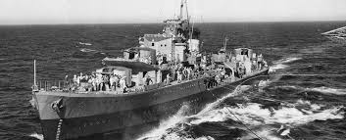
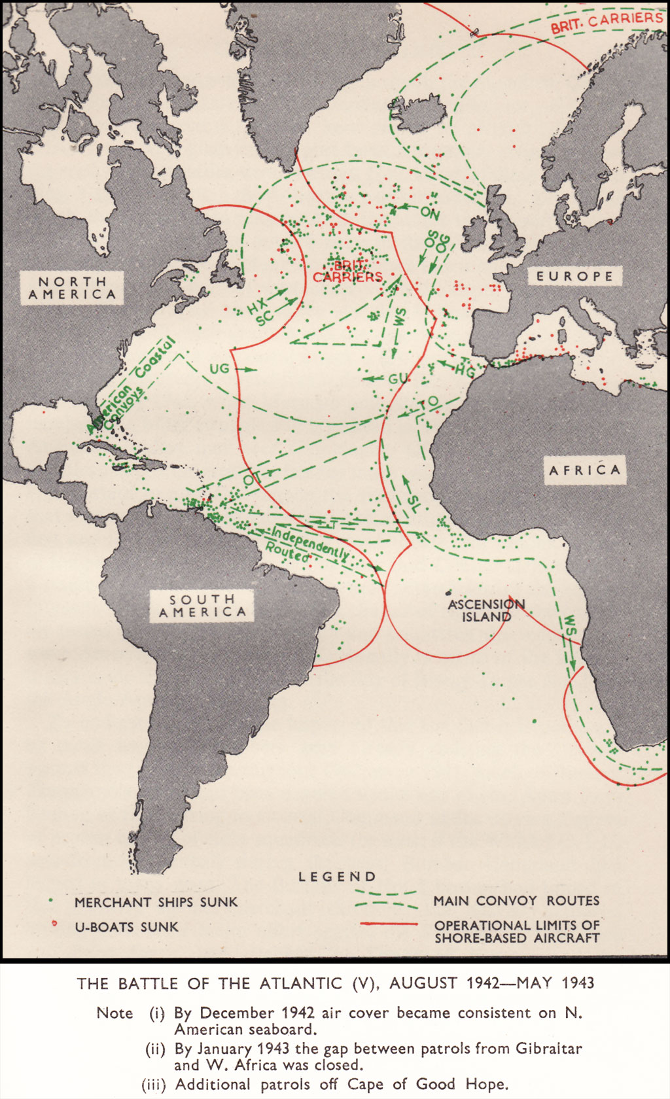
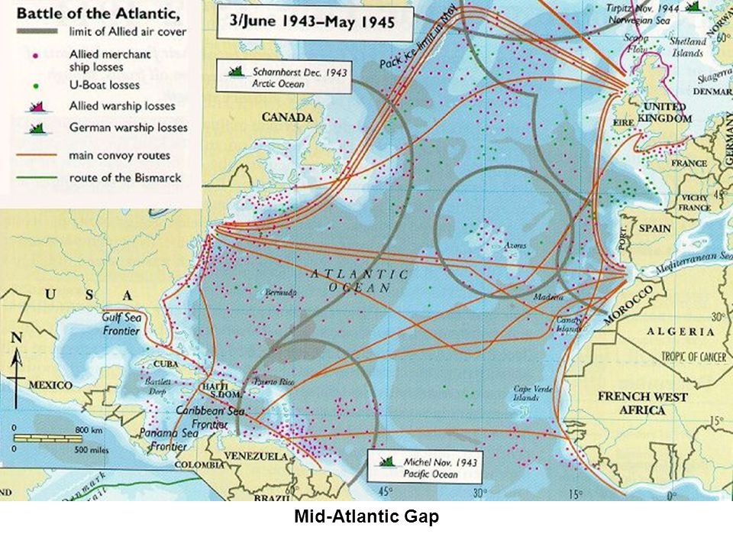
Visuals: Maps, Pictures, etc
Image 1.
Image 2.

Slide 16
Who won? Further Information and Key events:
The allies were unprepared for the Germans as their u-boats roamed at will from Canada to the Caribbean, slaughtering allied shipping (Miller).
In the beginning axis were dominat due to the use of their u boats and the allies inability to counter them but the tide turned after the allies gained a technological advantage

Slide 17
Who won? Further Information and Key events:
The allies found success in 1942 as Alan Turing, a British mathematician, broke the german messaging system for the u-boats. This, combined with new anti-submarine tech, allowed for the allies to gain supremacy in the battle

Slide 18
Works Cited
Axelrod, Alan. “Battle of the Atlantic.” Encyclopedia of World War II, Vol. 1, Facts On File, 2013. History Research Center,
online.infobase.com/Auth/Index?aid=150531&itemid=WEHRC&articleId=264577. Accessed 22 Apr. 2019.
Hastings, Max. Inferno: The World at War, 1939-1945. Vintage Books, 2011.
McLean, Douglas. "Confronting Technological and Tactical Change: Allied
Antisubmarine Warfare in the Last Year of the Battle of the Atlantic."
Naval War College Review. JSTOR.
Miller, Donald. The Story of World War II. Simon & Schuster, 2001
Norton, Douglas M. Naval War College Review. Naval War College Review, 1974.
JSTOR.
Redford, Duncan. "The March 1943 Crisis in the Battle of the Atlantic: Myth and
Reality." History. JSTOR.
Bing, Microsoft, www.bing.com/images/search?view=detailV2&id=2544F0181062ABB5B220510DC054F0941B1FC368&thid=OIP.TxIHTUTOAPtBZNtTI7e-uAHaMJ&mediaurl=http%3A%2F%2Fwww.ibiblio.org%2Fhyperwar%2FUN%2FUK%2FUK-RAF-II%2Fmaps%2FUK-RAF-II-7.jpg&exph=1680&expw=1024&q=battle%2Bof%2Bthe%2Batlantic%2Bmap&selectedindex=9&ajaxhist=0&vt=0&eim=1%2C2%2C6.

