Slide 1
BATTLE OF THE BALTICS
SS, IR, PV, MW​

Slide 2
LEARNING TARGET
Students will be able to understand the Battle of the Baltics and explain its lasting effects on the Allies' victory in World War II.

Slide 3
THESIS
The Baltic Operation resulted in the vast dispersion of the German army and resources across the Baltics in the form of a two-front war, decreasing their ability to battle proficiently, which in turn led to the defeat of Nazi Germany in World War II.

Slide 4
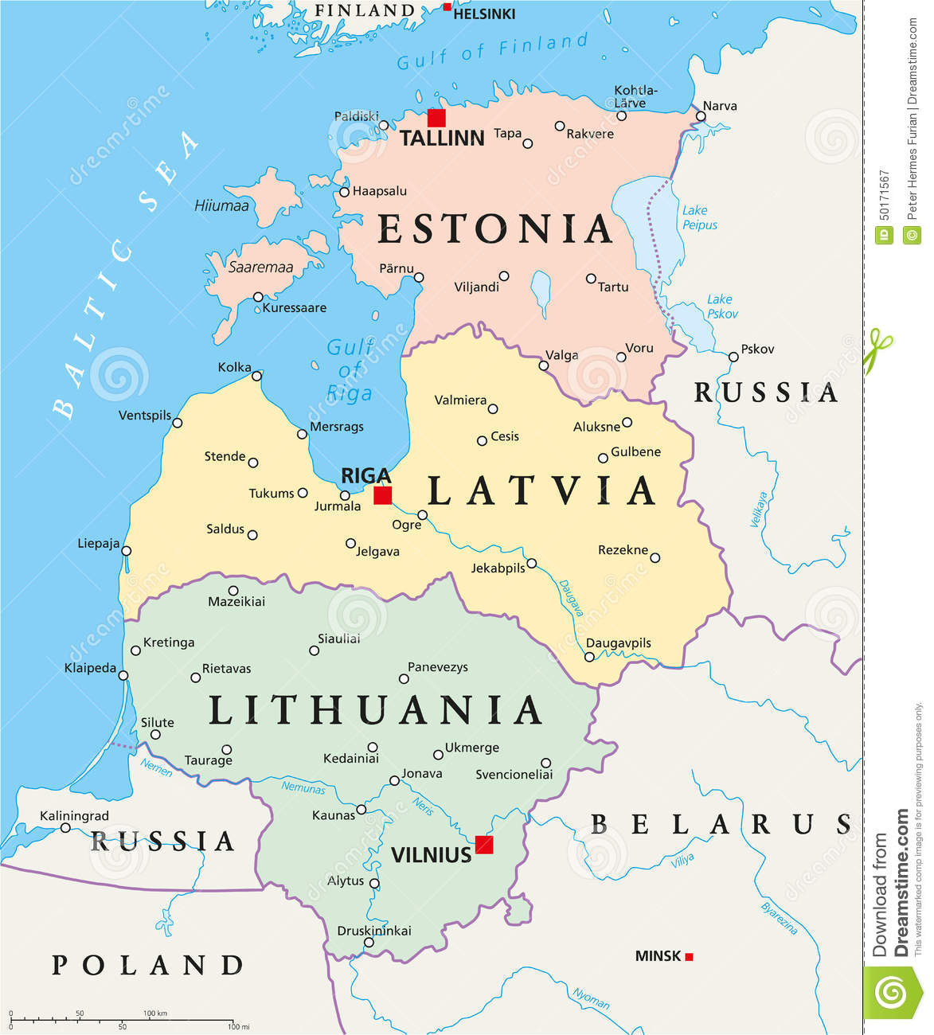
3 Baltic States: 1. Estonia​ 2. Lativa 3. Lithuania Importance: Relative proximity to water for trade and commerce

Slide 5
Baltic Wars vs Balkan Wars
Don’t mix up these 2!!
Around 1,000 miles away sits the Balkan region in south-eastern Europe.
Croatia
Bosnia-Herzegovina
Serbia

Slide 6
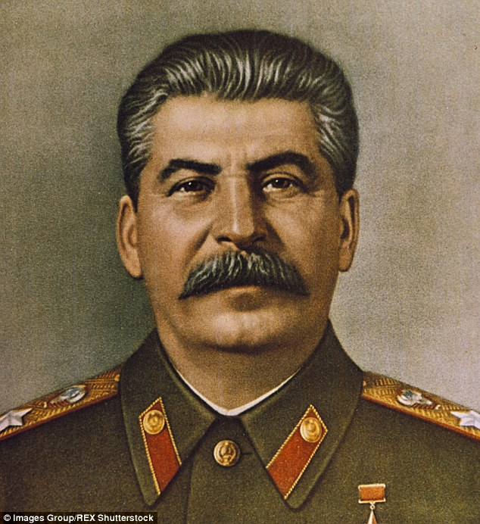
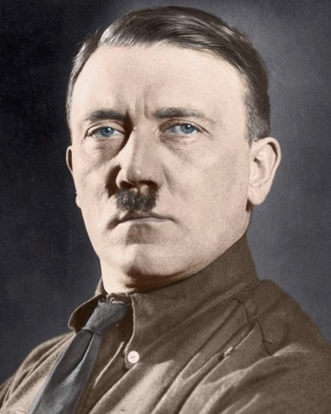
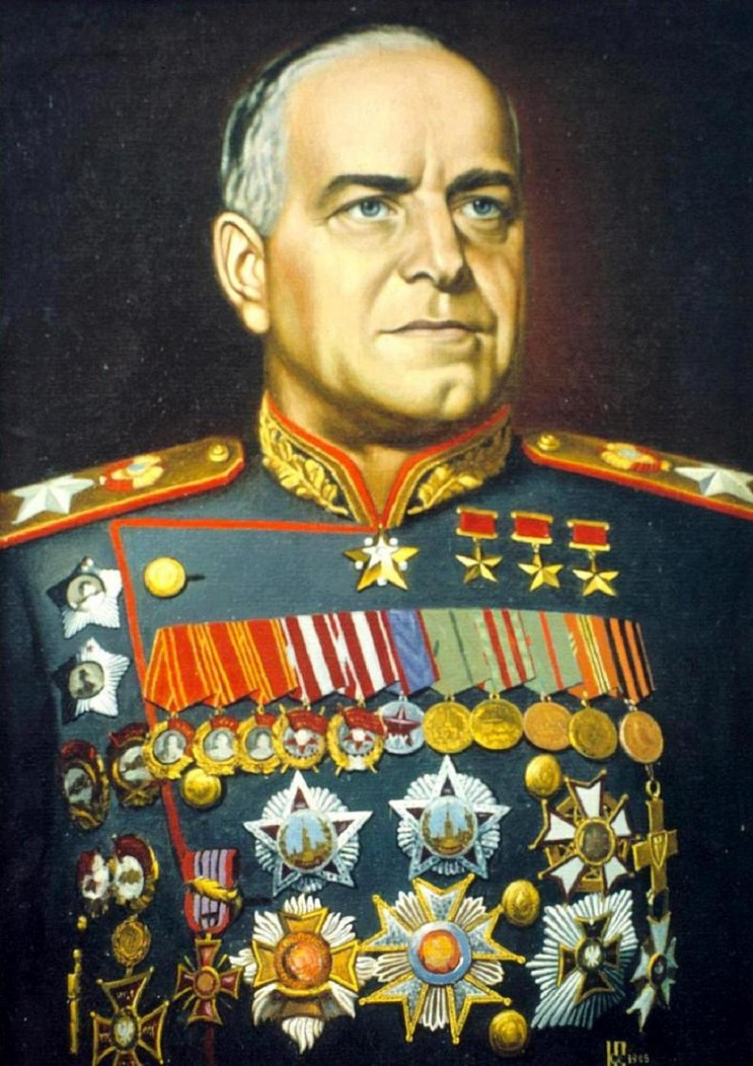
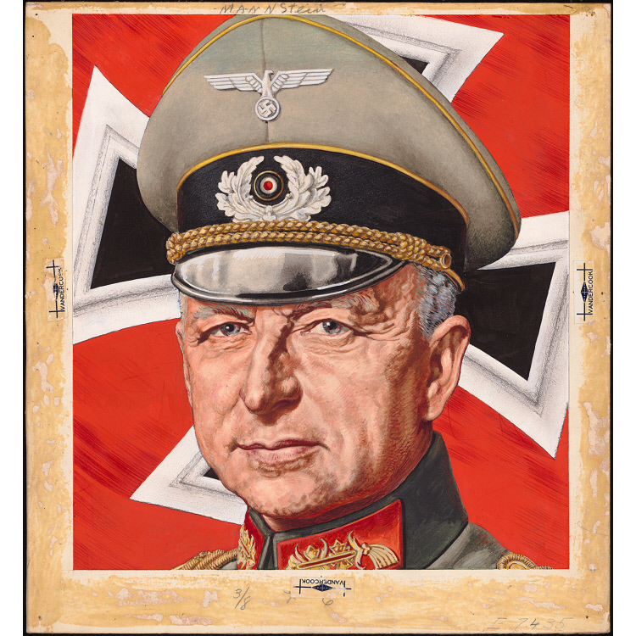
IMPORTANT FIGURES
USSR (ALLIES)
GERMANY (AXIS)
Joseph Stalin
Adolf Hitler
Georgy Zhukov
Erich Von
Manstein

Slide 7
TIMELINE
Before the Battle of the Baltics (1939-1941)
Baltic Operation (1941):
Baltic Offensive (1944): USSR gains Baltics back from Nazi Germany

Slide 8
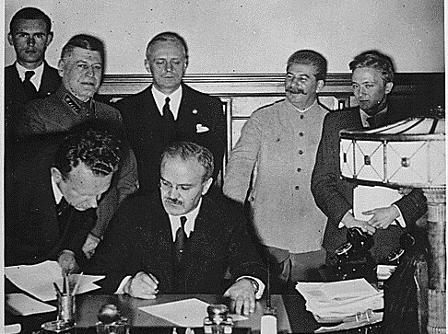
Before The War: Molotov – Ribbentrop Pact (Nazi-Soviet Non-Aggression Pact 1939)

Slide 9
TIMELINE
Before the Battle of the Baltics(1939)
August 23rd, 1939: Molotov-Ribbentrop Pact signed by USSR and Germany
1940: Lithuania, Estonia, Latvia (Baltic States) are grouped as part of USSR territory

Slide 10
Baltic Operation
June 22nd – July 9th 1941
Result of Operation Barbarossa (1941)
USSR taken aback from German attacks using blitkreig tactics
German victory
Failed attempt of USSR at defending Baltic territory against Germany

Slide 11
TIMELINE
Before the Battle of the Baltics (1939-1941)
August 23rd,1939: Molotov-Ribbentrop Pact signed by USSR and Germany
1940: Lithuania, Estonia, Latvia (Baltic States) are grouped as part of USSR territory
Baltic Operation (1941): Germany takes over the Baltics; USSR fails to defend Baltics
Result of Operation Barbarossa (June 22nd 1941) to reclaim Baltics
1939-1941: Germany and USSR dispute over Baltic territory
July 9th 1941 : German victory

Slide 12
THESIS
The Baltic Operation resulted in the vast dispersion of the German army and resources across the Baltics in the form of a two-front war, decreasing their ability to battle proficiently, which in turn led to the defeat of Nazi Germany.

Slide 13
Baltic Offensive "Baltic Strategic Offensive"
Sept. - Nov. 1944
Counterattack by USSR in response to Baltic Operation
Northern Fronts of Red Army vs. German Northern Army
USSR Goal: Push back Germany
Allies Victory
Hitler's Defeat

Slide 14
Operation Bagration (June – Aug 1944)
"Single most successful and strategic, military action" -Paul Adair (Hitler's Greatest Defeat)
Two-front war (WEST/EAST)
Hitler's biggest & indecisive mistake
"Maskirovka": Technique of Deception used by USSR
Hitler unable to withhold USSR pressure on both fronts
"There were three times as many Germans in action fighting trying to hold up the Russian advance" -Geoffrey Wawro (Hitler's Greatest Defeat)
Soviets recapture Polish lands from German territory

Slide 15
Map of Operation Bagration
Soviets push into Baltics to take back German territory
Numerous attacks from various directions

Slide 16
Aftermath of Baltic Offensive
Isolation and encirclement of the Army Group North​ (Nazi Germans)
Severe economic and military disorders​
Allows Red Army to advance towards Germany and near the end of WW2
USSR reoccupy Baltic States
No united German attack

Slide 17
TIMELINE
Before the Battle of the Baltics (1939-1940)
August 23rd, 1939: Molotov-Ribbentrop Pact signed by USSR and Germany
1940: Lithuania, Estonia, Latvia (Baltic States) are grouped as part of USSR territory
Baltic Operation (1941): Germany takes over the Baltics; USSR fails to defend Baltics
Result of Operation Barbarossa (June 22nd 1941) to reclaim Baltics
1939-1941: Germany and USSR dispute over Baltic territory
July 9th 1941 : German victory
Baltic Offensive (1944): Russia takes back the Baltics
June – August 1944: Operation Bagration: Huge success for USSR and destroyed German central army
1944: USSR reoccupies Estonia, Lativa, and Lithuania
1947: Sovietization of Baltic States

Slide 18
THESIS
The Baltic Operation resulted in the vast dispersion of the German army and resources across the Baltics in the form of a two-front war, decreasing their ability to battle proficiently, which in turn led to the defeat of Nazi Germany in World War II.

Slide 19
Importance of Battle & Long Term Effects
Hitler's Defeat​
Allies Victory​
Greatest land campaign ever fought during WWII​
Reinstillation of Stalinism

Slide 20
THESIS
The Baltic Operation resulted in the vast dispersion of the German army and resources across the Baltics in the form of a two-front war, decreasing their ability to battle proficiently, which in turn led to the defeat of Nazi Germany in World War II.

Slide 21
Flash Card Activity
Example:
Match each of the descriptions (bullet points) with the correct key terms/events we learned today!
Baltic Operation | Counterattack by USSR in response to Baltic Operation Northern Fronts of Red Army vs. German Northern Army

Slide 22
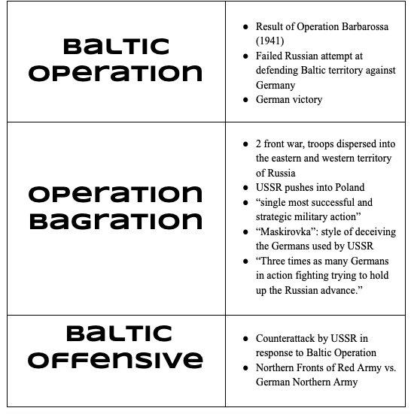

Slide 23
Works Cited
Axelrod, Alan, and Charles L. Phillips. "World War II on the Russian Front." Wars in the Early 20th Century (1900 to 1950), Facts on File, 2015. History Research Center, online.infobase.com/Article/Details/208115?q=baltic operation.
Britannica, The Editors of Encyclopedia. “German-Soviet Nonaggression Pact.” Encyclopedia Britannica, Encyclopedia Britannica, Inc., 20 Dec. 2018,
"Estonia." World History: The Modern Era, ABC-CLIO, 2018, worldhistory.abc-clio.com/Search/Display/217242.
Gompert, David C., et al. “Hitler’s Decision to Invade the USSR, 1941.” Blinders, Blunders, and Wars: What America and China Can Learn, RAND Corporation, 2014, pp. 81–92. JSTOR,
Hitler’s Greatest Defeat: The Collapse of Army Group Centre, June 1944, Arms and Armor Press, 1994, p. 66
"Latvia." World History: The Modern Era, ABC-CLIO, 2018, worldhistory.abc-clio.com/Search/Display/217278.
“Nazi-Soviet Relations 1939-1941 : Documents from the German Foreign Office.” Avalon Project - Documents in Law, History and Diplomacy, avalon.law.yale.edu/20th_century/ns025.asp.
Operation Barbarossa." Europe Since 1914: Encyclopedia of the Age of War and Reconstruction, edited by John Merriman and Jay Winter, vol. 4, Charles Scribner's Sons, 2006, pp. 1923-1926. Gale Virtual Reference Library,
Paul Adair, Hitler’s Greatest Defeat: The Collapse of Army Group Centre, June 1944, Arms and Armor Press, 1994, p. 66
Senn, Alfred Erich. “The Sovietization of the Baltic States.” The Annals of the American Academy of Political and Social Science, vol. 317, 1958, pp. 123–129. JSTOR, www.jstor.org/stable/1031085.
Stalingrad to Berlin: The German Defeat in the East, US Army Historical Series, 1987, p. 316
"The World at War, 1914-1945." World History: The modern Era, ABC-CLIO, 2018, worldhistory.abc-clio.com./Search/Display/340469.

