Slide 1
Operation 25 & Operation Marita
Mel McKune A, Sydney Williams A, Phoebe Choi A

Slide 2
Welcome to the German branch of the Axis. We’re on a conquest of lebensraum and are happy to report that we’re on a winning streak! We need to move quickly and swiftly.
GOAL

Slide 3
What is your role today?
We want your help to decide Germany’s next moves. Collaborate to choose the best answer when given each scenario.
Let’s begin.

Slide 4
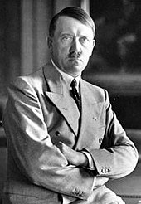
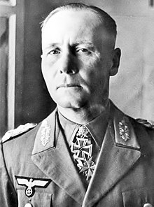
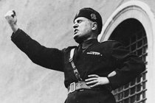
Who’s on our side? (Who’s Who - Axis)
Team Axis
Adolf Hitler
Germany
Benito Mussolini
Italy
Erwin Rommel (ROM-EL)
Germany
Tripartite (TRI-PAR-TIGHT) Pact w/ Bulgaria, Hungary, Romania

Slide 5
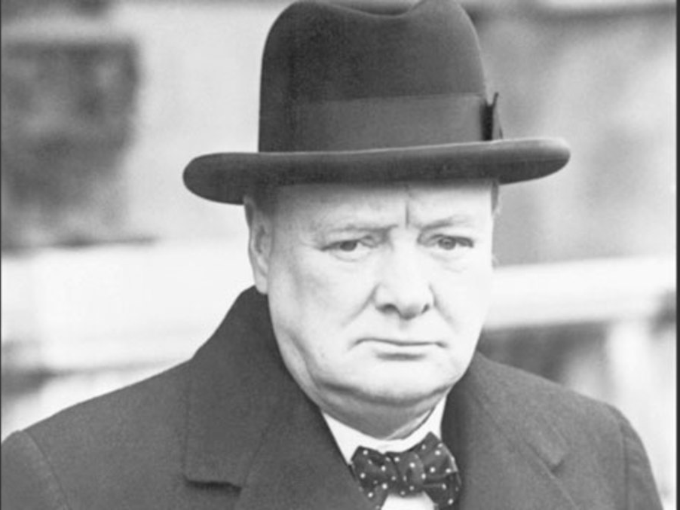
Who’s on our side? (Who’s Who - Axis)
Team Allies
Winston Churchill
Britain
France?

Slide 6
What should our ultimate goal be?
Option 1
INVADE RUSSIA
Option 2
INVADE THE UNITED STATES
4

Slide 7
INVADE RUSSIA
Secure lebensraum!!

Slide 8
How should we invade?
8
OPTION 1
Northern Flank - go through France
OPTION 2
Southern Flank - go through Greece and Yugoslavia

Slide 9
SOUTHERN FLANK
Balkan resources
Prevent Allies from gaining land bases
Step 1: Invade Yugoslavia:
OPERATION 25

Slide 10
What is happening as of now?
Serbs vs. Croats
Prince Paul
Yugoslav coup d’etat
Germany wants to expand

Slide 11
Guerilla Warfare
Both sides of these operations fight with guerilla warfare
This worked relatively well for the resistance fighters

Slide 12
GOAL
ALERT!
We’re experiencing some resistance from the Yugoslav Partisans, a group led by a man named Josip Broz Tito.

Slide 13
Will this resistance affect our goal?
1
Option 1
YES, we will experience a lot of nationalism from the resistance.
Option 2
NO, we can convert Tito to our side and continue on undeterred.

Slide 14
YES, we will experience heavy nationalistic resistance.
“Individual national identity was consumed by the all-purpose Yugoslav ideal which enjoyed a strong appeal among many for sustained periods of the Titoist state” (Glenny 12).

Slide 15
Who’s on our side? (Who’s Who - Axis)
Mission Report Statement
Operation 25 and Operation Marita were the successful German invasions of Greece and Yugoslavia despite nationalist resistance movements which ultimately delayed the German invasion of Russia.

Slide 16
How should we deal with this resistance?
Option 1
Surrender
Option 2
Attempt to make Yugoslavia a puppet state
9

Slide 17
ATTEMPT TO MAKE YUGOSLAVIA A PUPPET STATE
Install a puppet regime under General Milan Nedic
Work to “Germanize” Yugoslavia
Begin a campaign of genocide against the Serb minority

Slide 18
7
WAS THE INVASION OF YUGOSLAVIA SUCCESSFUL?
Option 1
YES
Option 2
NO

Slide 19
YES
Now that we have gone through to Yugoslavia, it’s time to move on to the next phase to reach our goal.
We will invade Greece and call it...
OPERATION MARITA

Slide 20
Who’s on our side? (Who’s Who - Axis)
Mission Report Statement
Operation 25 and Operation Marita were the successful German invasions of Greece and Yugoslavia despite nationalist resistance movements which ultimately delayed the German invasion of Russia.

Slide 21
Should we assist Italy?
Option 1
Save Mussolini and Italy
Option 2
Ditch Italy
3

Slide 22
SAVE MUSSOLINI AND ITALY
Info about why they would do such a thing
Rescue Italian ally to keep Italy under our supervision
Secure Southern flank before invading the Soviet Union

Slide 23
WHO COMES IN TO HELP THE GREECE GUERILLA FIGHTERS?
Option 1
The United States
Option 2
The British
10

Slide 24
THE BRITISH
Winston Churchill
Sabotage
Set Germany back as the fight took much longer than expected

Slide 25
11
WAS THE INVASION OF GREECE SUCCESSFUL?
Option 1
YES
Option 2
NO

Slide 26
YES
*AUDIENCE APPLAUSE*
(WE WON!!!!!!!)

Slide 27
HOWEVER...
The unexpected resistance set us back in Yugoslavia and Greece. Now, our ultimate goal must be set back. What was that goal again?

Slide 28
WHAT WAS THAT GOAL AGAIN?
Option 1
Invade the United States
Option 2
Invade Russia
2

Slide 29
INVADE RUSSIA
We have been over this goal many times. Does that maybe give you a hint about its importance?

Slide 30
Who’s on our side? (Who’s Who - Axis)
Mission Report Statement
Operation 25 and Operation Marita were the successful German invasions of Greece and Yugoslavia despite nationalist resistance movements which ultimately delayed the German invasion of Russia.

Slide 31
DUE TO THESE SETBACKS...
what do you suppose may happen to our ultimate goal?
Option 1
The invasion of Russia will be unsuccessful and cause a turning point in the war
Option 2
The invasion of Russia will continue successfully due to the might of Germany
5

Slide 32
Make a prediction regarding Germany’s success during the Russian invasion.
(You will find out if you are correct during the “Operation Barbarossa” presentation)

Slide 33
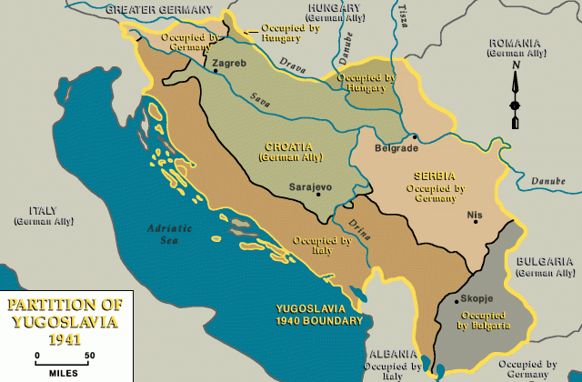
Who’s on our side? (Who’s Who - Axis)
Mission Report
Operation 25
Date: April 6-17, 1941
Place: Yugoslavia
Tito resistance hurt German divisions, sparking nationalism
Ethnic clashes between Serbs and Croats
568 German Soldier deaths
Axis victory

Slide 34
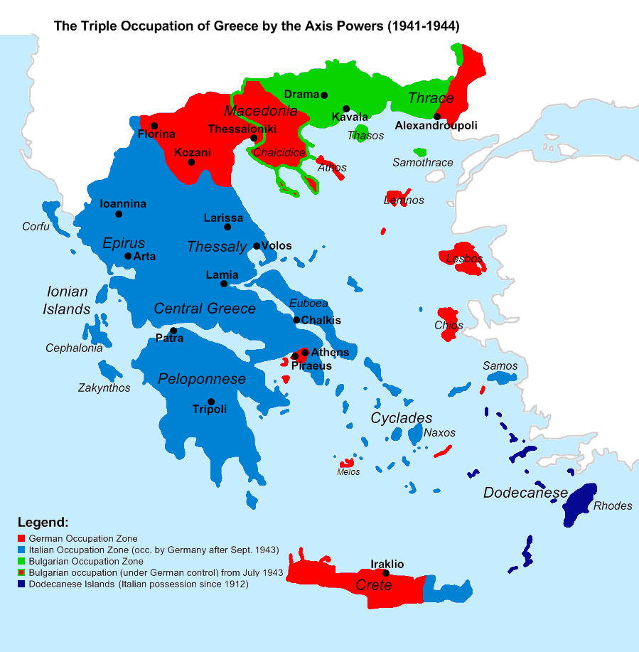
Who’s on our side? (Who’s Who - Axis)
Mission Report
Operation Marita
Date: April 6-30, 1941
Place: Greece
Germany established base for invading Russia
Greek Civil War after World War II
Resistance groups formed the National Liberation Front (EAM)

Slide 35
Who’s on our side? (Who’s Who - Axis)
Mission Report Statement
Operation 25 and Operation Marita were the successful German invasions of Greece and Yugoslavia despite nationalist resistance movements which ultimately delayed the German invasion of Russia.

Slide 36
Operation 25 & Operation Marita Timeline
April 6 1941
Germany and Italy initiates ______________________ and ____________________ in order to start Operation Barbarossa to get to Russia.
Yugoslavia signs Tripartite Pact
Operation 25
Operation Marita
Tito
Yugoslav Partisans Resistance
Yugoslav coup d’etat
Invasion of Yugoslavia ends
Battle of Greece ends
March 25 1941
______________________ - After negotiations with Germany, Yugoslavia agrees to join the Axis Powers.
April 17 1941
_______________________
April 1941
March 1941
May 1941
During Invasion of Yugoslavia
________ led the _______________________________ (nationalist military resistance) against the opposing attacks, holding Germany back.
April 30 1941
______________________
March 27 1941
In Belgrade, Kingdom of Yugoslavia, Prince Paul was overthrown by the Serbs during the ______________________________.

Slide 37
Operation 25 & Operation Marita Timeline ANSWER KEY
April 6 1941
Germany and Italy initiates Operation 25 and Operation Marita in order to start Operation Barbarossa to get to Russia.
Yugoslavia signs Tripartite Pact
Operation 25
Operation Marita
Tito
Yugoslav Partisans Resistance
Yugoslav coup d’etat
Invasion of Yugoslavia ends
Battle of Greece ends
March 25 1941
Yugoslavia signs Tripartite Pact - After negotiations with Germany, Yugoslavia agrees to join the Axis Powers.
April 14 1941
Invasion of Yugoslavia ends
April 1941
March 1941
May 1941
During Invasion of Yugoslavia
Tito led the Yugoslav Partisans Resistance (nationalist military resistance) against the opposing attacks, holding Germany back.
April 30 1941
Battle of Greece Ends
March 27 1941
In Belgrade, Kingdom of Yugoslavia, Prince Paul was overthrown by the Serbs during the Yugoslav coup d’etat.

Slide 38
Works Cited
Axelrod, Alan. “Yugoslavia during World War II.” Encyclopedia of World War II, Vol. 2, Facts On File, 2013. History Research Center, online.infobase.com/Auth/Index?aid=150531&itemid=WEHRC&articleId=265236. Accessed 22 Apr. 2019.
Axelrod, Alan. “Invasion of Greece during World War II.” Encyclopedia of World War II, Vol. 1, Facts On File, 2013. History Research Center, online.infobase.com/Auth/Index?aid=150531&itemid=WEHRC&articleId=264642. Accessed 22 Apr. 2019.
“Germany Invades Yugoslavia and Greece.” History.com, A&E Television Networks, 5 Nov.
2009, www.history.com/this-day-in-history/germany-invades-yugoslavia-and-greece.
Glenny, Misha. The Balkans. Penguin Books, 1999.
Glenny, Misha. The Fall of Yugoslavia: the Third Balkan War. Penguin Books, 1996.
“Greece." Britannica Library, Encyclopædia Britannica, 25 Feb. 2019. library-eb-com.ezproxy.kcls.org/levels/referencecenter/article/Greece/106266. Accessed 27 Apr. 2019.
Hall, Richard C., editor. War in the Balkans. ABC-CLIO, 2014.
Hart, Dr Stephen A. “History - World Wars: Partisans: War in the Balkans 1941 - 1945.” BBC, BBC, 17 Feb. 2011, ww.bbc.co.uk/history/worldwars/wwtwo/partisan_fighters_01.shtml.
Malkoff, Karl. “Axis Occupation of Greece.” History in Literature, Facts On File, 2004. History Research Center, online.infobase.com/Auth/Index?aid=150531&itemid=WEHRC&articleId=45372. Accessed 22 Apr. 2019.
United States Holocaust Memorial Museum. “Axis Invasion of Yugoslavia” Holocaust Encyclopedia. https://encyclopedia.ushmm.org/content/en/article/introduction-to-the-holocaust. Accessed on 22 Apr. 2019.

