Slide 1
Operation Weserübung

Slide 2
Pronunciation
OPERATION
VES-UR-OO-VONG

Slide 3
Thesis
Operation Weserübung allowed Germany to grab control of land and resources in the North, leading to a strengthened German military and ultimately heightening the fear other countries had for Germany during WWII.

Slide 4
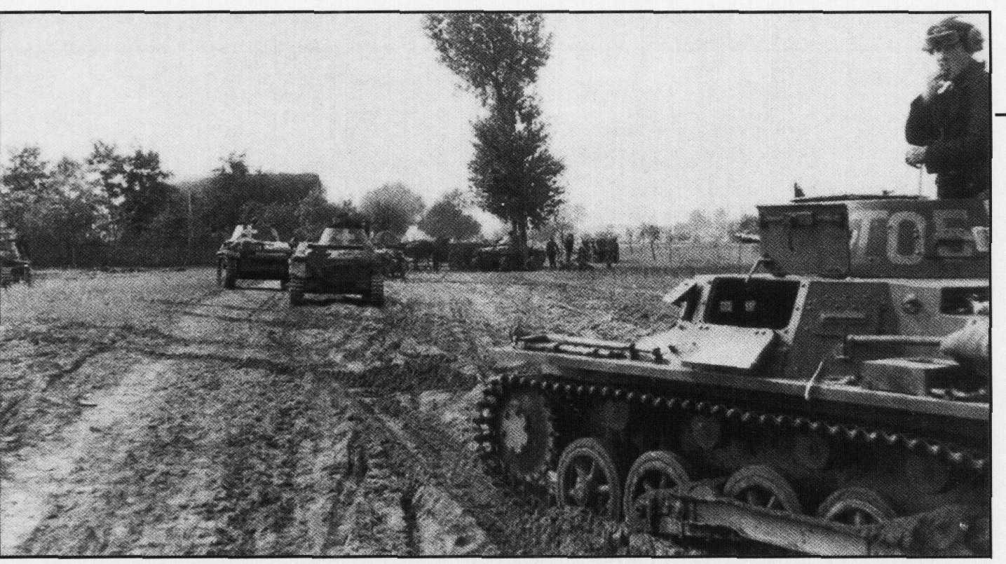
Background
Operation Weserübung was near the start of the war
Germany attacked Denmark and Norway
Germany wanted to defend trade in the region

Slide 5
Timeline
Hitler approved sending troops into Norway and Denmark
Ally and Norwegian forces stage a final assault upon Narvik
The Norwegian Armed Forces surrendered
April 5th
May 27th
June 10th
1940
April 9th
June 5th
Germany sent troops into Norwegian waters and took over Denmark
Britain and France began removing troops from Norway

Slide 6
Denmark Campaign
Land Battle that ended within 3 hours
Germany took control of Denmark in order to control Norway
Demark had a small and unprepared army
Aalborg
Denmark
Kiel
Germany

Slide 7
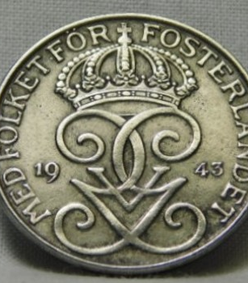
Swedish Ore and Narvik
Germany was dependent on Swedish Ore
The ore had to travel through the port of Narvik
Britain began mining in Norwegian water, concerning the Germans

Slide 8
Importance of the Swedish Ore
“The flow of Swedish iron ore – the main reason Germany conquered Norway – continued without interruption to the end of the war”
(Cordier)

Slide 9
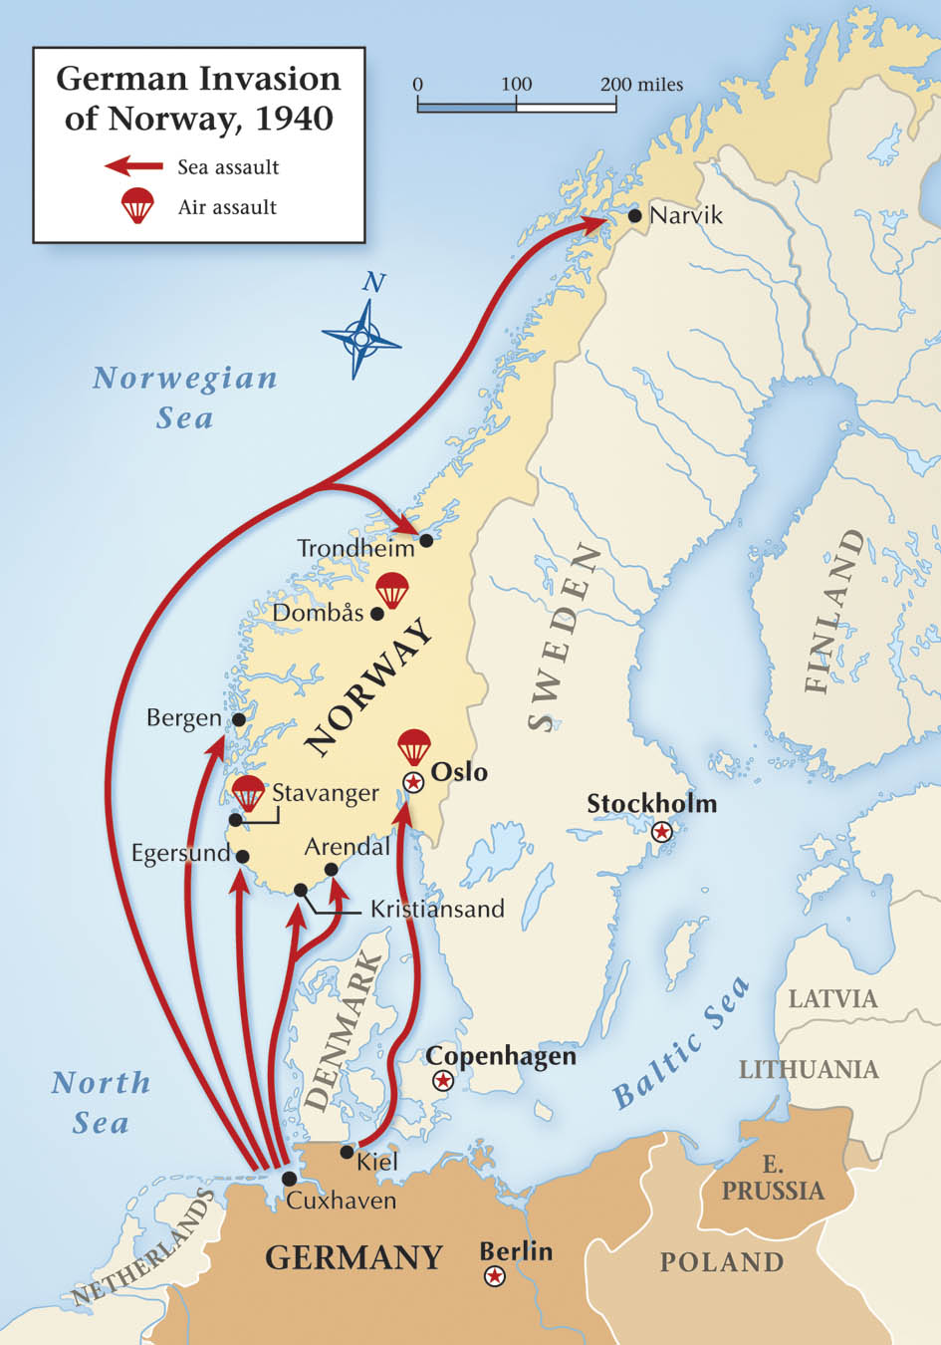
Norway Campaign

Slide 10
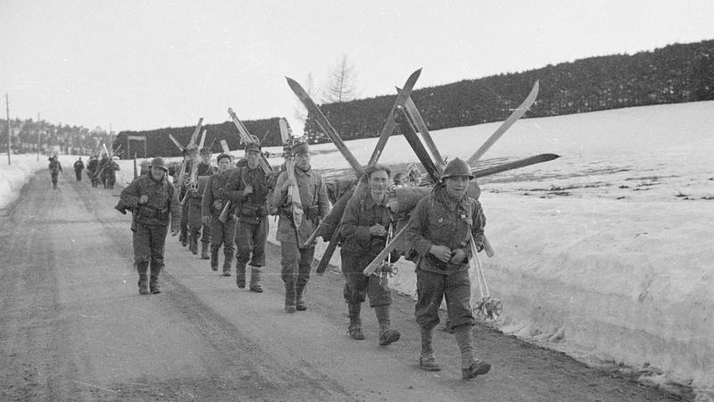
Norway Campaign
Hitler pretended he was defending Norway from the allies
Hitler wanted to protect the Swedish Ore
Norway was neutral
Germany won the battle
Operation Weserübung weakened the German navy (Kriegsmarine)

Slide 11
Long Term Effects
Germany had control of three countries
Germany kept control of Denmark and Norway until 1945
Hitler increased his reliance on the air force, or Luftwaffe
German military capabilities were displayed

Slide 12
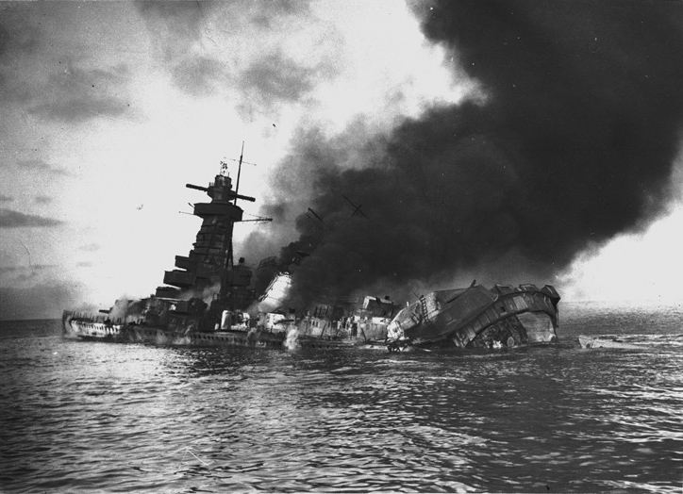
Casualties and Losses
Not many losses in the Denmark Campaign
Norway Campaign losses were in the thousands
Germany lost about twice as many men as Britain

Slide 13
Works Cited
Bird, Keith W. "Weserübung, Operation (April 1940)." World War II at Sea: An Encyclopedia, edited by Spencer C. Tucker, vol. 2, ABC-CLIO, 2012, pp. 797-800. Gale Virtual Reference Library, http://link.galegroup.com/apps/doc/CX3311800452/GVRL?
Cordier, Sherwood S. "Norway Campaign (April 10–June 10, 1940)." Germany at War: 400 Years of Military History, edited by David T. Zabecki, vol. 3, ABC-CLIO, 2014, pp. 942-944. Gale Virtual Reference Library, https://link.galegroup.com/apps/doc/CX6174900684/GVRL?u=kcls_main&sid=GVRL&xid=742cc46d. Accessed 20 Apr. 2019.
"Deployment of Naval Forces for the Invasion of Norway, 8 April 1940." Military History Maps, 2011. History Study Center, http://gateway.proquest.com/openurl?url_ver=Z39.88-2004&res_dat=xri:ho-us&rft_dat=xri:ho:sup_ref:osm01170.
Holland, James. The Rise of Germany, 1939-1941. New York, NY, Atlantic Monthly
Press, 2015.
Janda, Lance. "Denmark Campaign (April 9, 1940)." Germany at War: 400 Years of Military History, edited by David T. Zabecki, vol. 1, ABC-CLIO, 2014, p. 323. Gale Virtual Reference Library, https://link.galegroup.com/apps/doc/CX6174900232/GVRL?u=kcls_main&sid=GVRL&xid=2e03997b. Accessed 20 Apr. 2019.
"Jointness and the Norwegian Campaign, 1940 - Dr. Phillip S. Meilinger, Colonel, USAF, Retired." Air & Space Power Journal, sec. News, 21 Mar. 2017, p. 4. NewsBank, infoweb.newsbank.com/apps/news/document-view?p=AWNB&docref=news/164B427DC1E536D8. Accessed 22 Apr. 2019.
MacIntyre, Douglas J. "The German Invasion of Norway: April 1940." United States Naval Institute. Proceedings, vol. 136, no. 2, 2010, pp. 72. ProQuest, http://ezproxy.kcls.org/docview/205989952?accountid=46

