Slide 1
The Phony War and the Winter War

Slide 2
Thesis:
The Phony War/Winter War demonstrated to the Axis powers that the Allies were indecisive about fighting, which allowed them to initially gain the upper hand during the Sitzkrieg and instill paranoia within Ally ranks, foreshadowing a future Ally losing streak until halfway through the war.
Notes:
Battle of Midway - Midway through the war
Henry UwU

Slide 3
Timeline:
Notes:
Richard

Slide 4
Background:
Takes place right after Hitler invaded Poland with the use of blitzkrieg tactics
In reality it was just a planning period for both sides
The ‘Phony War’, during which the two sides in the West glared at one another across the Siegfried (German) and Maginot (French) Lines. (Roberts)
France
Germany
Notes:
Someone needs to explain the quote, as well as elaborate on the other information
there 85 French Units faced 40 German Units
Richard

Slide 5
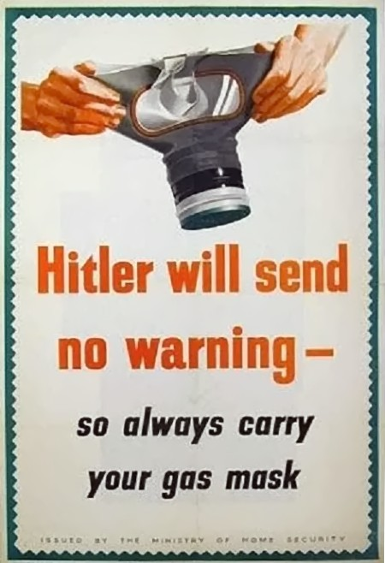
What Happened?
Beginning of German occupation of Poland
Most people were oblivious to the torpedoing of boats until German radios talked about it
British leader paranoid of attacks and decided to go all in on the defensive
Britain starts bombing Germany with something other than bombs… (Guess what it is!)
Notes:
Abheek
the Germans blame this on the British by accusing they had “placed a bomb on board Athenia” (Trueman)

Slide 6
Why Is This Important?
The Allies did nothing in response to the invasion of Poland
The Allies were paranoid of a potential blitzkrieg and still tried to maintain relations with Germany
Notes:
Talk about paranoia & indecisiveness 7 battles
Henry

Slide 7
Brief Intermission!
Write down the three main ideas you think that we as a group were trying to cover to the class for the Phony War (were you paying attention or tuning out?)
Disclaimer: Whether or not this participation actually affects your score in the battle presentation assignment is up to Mrs. Maners
Notes:
Make sure that audience doesn’t take up too much time
Richard

Slide 8
The Winter War

Slide 9
Thesis:
The Phony War/Winter War demonstrated to the Axis powers that the Allies were indecisive about fighting, which allowed them to initially gain the upper hand during the Sitzkrieg and instill paranoia within Ally ranks, foreshadowing a future Ally losing streak until halfway through the war.
Notes:
Focus on the parts of the thesis that were already covered, and link the audience into the parts that they might not have gotten

Slide 10
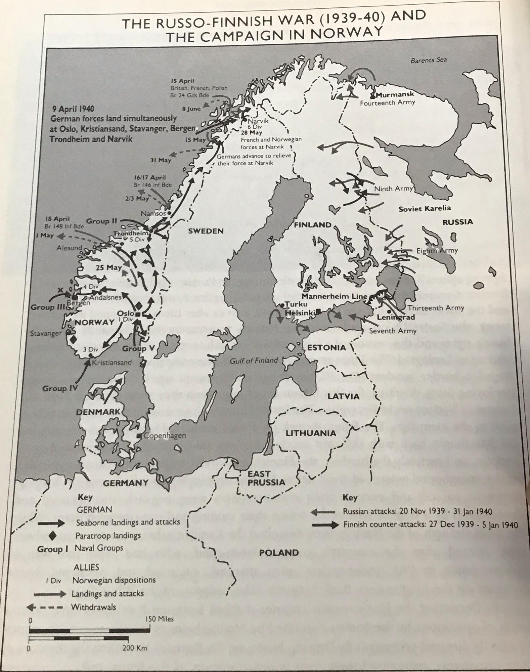
Background:
Conflict between Finland and Russia
Finland used to be part of Russia
Stalin wanted to recover old Russian territory
Finland just wanted to be a neutral country
Finland joined the League of Nations in 1920 to prevent future conflict with Russia
Notes:
Talk about the League of Nations as well as the October Revolution
Abheek

Slide 11
What Happened?
Stalin knew that the Germans were planning to attack the USSR later in the war and (allegedly) use Finland as a base of operations
The Soviets went up to the Mannerheim Line
Despite being in the League of Nations, nobody came to Finland’s aid.
Ended with the Moscow Peace Treaty, making Finland move back their borders
Notes:
Stalin wanted land buffer (Zygarde), outcome of the Russian Peace treaty
hEnRy

Slide 12
Why Was It Important?
Russia was expelled from the League of Nations because the attack was seen as illegal due to Finland being part of the League
This happened two months after the invasion of Poland
The “league derived from a knowledge that neither its Scandinavian neighbors nor Britain, France and Germany seemed likely to provide substantial assistance” (Beck)
“Finland's Scandinavian neighbors, as confirmed by their Oslo meeting on 7 December, demonstrated little desire to pursue Nordic cooperation at the expense of their neutrality” (Beck)
Notes:
Need to explain and give further detail about the quotes

Slide 13
Works Cited:
Beck, Peter J. THE WINTER WAR IN THE INTERNATIONAL CONTEXT: BRITAIN AND THE
LEAGUE OF NATIONS' ROLE IN THE RUSSO-FINNISH DISPUTE, 1939-1940. JSTOR,
www.jstor.org/stable/pdf/
43211076.pdf?refreqid=excelsior%3Aa714cec15bcfa5224bcc40bec0dcc700&seq=1#page_sca
n_tab_contents.
Reiman, Michael. "8. The USSR in the Second World War, 1941-1945." About Russia, Its Revolutions, Its Development and Its Present. JSTOR.
"History of Europe." Britannica Library Reference Center.
Trueman, Chris. "The Phoney War." The History Learning Site, 20 Apr. 2015. Accessed 19 Apr. 2019.
Rentola, Kimmo. "The Finnish Communists and the Winter War." JSTOR, 16 Jan. 1998, www.jstor.org/stable/pdf/260988.pdf?ab_segments=0%252Fl2b-basic-1%252Frelevance_config_with_tbsub&refreqid=excelsior%3A994af4b07d401313e5cad21877742f94. Accessed 20 Apr. 2019.
The Phony War." History of World War II, vol. 1: Origins and Outbreak, Marshall Cavendish, 2005. Gale Virtual Reference Library, https://link.galegroup.com/apps/doc/CX4097500092/GVRL?u=kcls_main&sid=GVRL&xid=f5029413. Accessed 20 Apr. 2019.
Tucker, Spencer C. "Western Europe, World War II (1939–1945)." Germany at War: 400 Years of Military History, edited by David T. Zabecki, vol. 4, ABC-CLIO, 2014, pp. 1436-1443. Gale Virtual Reference Library, https://link.galegroup.com/apps/doc/CX6174901024/GVRL?u=kcls_main&sid=GVRL&xid=c10ebe8f. Accessed 20 Apr. 2019.
Hohum. Hitlerwarn. 7 June 2018. Wikipedia, 7 June 2018, en.wikipedia.org/wiki/Ministry_of_Home_Security#/media/File:Hitlerwarn.jpg. Accessed 23 Apr.2019.
Notes:
Richard

